Slide 1
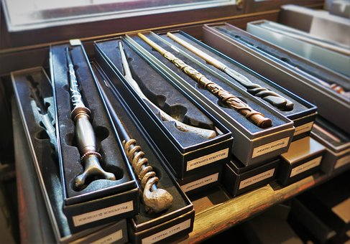
TIM QUINN Stanford University
MAGIC WAND PANEL
. . . And His Magic Wands
Harry Potter
Presented by the Water Association of Kern County

Slide 2
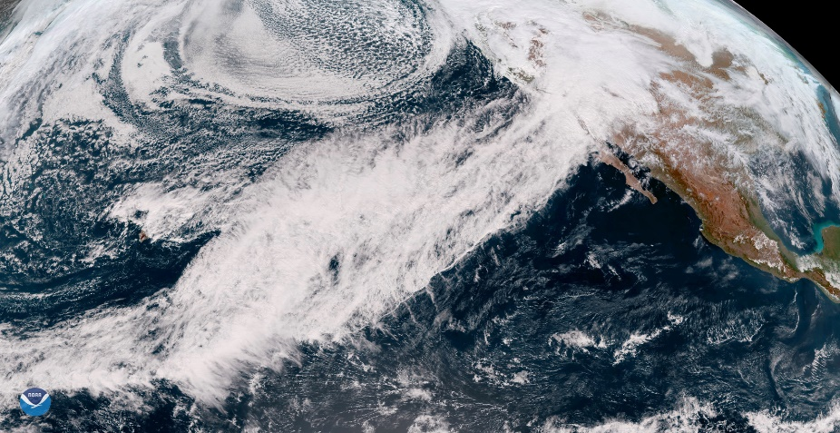
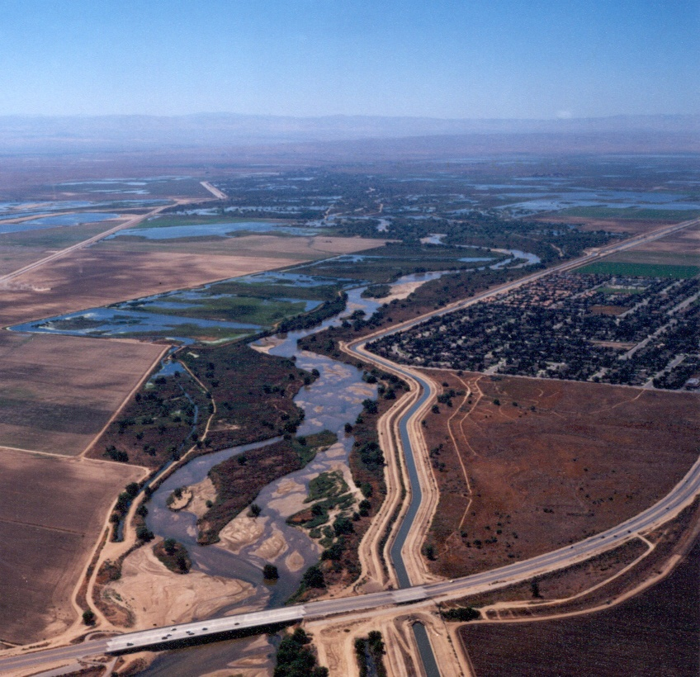
What is the Right Governance Model?
Question: How do you connect Atmospheric Rivers to Groundwater Basins?
Answer: By using a collaborative governance model
Presented by the Water Association of Kern County

Slide 3
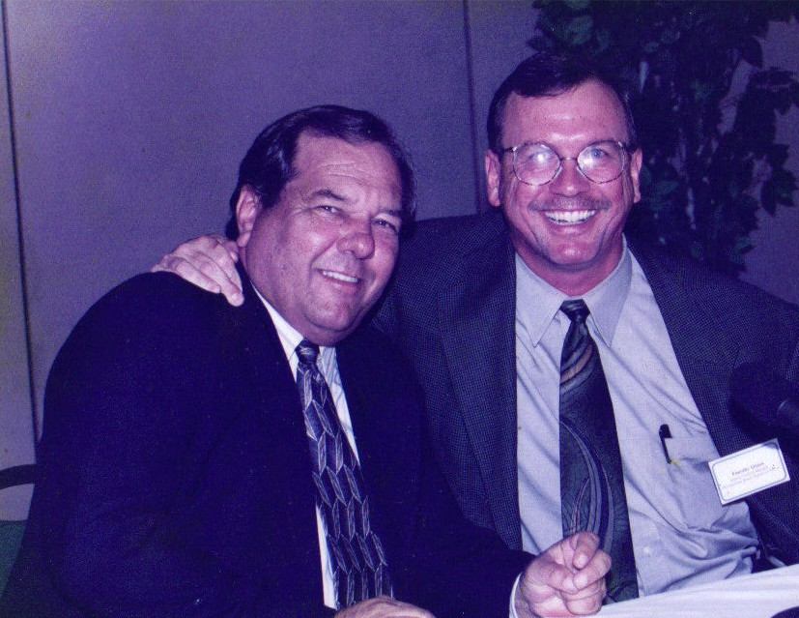
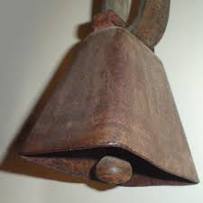
Kern County Lessons in Collaboration
The Cowbell Clark Was Going to Tie to Quinn’s MWD Car
Tom Clark and Tim Quinn
Presented by the Water Association of Kern County

Slide 4
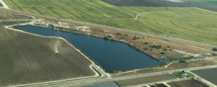
Water Storage Partnerships in Kern County
A Truly Collaborative Process
Sitting down especially with those who oppose you
Listening
Changing the project to build a coalition of support
Leads to Impressive Results
430,000 AF to MWD during 2012-2016 drought
Significantly improved drought supply for local growers
Kern Delta Water District
A Collaborative Process Works Where an Adversarial Process Will Fail
Presented by the Water Association of Kern County

Slide 5
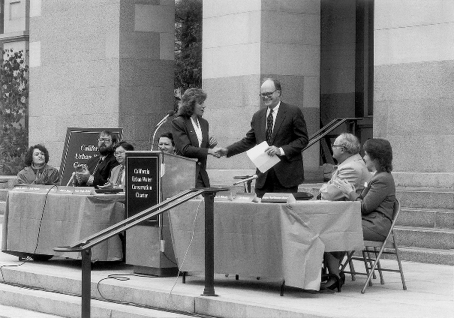
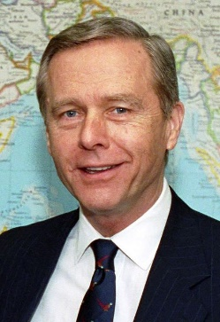
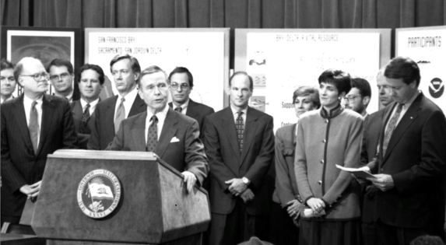
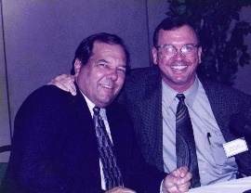
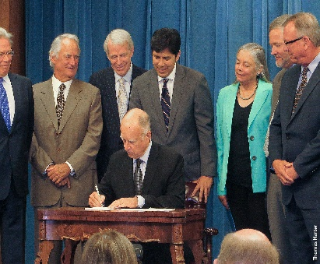
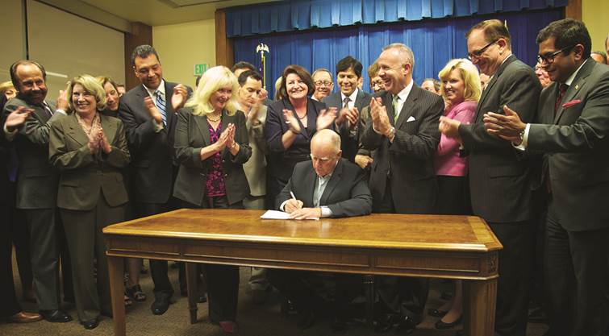
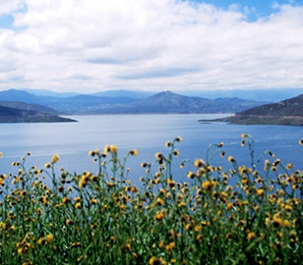
COLLABORATION AT WORK IN CALIFORNIA
1990 Urban BMPs
1991 Drought Water Bank
1994 Bay-Delta Accord
1994 Monterey Agreement
2014 SGMA
2014 Proposition 1
Presented by the Water Association of Kern County

Slide 6
Collaboration at Work in SGMA?
SGMA has revolutionized governance
Decision-making is much more participative
The Ag Silo
The Enviro Silo
But we are still making important decisions in silos
All Replenishment
No Pumping Restrictions
No Replenishment
All Pumping Restrictions
Presented by the Water Association of Kern County

Slide 7
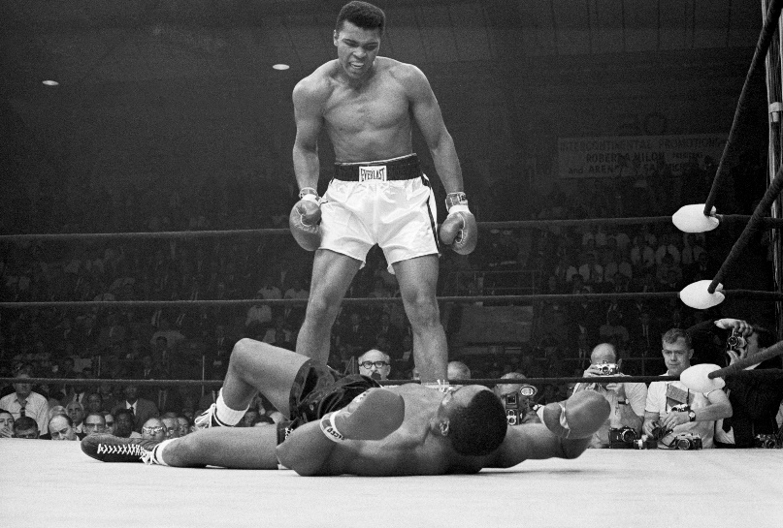
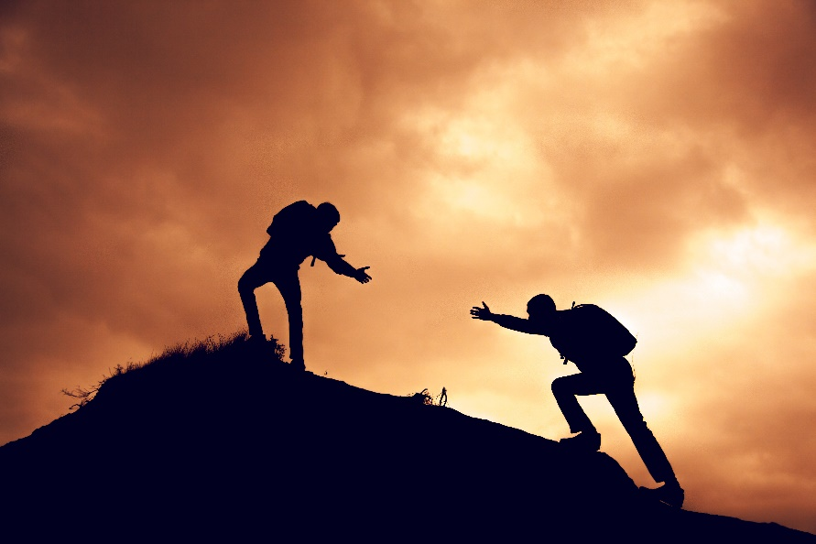
Magical Change #1: Warriors Become Collaborationists
Warriors want to put their adversaries on the mat.
Collaborationists help each other to the top of the mountain
Presented by the Water Association of Kern County

Slide 8
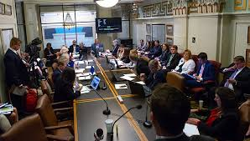
Magical Change # 2: Knock Down the Silos
The Ag Silo
The Enviro Silo
Invite Enviros to become a part of a truly collaborative process
Sit down and listen to each other
Be prepared to change to build a broad support coalition
Presented by the Water Association of Kern County

Slide 9
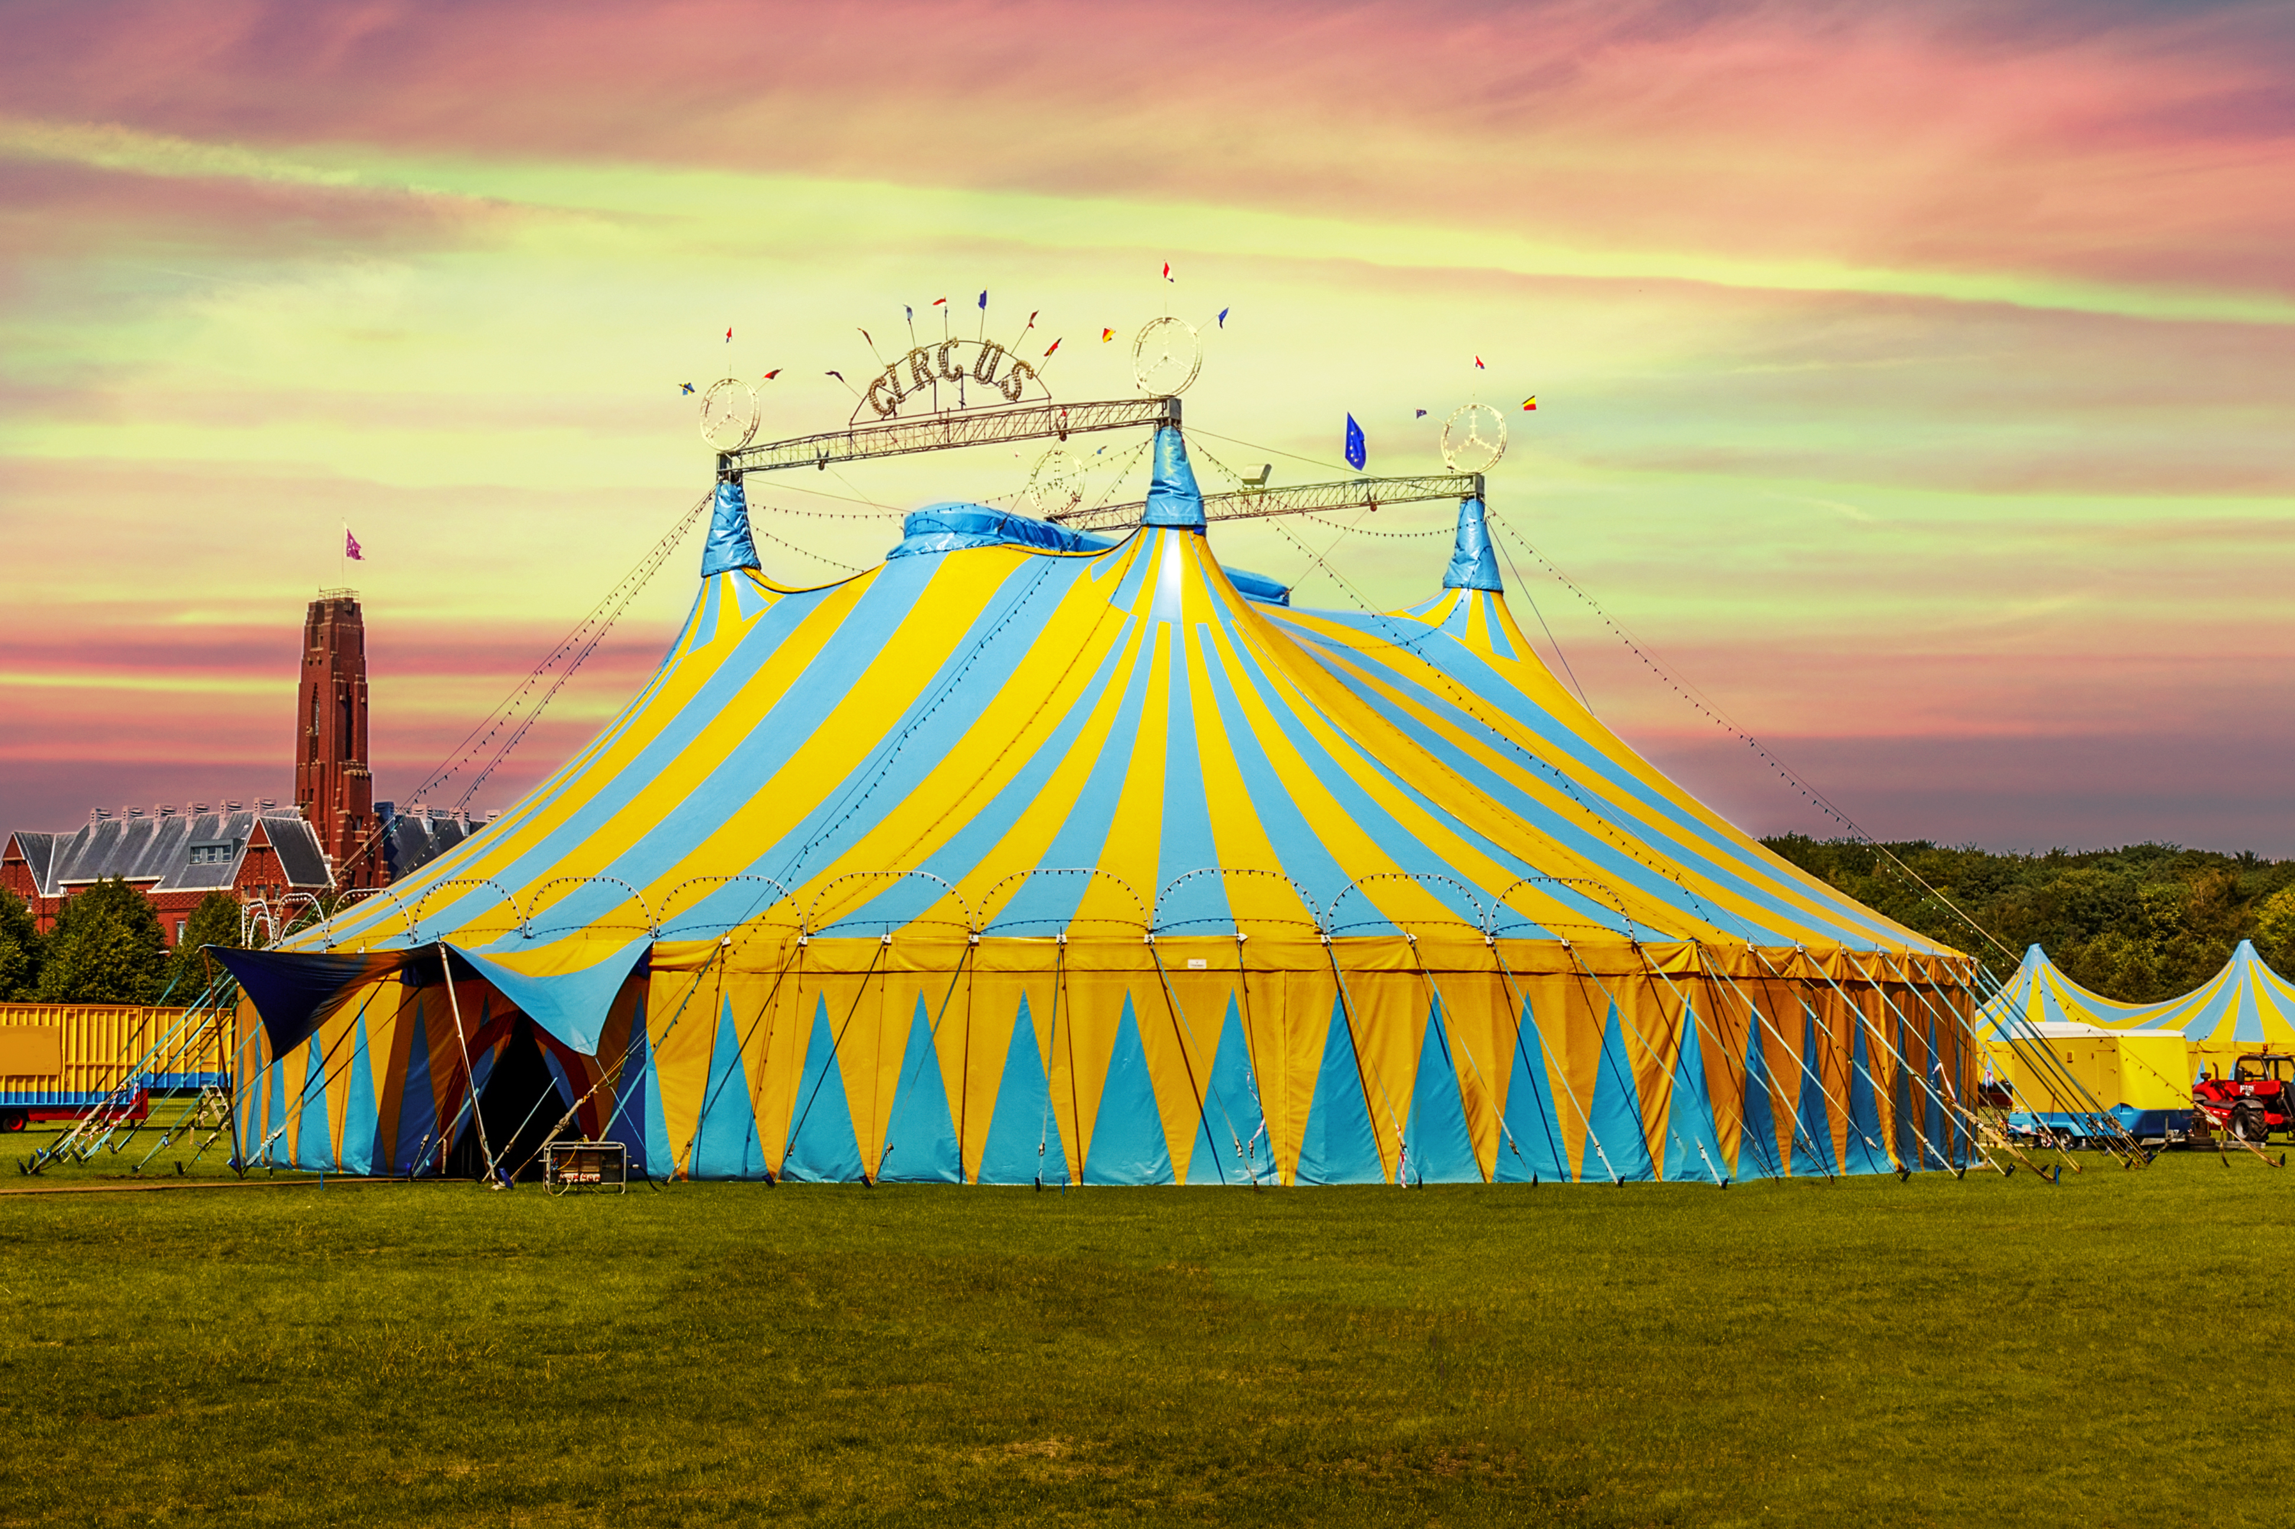
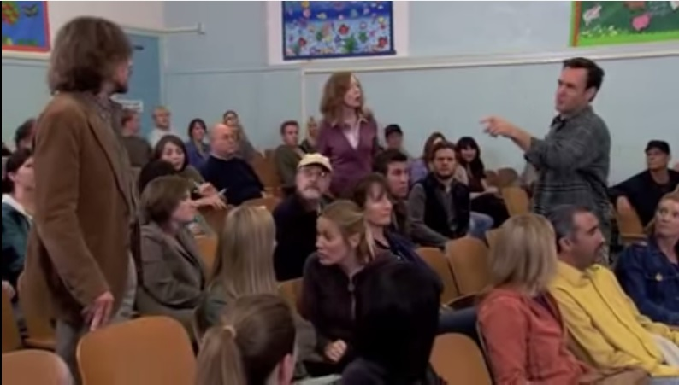
Magical Change #3: Stick With It
You’ll need a big tent
“War is easy.
Collaboration is hell.”
Tim Quinn, Water Manager
You have to listen to angry people
But it’s also the only way to solve the “wicked” problems of California water
Presented by the Water Association of Kern County

