Slide 1
Kern County water, the Delta and Sea Level Rise

Slide 2
Source | Percent
Kern River | 20%
State Water Project (California Aqueduct) | 26%
Federal (CVP) (Friant-Kern Canal) | 12%
Local Streams and Other Sources (Poso Creek, etc.) | 6%
Groundwater | 36%
TOTAL | 100%

Slide 3
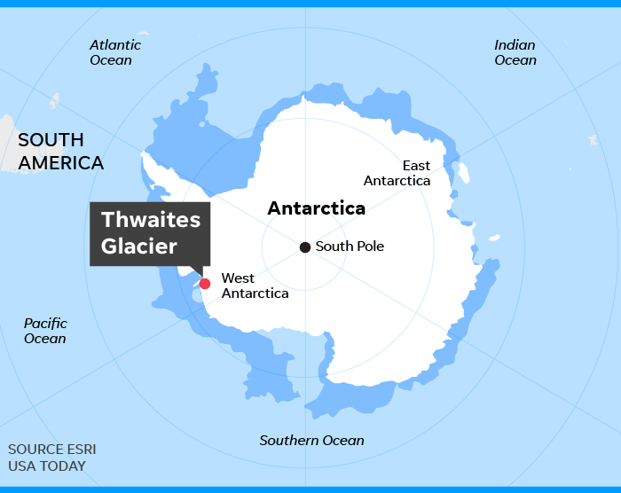
Thwaites Glacier's melting could trigger an unstoppable 20-inch rise in sea level. Surprisingly warm water found on underside of Antarctica's 'Doomsday Glacier.

Slide 4
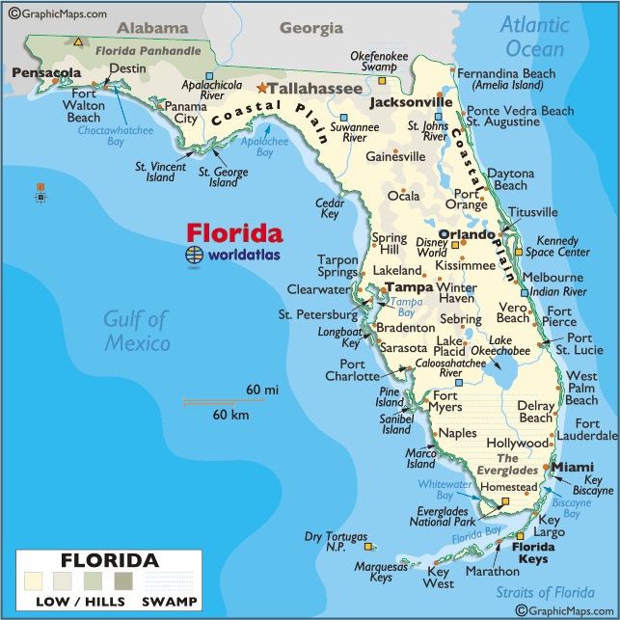
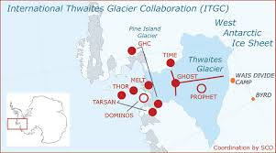

Slide 5
CALIFORNIA OCEAN PROTECTION COUNCIL
Low risk: 3 foot sea level rise by 2100.
Medium-high risk: 7 foot sea level rise by 2100.
Extreme risk aversion: 10 foot sea level rise by 2100.

Slide 6
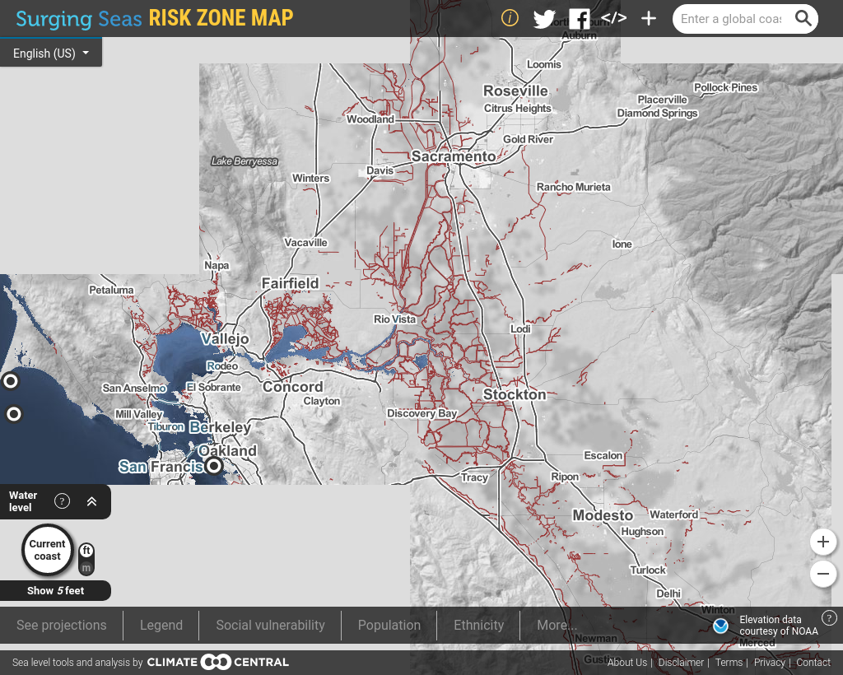

Slide 7
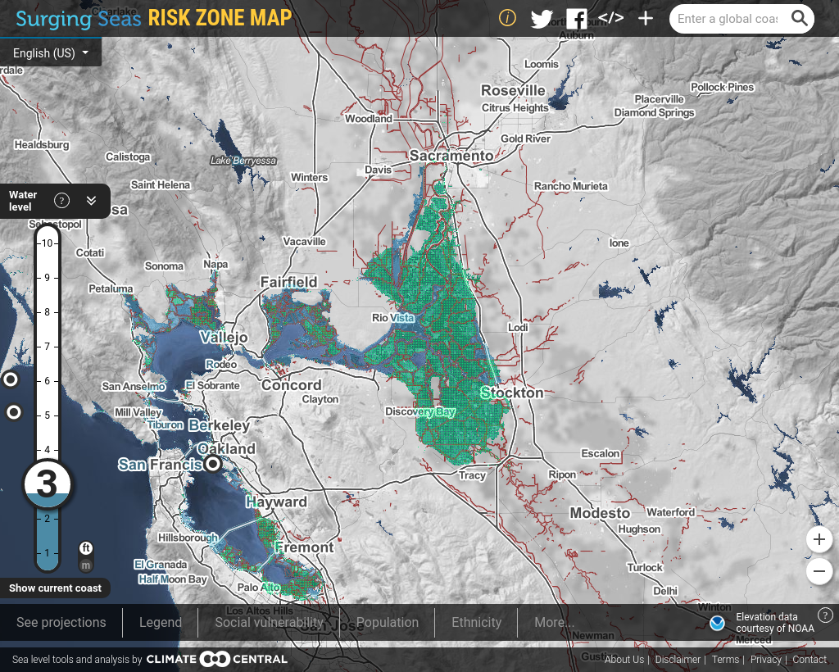

Slide 8
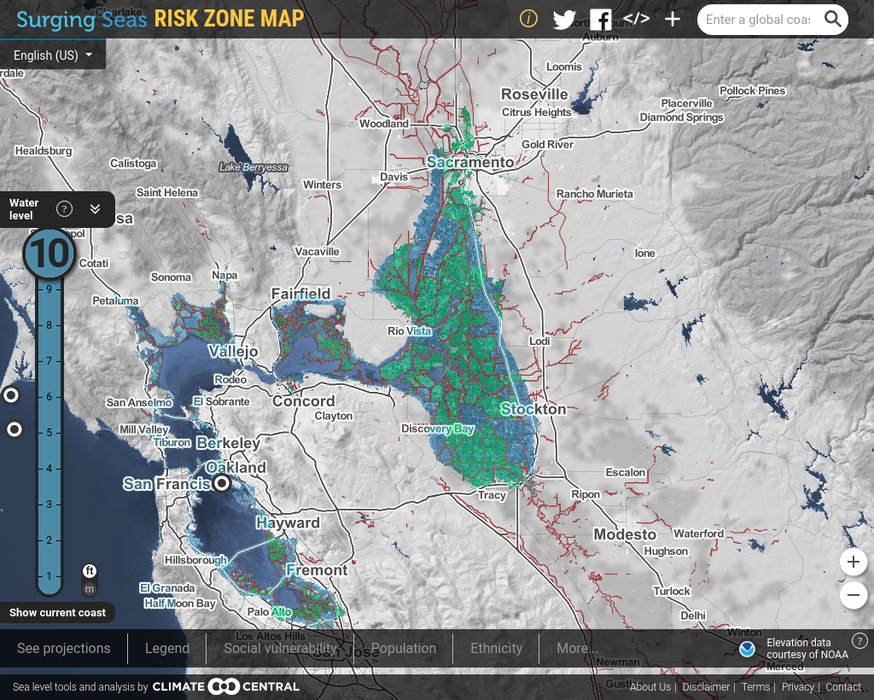

Slide 9
Message
Build Delta Tunnel intake to quickly allow for extension upstream to higher elevation.

