Slide 1
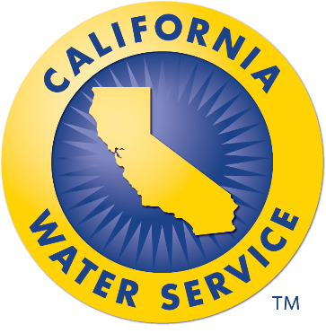


A New Decade:
More of the Same for Water Suppliers?
Justin Skarb
Director of Community Affairs
& Government Relations
Presented by the Water Association of Kern County

Slide 2

What We’ll Cover
Overview of Cal Water
Water Conservation Regulations
Wildfires & PSPS
Questions
Presented by the Water Association of Kern County

Slide 3
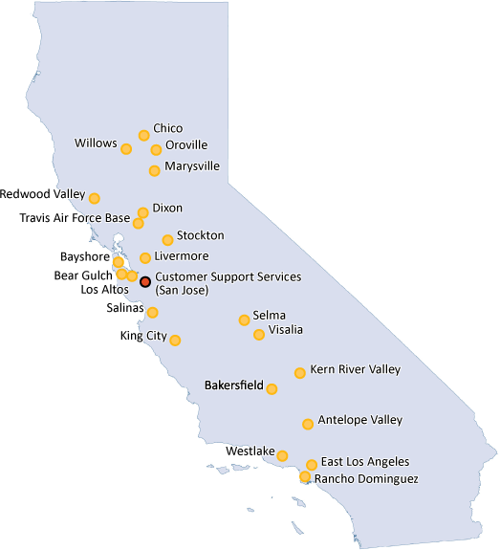

California Water Service (Cal Water)
2nd Largest Water Utility in California
Largest Water Utility Regulated by the California Public Utilities Commission
Serve Population of 2 Million
Presented by the Water Association of Kern County

Slide 4


Water Conservation (Becomes Political)
Yes, California Has Effectively Banned Showering And Doing Laundry On The Same Day
Presented by the Water Association of Kern County

Slide 5


Water Conservation (Becomes Political)
Can you believe California has same-day laundry and shower limits? No, you can’t.
No, it's not illegal in California to do laundry and shower in the same day
You won't be fined $1,000 if you shower and do laundry on same day
Presented by the Water Association of Kern County

Slide 6
Water Conservation (Becomes Political)
Presented by the Water Association of Kern County

Slide 7
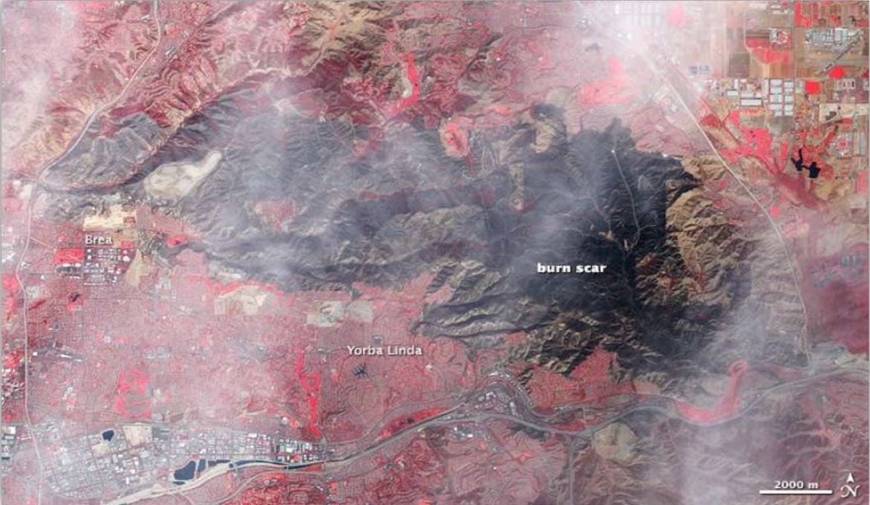
Wildfires & Liability: 2008 Freeway Complex Fire
Ignited by a vehicle’s catalytic converter along the 91 Freeway
314 homes destroyed, including 112 in Yorba Linda
Presented by the Water Association of Kern County

Slide 8
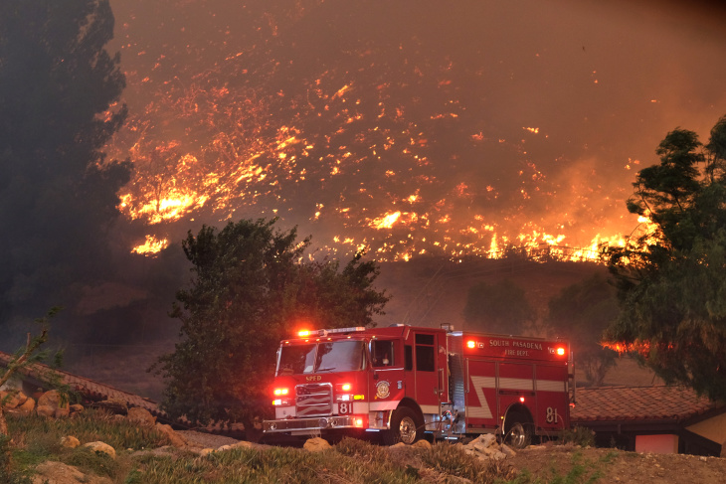
Wildfires & Liability: 2008 Freeway Complex Fire
Fire damaged Yorba Linda Water District’s facilities, including pump station that supplies water to one neighborhood at a higher elevation
Damage to water system caused fire hydrants to fail
Lawsuit filed for a failure to protect
Presented by the Water Association of Kern County

Slide 9

Wildfires & Liability: 2008 Freeway Complex Fire
Local Fire Victims Awarded $70 Million
Presented by the Water Association of Kern County

Slide 10

Wildfires & Liability: Proliferation of Lawsuits
Some Fire Hydrants Didn’t Work Because Of Power Outages, Firefighters Say
Residents Sue Utilities, City Of Ventura Over Damage Caused By The Thomas Fire
Presented by the Water Association of Kern County

Slide 11

Wildfires & Liability: What’s at Stake
The current interpretation of inverse condemnation, holding utilities strictly liable for any wildfire caused by utility equipment regardless of standard of care or negligence, imperils the viability of the state’s utilities, customers’ access to affordable energy and clean water, and the state’s climate and clean energy goals; it also, does not equitably socialize the costs of utility-caused wildfires.
Presented by the Water Association of Kern County

Slide 12

Wildfires & Liability: Legislative Fix
Public drinking water systems should not be blamed and held liable for fires they don’t start
Without common sense reforms, lawsuits for wildfire damages could drain millions of dollars needed to build and maintain water infrastructure – putting clean, safe drinking water at risk for Californians
www.firesafecalifornia.org
Presented by the Water Association of Kern County

Slide 13
Questions
Presented by the Water Association of Kern County

