Slide 1
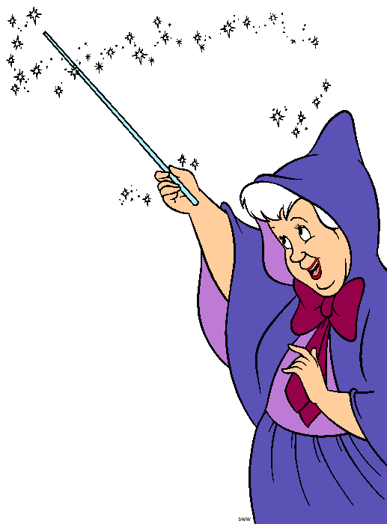
Oh, to have a Magic Wand:
California Water Resilience:
What Will It Take?
Felicia Marcus
Fmr. Chair, State Water Resources Control Board
Consultant; Member, Water Policy Group
Kern Water Summit
March 4, 2020
feliciaamarcus@gmail.com
Notes:
.

Slide 2
The why

Slide 3
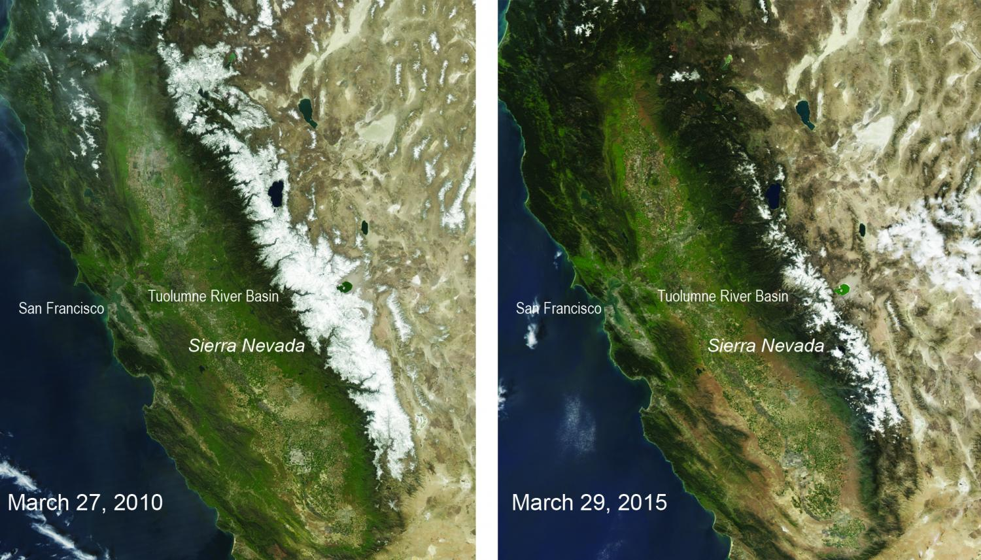
This is California on Climate Change
March 27, 2010 March 29, 2015
Source: NASA
Notes:
Most importat slide I have. It’s our future we need to be thinking about rather than the past as roadmap.
This is our future under climate change—WATER IS BLEEDING EDGE OF CLIMATE ADAPTATION; AND, CAN BE A MORE EFFECTIVE TOOL TO ILLUSTRATE THE NEED TO MITIGATE THAN LOFTY WORDS. Note Peter Gleick.
Challenges, e.g.,
Climate change→ particularly loss of snowpack
Population growth
Aging infrastructure even in a “newer” state
Food security
Disadvantaged community issues finally a high priority
Selected issues:
Financing enormous need and disparate types
Going for 21st century infrastructure vs. rebuilding the old—e.g., how to make integrated water management the norm
Dysfunction of the dialogue in a political milieu

Slide 4
Future drivers require change
  Climate change→ particularly loss of snowpack
  Limitations of looking at “recorded history”
  Population growth
  Increasing recognition of need for food security here and the world
  Increasing recognition of importance of protecting/restoring nature
Notes:
These are the drivers that exacerbate the issues we have now if we look only a few decades hence.
Loss of snowpack and sea level rise have profound implications for California. You don’t have to be a genius to see it and yet many don’t acknowledge it as it is inconvenient and requires a shift. Others are adapting, adjusting, and admitting that we have to think differently.
March of Folly
Shame on us if we do not.

Slide 5
The tools

Slide 7
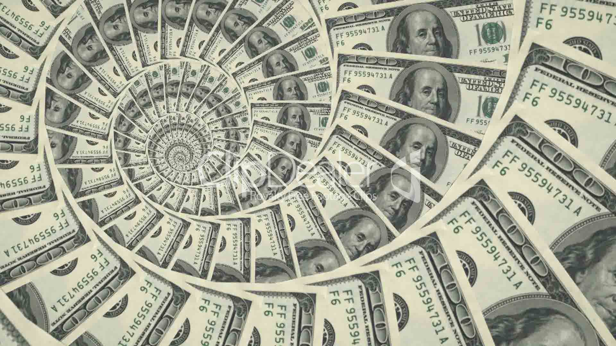

Slide 8

Notes:
It’s one thing to want to do this, but how do we do this? Again, theory and practice. In theory, this is all easy. In practice, it is not.
No one does this right all the time. Maybe the Dalai Lama, but he’d be the last one to say he did, or feel he did. Maybe Mr. Rogers. Maybe Deanna Troi. Maybe Sandy Koufax. Maybe your favorite teacher, religious leader, maybe Lou Gehrig.
I think it requires working to remind yourself every day, in every encounter where it matters. Again, no one can do this all of the time. Some people are better at it in their personal lives and not good at work. Some are great at work, but stink at it with their friends and family. Some can teach it but not do it, or certainly not do it all the time.

Slide 10
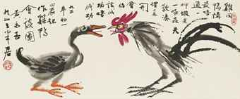
Like a chicken talking to a duck…
就像一只鸡和一只鸭子说话
Notes:
就像一只鸡和一只鸭子说话
Jiù xiàng yī zhǐ jī hé yī zhǐ yāzi shuōhuà
Speaking different language.
Farmers→environmentalists
Government→non government
Engineers→non-engineers
See it everywhere—a key problem
“Egosystem” management as our greatest challenge—not the tech, law, story for another day too with examples.
Just two examples:
Speak a different language→ Like a chicken talking to a duck--. Bob Horii story
Hear what you expect to hear vs what is said:
China story
Smog Check story
Women. Men with sourthern accents.
My point here, is that we need to use our human skills, our egosystem management skills, to really connect with and try to find convergence in interests vs. looking at face value. It’s about self awareness first, humility, and an awareness that change happens through myriad small acts of leadership, when folks focus on how to make progress with people, rather than being satisfied with being “right” and making others “wrong.”. It is all about attitude.
The issues we are dealing with in this rapidly changing world are complex. And require complex, diffuse, distributed solutions, relying on people to make behavior and other changes. We need an attitude of “we’re all in this together” vs. blaming others. It’s gotta be convergence over conflict or we won’t make it. My point is that it will take all of our technical, legal, intellectual, economic and other professional skills to make it through what climate change will wreak, let alone trying to mute those impacts. Let’s not overlook, and let’s elevate our human skills, rather than valuing just our expertise or advanced degrees, or overvaluing someone else’s expertise or advanced degrees. We are all in this together, and we all have a role to play. To my mind, devaluing our human skills is a cop out, and we do it at our peril, but we do it all the time.
Here: lawyers litigate, advocates advocate, lobbyists wanna lobby or write legislation, politicians pontificate, engineers want to solve problems (note cal tech tshirt) and build things, etc.

Slide 11
The what
At least a few…..

Slide 12
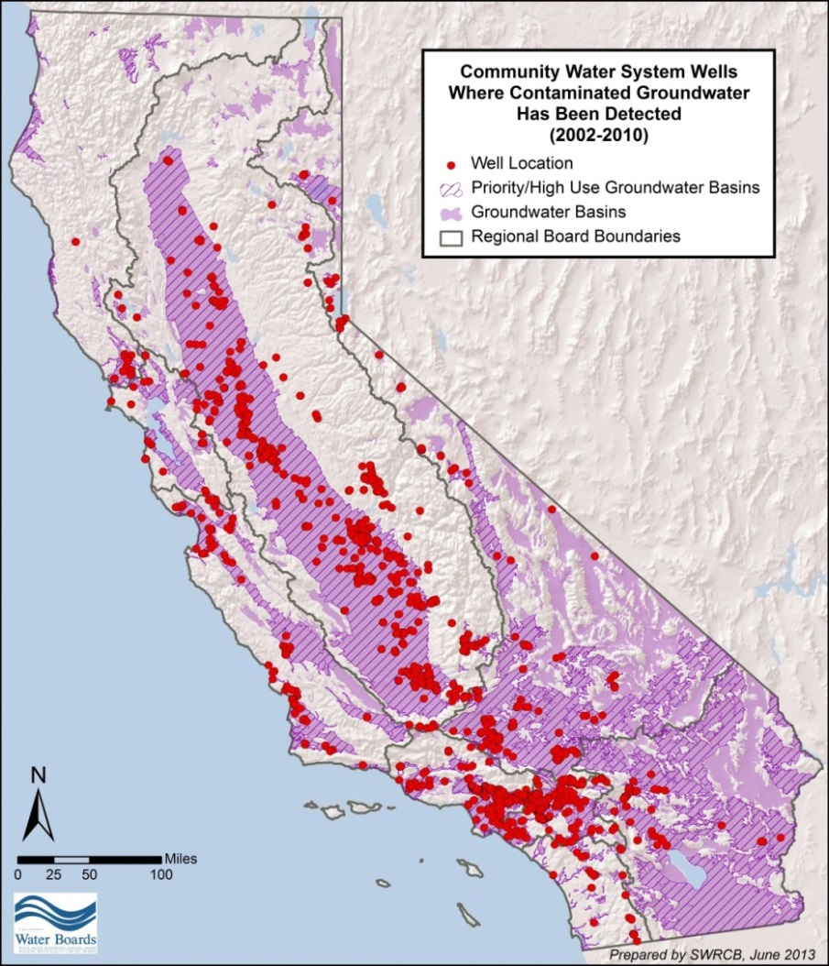
Drinking Water for All: Just do it!
Notes:
No time, but this is a big deal so couldn’t go without saying. We have a huge quality problem too—from legacy and ongoing ag and industrial pollutants. Just couldn’t not mention—not so much of a prob in urban areas, but hard on rural communities dependent upon shallow domestic wells.
2 reports; 98% of califs have consistent accept to DW that meets health standards. Good news. Bad is 2% of 38 million to be exposed or have uncertainty. Big issue for us and legis: DW consolidation; ILRP for ag; how to expedite for urban—this area a Superfund site, but entities like SGBWQA awesome. Trying to replicate success. Inis with EJ com and industry alike. Good news is that this issue has captured the hearts and minds of Californians, with hundreds of illions of dollars in capital costs spent in the last few years, and just a few weeks ago, we got funding to help subsidize.operating costs.
Another story for another day—but huge issue we’ve now gotten money to help solve for small communities.

Slide 13
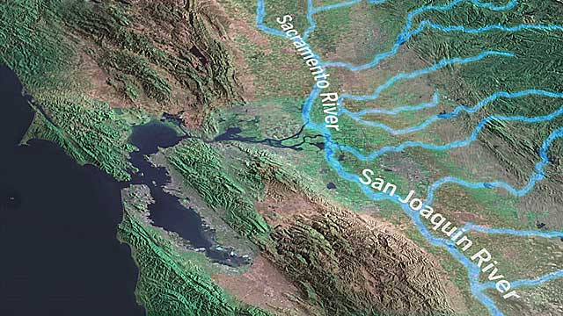
Deal with the Delta

Slide 14
Data and Technology for all who want it
Atmospheric river predictive capacity
“Virtual grid”
Broadband for all to make tech possible
Drip & Flood
Sensors &
Software
Data for good
Lidar +++

Slide 15
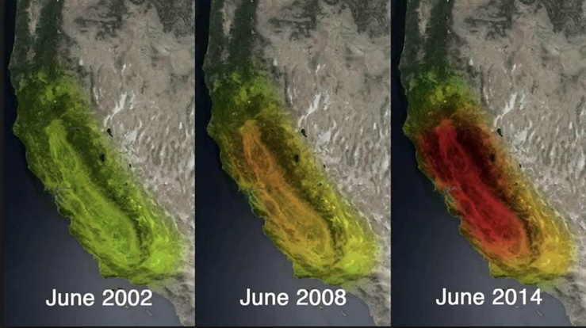
Help all with dealing with long term groundwater management—transition and MAR
Notes:
We cannot talk about drought without talking about groundwater. In March of this year, work by Jay Famiglietti – a water scientist at NASA and current Board Member of the Santa Ana Regional Water Board depicted the dramattic decline of groundwater levels across much of California as both municipalities and agriculture have increased their reliance on groundwater as surface water supplies have been drying up.
In 2014, all combined water sources (snow, rivers, reservoirs, and groundwater) in the Sacramento and San Joaquin river basins amounted to a volume that was 34 million acre-feet below normal levels.[2] According to Famiglietti, California has lost approximately 12 million acre-feet of stored water every year since 2011.
Average 2MAF/yr overdraft
Flip side is that our groundwater basins are the only things big enough to store as much water as we will lose in snowpack for storage.
Just at symposium at Berkeley last week on “managed aquifer recovery” where folks working hard to get more water into gvroundwater storage.
Another story for another day.

Slide 16
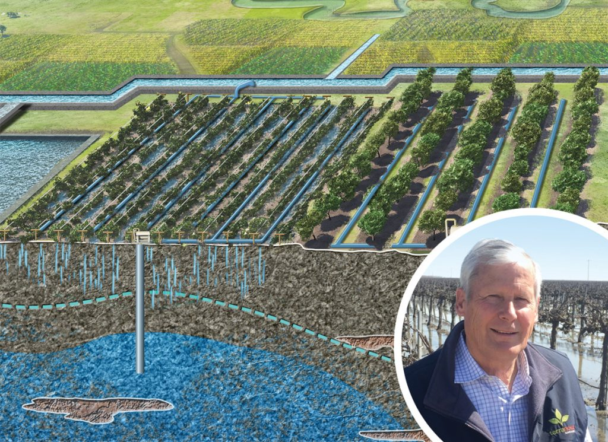
Notes:
Floodplains: Rice, fish flood

Slide 17


Bonus point: While I have the wand…..
No! Not ALL YEAR!
Notes:
What happened in So. Ca
How they answered the call
What Met did
Why they did it-not $ for drop saved ROI, but to seize the moment for a paradigm shift and to respond to their customers demands
Over half a billion snapped up
Don’t always agree on everything with Met, but on this they deserve laurels

Slide 18
The Who

Slide 19
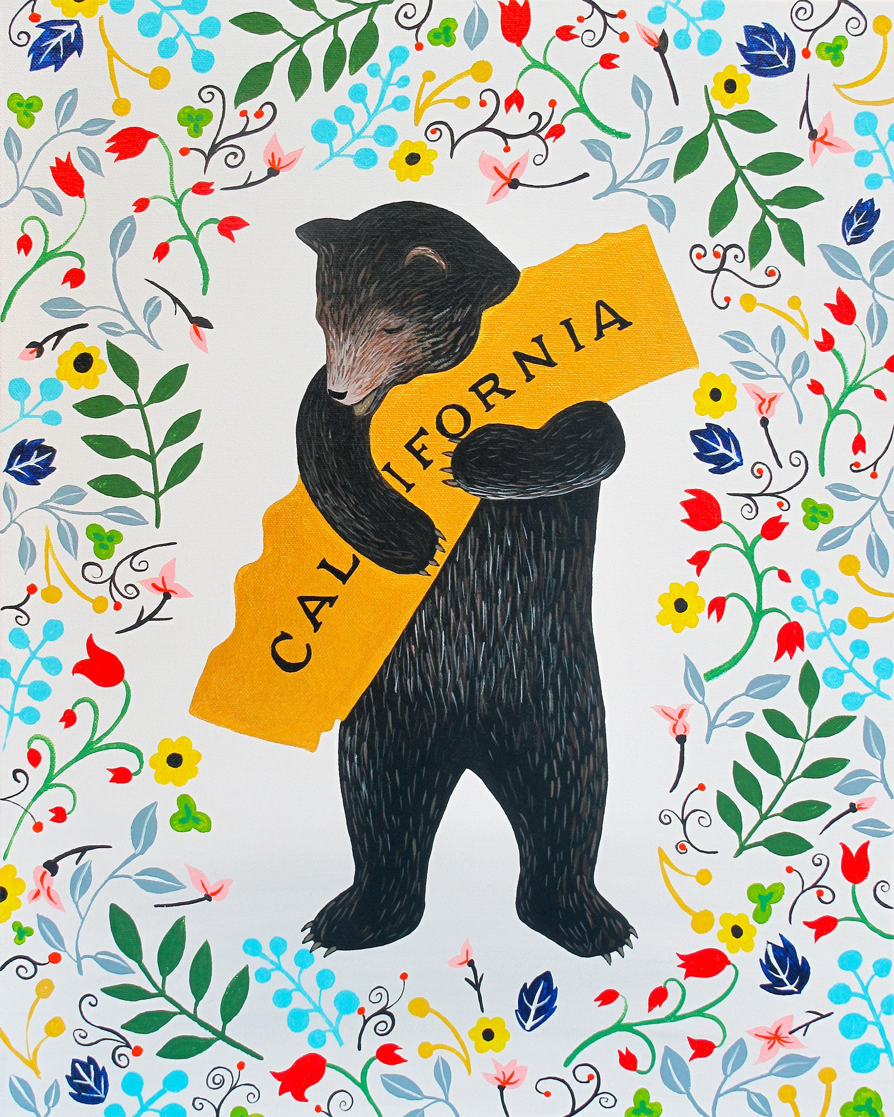

Slide 20
Thank you!!!!

