Slide 1
Presented by the Water Association of Kern County

Slide 2
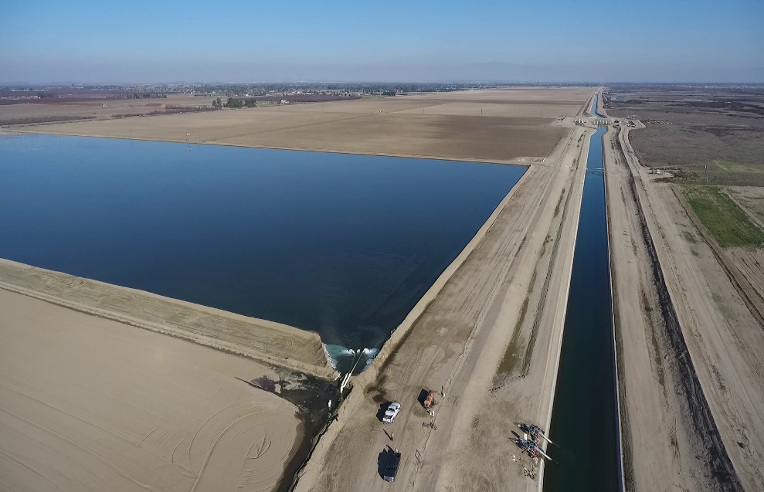
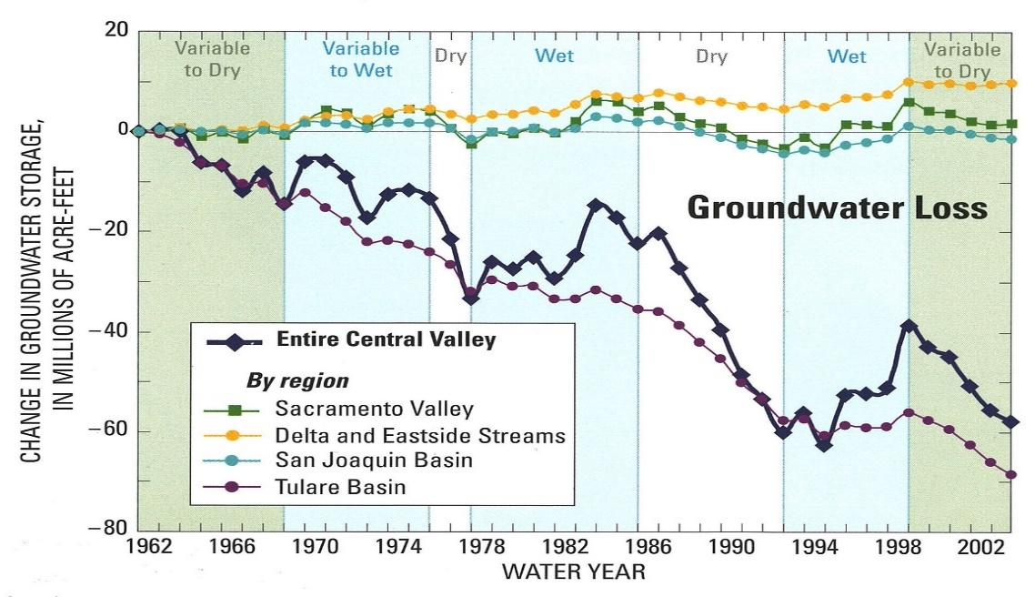
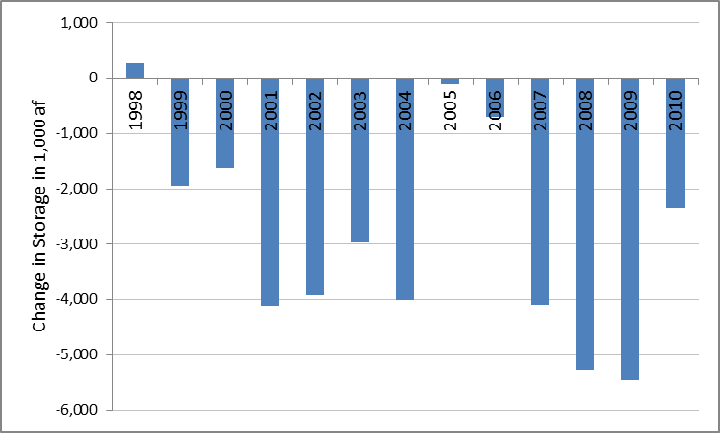
What do we know of the past?
Kern maximized access to local and imported water through groundwater banking & replenishment programs.
Historic supplies were insufficient to meet Tulare Lake/Kern County demands
Tulare Lake/Kern Sub-Basin is critically overdrafted
(DWR 2009 and 2013, CA Water Plan Updates))
Presented by the Water Association of Kern County

Slide 3
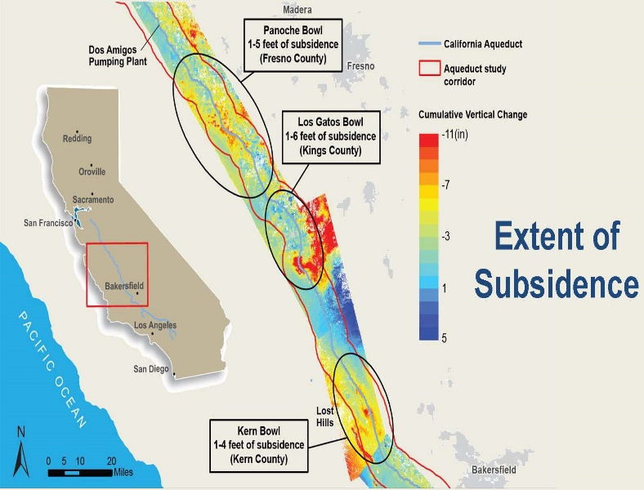
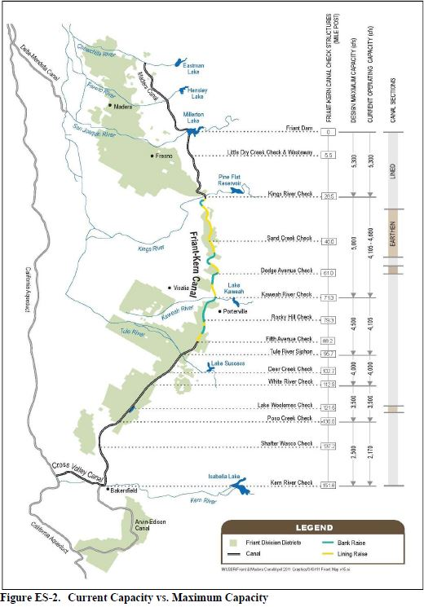
What do we know of the present?
Subsidence:
“The most subsidence we’ve seen is in Pool 20, that’s where we see our greatest reduction in capacity, it’s about 20%, and that capacity reduction translates itself all the way down through the San Luis Field Division and into the San Joaquin until we get to the next subsidence bowl in pools 24, 25 and then that capacity reduction is reflected all the way to almost the Buena Vista Pumping Plant.”
“The Friant-Kern Canal Subsidence and Capacity Correction Project (Project) would restore capacity from the current estimated 1,900 cubic-feet-per-second to the original 4,000 cubic-feet-per-second in the most critical area near the Dear Creek Check Structure (milepost 103)”
Regulatory Decisions:
Imported water supplies from the State Water Project and Central Valley Project(s) have declined (in both volume and reliability) over the past twenty years.
Presented by the Water Association of Kern County

Slide 4
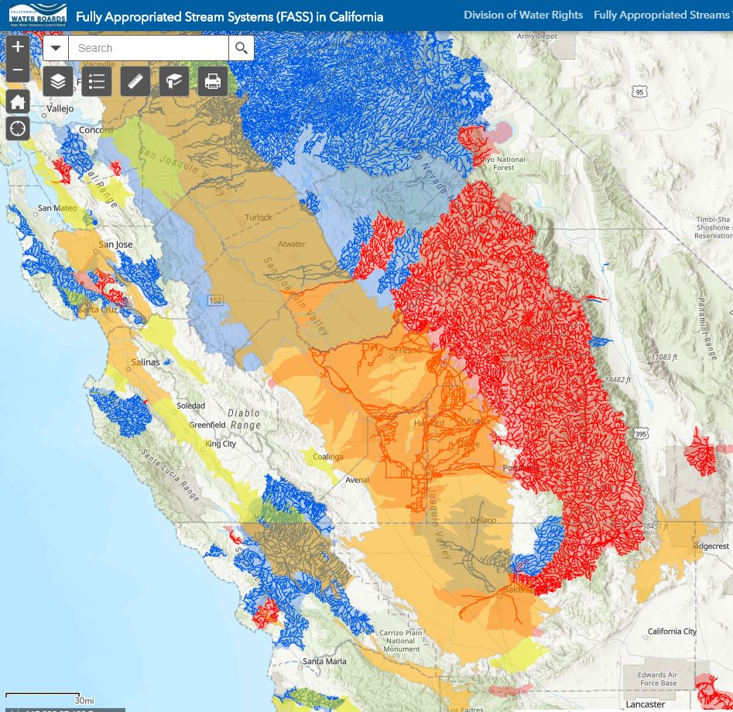
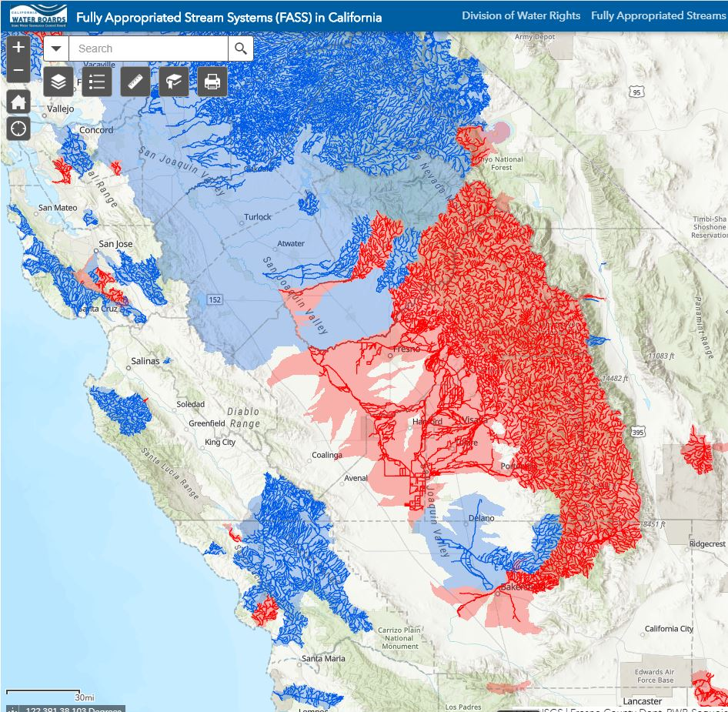
Red = Fully Appropriated
Light Blue = Seasonally Appropriated
Dark Blue = Unappropriated
What do we know of the future?
There is less water and capacity available today compared to 10 years ago………and;
There is less water and capacity projected over the next 10 years than there is today.
Modesto
Kern’s estimated deficit is ~350k AF/Year
Kern’s GSP’s showed “Projects” developing ~350K AF/Year of
NEW WATER
THERE IS NO NEW LOCAL WATER
Bakersfield
Presented by the Water Association of Kern County

Slide 5
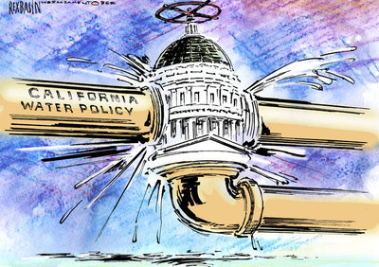
CALIFORNIA WATER POLICY
SGMA calls for “Local Solutions”
Absent a regional approach to enhance imported water supplies, the only realistic local solution is demand reduction.
Investment in restoring existing and constructing NEW conveyance, is required.
Absent this investment groundwater recharge projects do not create “NEW” water. They only change the name of the local beneficiary.
San Joaquin Valley Water Blueprint seeks to coordinate valley interests on water
Presented by the Water Association of Kern County

