Slide 2
The State of California’s Oil Industry
A look at where we are and what’s ahead
Presented by Christine Luther Zimmerman, Senior Geological Engineer,
Technical and Regulatory Affairs
Western States Petroleum Association

Slide 3
About WSPA
Western States Petroleum Association (WSPA) is a non-profit trade association representing the companies that safely and reliably explore for, produce, refine, transport and market the petroleum and energy products that fuel the five western states of Arizona, California, Nevada, Oregon, and Washington.
We represent 150,000 women and men who have proudly been powering the western states since 1907.
Notes:
There is nothing more important than the health and safety of the communities where the women and men of our industry work, live and raise their families. We are proud to serve as good neighbors and adhere to California’s environmental regulations as we support our state’s energy independence by producing oil that remains in California and provides affordable energy for us all.

Slide 4
State of the Industry

Slide 5
Petroleum’s Role in California’s Economy
365,970
Total Jobs supported by the oil and gas industry.
Total economic output contributed to CA’s economy:
152.3B
$21.8B
Tax Revenue Contributions
2.1% of the state’s Gross State Product
Economic Development
Public Safety
Healthcare
Education
Infrastructure
Transportation

Slide 6
Average Annual Wage
$80,500
High wage positions across the spectrum:
$81,580
Refinery Operator
Average Annual Wage for Oil & Gas Industry Employees
$87,330
Extraction Worker
$114,230
Mechanical Engineer
$139,330
Petroleum Engineer
$152,490
Construction Manager

Slide 7
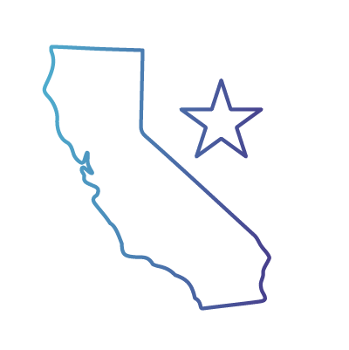
California is in an Energy Deficit
42 Million
gallons of gasoline and
8.4 Million
gallons of diesel are consumed daily
Demand for energy in California exceeds production levels.
3rd largest in world behind China and US as a whole.
35 million motor vehicles on road. Californians drive 300+ billion miles a year.
70%
of oil refined in CA is imported
Notes:
Where utility providers wrestle with power shutoffs, oil and natural gas are key energy sources that Californians can rely on when the electricity grid goes dark.
Every barrel delayed or not produced in this state will only increase imports from more costly foreign sources that do not share our environmental and safety standards
To meet California’s energy demand, $67 million is leaving the state EACH day – that’s $24.4 billion per year.

Slide 8
What is Produced Water
Water that is brought to the surface when oil is extracted from formations below drinking water zones.
Average 15 barrels of water are produced with every barrel of oil. (42 gallons = 1 barrel)
Produced water is not wastewater.
Technology creating potential for beneficial reuse.
Notes:
Water that is brought to the surface when oil is extracted from the ground, often referred to as “produced water,” is water that is held in oil-bearing geologic formations, separate from groundwater. This water has been trapped and sealed underground for millions of years until it is brought to the surface along with oil and gas. It is an untapped resource that can help us meet our water needs both now and in the future.
When oil is extracted from the ground an average of 15 barrels of water are brought to the surface for each barrel of oil. Most of this water is put back into the geological formation from which it came. But technology and our need to find new sources of water are enabling us to process and treat this water, making hundreds of millions of gallons available for beneficial reuse.
Produced water is not wastewater. It also has nothing to do with well stimulation techniques like hydraulic fracturing. Some of this water is pure enough to be used immediately for agricultural purposes, though most is treated and blended with other water before use.
Water and oil are brought to the surface together as part of the oil and gas production process. At the surface, water and oil proceed through facilities designed to separate them. This begins in a series of tanks, where gravity naturally removes oil from water and vice versa. Not unlike the ingredients in a bottle of Italian dressing that has been sitting a while, the oil and water naturally separate.
After gravity has done its job, produced water is further processed before finding an end use. The water travels through “depurators”—long, cylindrical vessels—where bubbles of air and skimming paddles further filter the water and remove smaller particles of oil and other solids. In some cases, the water flows through additional filtering tanks which absorb any microscopic remnants of oil.
Depending on the salts and other minerals in the water, produced water sometimes requires additional treatment. Finally, it is often blended with other water sources before it can be used.

Slide 9
Produced Water as Irrigation Water Source
For over 20 years, treated produced water has been used to help irrigate permanent crops in Kern County.
In one project alone, about 23 million gallons a day of produced water is treated and delivered to 160 farmers, covering 45,000 acres.
CVRWQCB Food Safety Panel recent findings allows continued beneficial reuse.
Notes:
Industry cooperated with the Food Safety Panel created by the Central Valley Regional Water Quality Control Board to evaluate the use of treated, produced formation water to irrigate crops by providing the information requested to document the quality of the water. According to the Draft Final Report prepared by the Regional Board’s consultant in consultation with the Food Safety Panel after a multi-year independent technical review, there is no statistical evidence of a difference in the detected chemicals between crops irrigated with produced water as part of the irrigation water, and those crops irrigated strictly with other local sources of irrigation water. This conclusion provides for the continuation of the use of an alternative water source in this drought-plagued region for the benefit of our communities.
Without the use of produced water, businesses and jobs in the state would be put at risk.
Substantial Federal and State permitting and regulatory compliance are ongoing in this space.

Slide 10
SGMA and the Oil Industry
Hydrocarbon formations are not a DW source under SGMA.
Ongoing support of KGA on SGMA GSP development/implementation.
Facilitated engagement with DWR and SWRCB to support understanding of oil operations in Tulare Lake Basin.
Beneficial reuse of produced water can be a resource as SGMA is implemented.

Slide 11
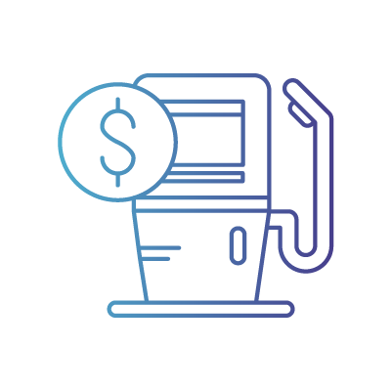
Top Production Issues and What's at Stake
$1.7 Billion Lost
in tax revenue to schools, public safety and local governments.
Well Stimulation Treatment (WST) Permits
Cyclic Steam
Setbacks - AB 345 by Assemblymember Muratsuchi
55,000 Career Jobs Lost
Diverse, high-wage jobs
Increased gas prices up to $2.33 per gallon.*
*Source: Capitol Matrix—Impact of a Statewide Oil Production Ban on Downstream Petroleum Markets, 2019
Notes:
Well Stimulation Treatment (WST) Permits: WSPA member companies continue to wait for permits to be approved, which were deemed complete by CalGEM in May 2019.
Cyclic Steam: In certain sites, this technique inserts high-pressure steam into a well to extract oil. These permits are currently undergoing additional review, which we welcome, but request regulatory certainty in this new process. Delayed permits have already cost jobs and local revenue.
Setbacks: AB 345, by Assemblymember Muratsuchi, leap frogs an existing regulatory process currently underway at CalGEM. Through science and data, CalGEM will determine if a setback is necessary. AB 345 arbitrarily assumes a setback is warranted; eliminating the role for science in the regulatory process.
Delaying WST permits, pursuing unnecessary studies and proposing oil and gas well setbacks are essentially bans on production that have detrimental effects on our ability to provide safe, reliable, affordable energy in California.
Impact of Bans
State production bans mean the loss of the livelihoods for hundreds of thousands of Californians. There is no such thing as a “just” transition for a family uprooted from their community or forced out of a career.
The state is an energy island, and an in-state production ban will only mean increased imports from foreign countries, and a potential limiting of consumer access to fuel.*

Slide 12
Community Engagement
Local Environmental Monitoring
Community Emission Reduction Planning
STEM Programs
Energy Efficiency Programs
Education and Vocational Training
Scholarships

Slide 13
We Must Stand Together
How to get involved
Notes:
The future of energy is at a tipping point- our people, our planet, and our shared prosperity are at stake.
It’s time to remember that even if we don’t share the same politics, we all share the same future.
And the only sustainable way forward is the one we work toward together– starting now.

Slide 14
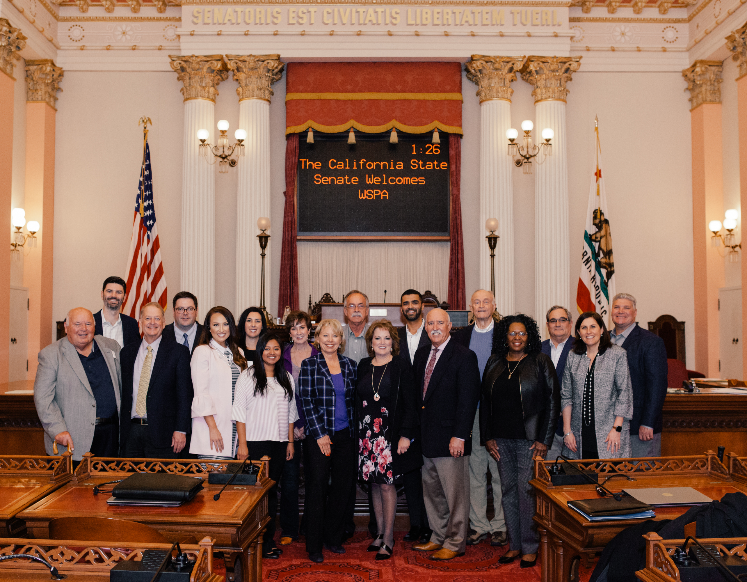
About WSPA Associates
The WSPA Associates is a voluntary organization of diverse individuals and businesses who furnish goods and services to the petroleum industry.
The group actively promotes and supports all aspects of petroleum and natural gas development and operations in the West.
By bringing together companies and individuals that have a stake in the petroleum industry, WSPA Associates represent a persuasive force advocating for economic and environmental balance.

Slide 15
WSPA Associates Program Benefits
The WSPA Associates program presents members with a unique opportunity to network and become better acquainted with industry colleagues and others who share a strong commitment to America’s energy future.
Network with WSPA member company leaders and decision-makers
Associate members also have exclusive access to several special events and sponsorship opportunities throughout the year.
All WSPA Associates are listed for industry connections in an easy to use searchable database of Associate members.

Slide 16
Thank You.
Learn more at wspa.org

