Slide 1
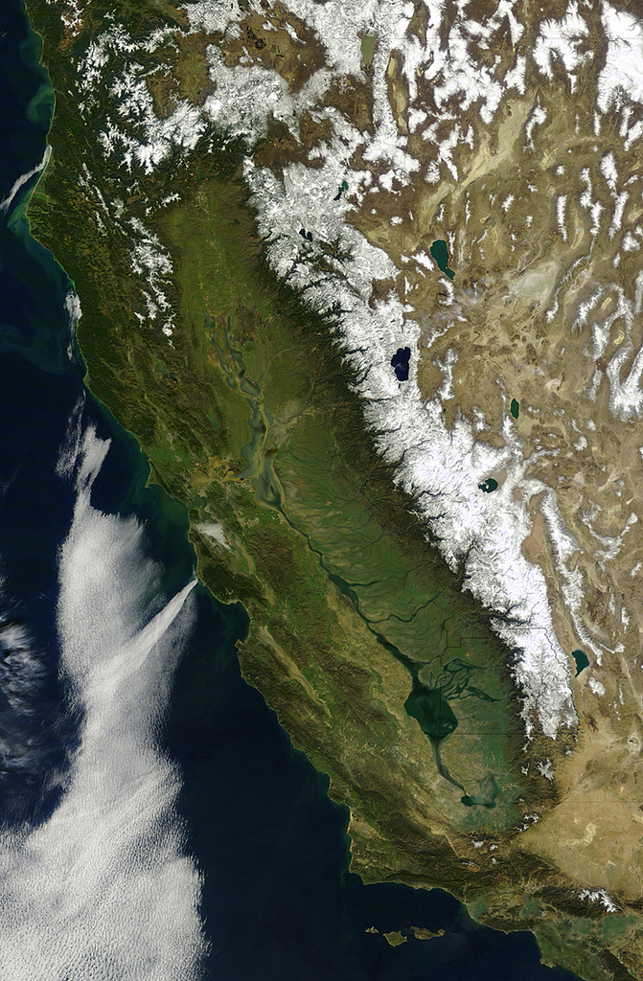

What’s on Tap for California
The California Water Commission
Water Storage Investment Program
SGMA - an update
The Water Resiliency Portfolio
Questions
Armando Quintero
Chair, California Water Commission
Presented by the Water Association of Kern County

Slide 2
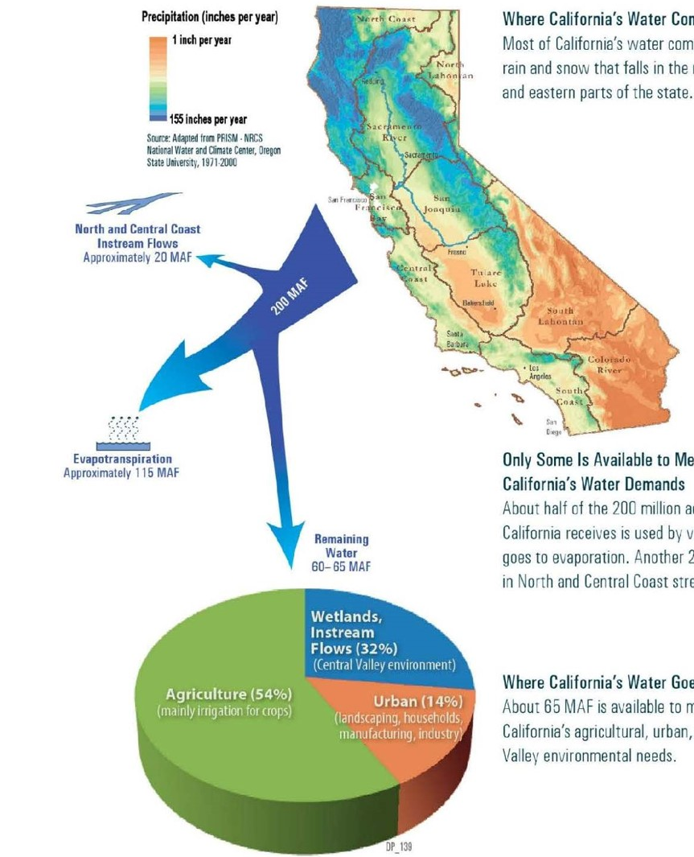
California Water Basics
Where California’s Water Comes From
Most of California’s water comes from rain and snow that falls in the northern and eastern parts of the State
Only Some Water is Available to Meet Demands
About half of the 200 million acre-feet (MAF) of water
that California receives is used by vegetation or goes to evaporation. Another 20 MAF stays in North and Central Coast streams
Where California’s Water Goes
About 65 MAF is available to meet agricultural, urban, and Central Valley environmental needs.

Slide 3
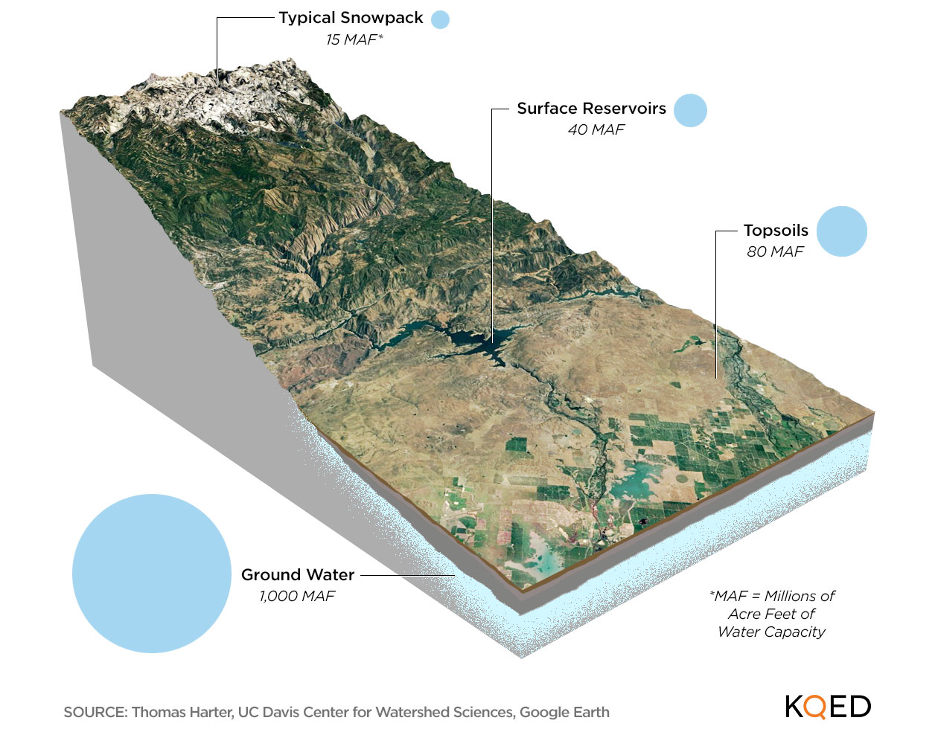
California’s Largest Water Reserves
Groundwater is by far the State’s largest water reserve, dwarfing the total capacity of all surface reservoirs, soils, and the Sierra snowpack. But how much can be used for drinking and crops isn’t precisely known.

Slide 4
The California Water Commission Serves a
Central Role in California Water Management
Nine members appointed by the Governor and confirmed by the State Senate.
Provides a public forum for discussing water issues.
Advises the Department of Water Resources.
Approves DWR rules and regulations.
Monitors the State Water Project and names new facilities.
Adopts resolutions of necessity for DWR eminent domain proceedings.
Tasked with allocating $2.7 billion from Proposition 1 for the public benefits associated with new water storage projects.

Slide 5
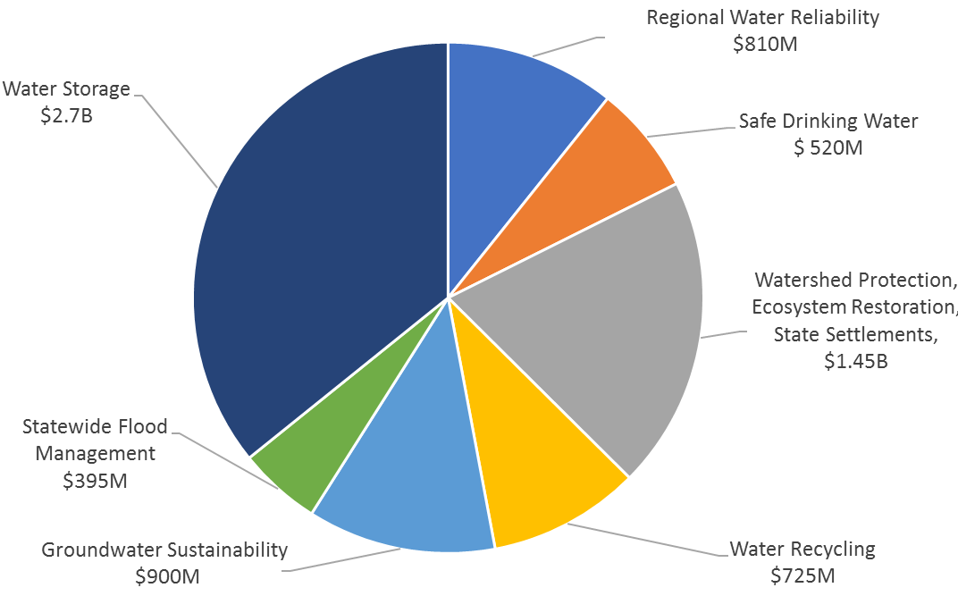
Proposition 1
Water Quality, Supply and Infrastructure Improvement Act of 2014 – $7.545 B

Slide 6
Water Storage Investment Program (WSIP)
Paradigm Shift in How Storage Projects Are Funded
  Funding directed to specific public benefits of new storage projects:
      Ecosystem improvement
      Water quality improvement
      Flood control
      Emergency response
      Recreation

Slide 7
Water Storage Investment Program (WSIP)
12 applicants sought a total of $5.8 billion in WSIP funding
Maximum Conditional Eligibility Decisions (MCED) made for eight projects
Diverse set of projects moving ahead to prepare the state for climate change and future droughts.
Potential to add 4.3 million acre-feet of new storage capacity both above and below ground to strengthen water resiliency.
Will be state’s largest investment in water storage in a generation.

Slide 8
Project | MCED | Early Funding
Chino Basin Conjunctive Use Program | $206,900,000
Kern Fan Groundwater Storage Project | $67,537,315
Los Vaqueros Reservoir Expansion Project | $459,000,000 | $13,650,309
Pacheco Reservoir Expansion Project | $484,550,000 | $24,200,000
Sites Project | $816,377,686 | $40,818,884
South County Agriculture Program | $280,500,000
Temperance Flat Reservoir Project | $171,330,000
Willow Springs Water Bank Conjunctive Use | $95,405,999
Total MCED | $2,581,601,000
Statewide Bond Costs (Treasurer’s Office) | $54,000,000
Program Delivery (State Operations) | $64,399,000
Total Proposition 1, Chapter 8 | $2,700,000,000

Slide 9
Water Storage Investment Program (WSIP)
WSIP regulations require the following in order to schedule a final award hearing:
Contracts for the administration of public benefits
Contracts for non-public benefit cost share
Environmental documentation complete
Required permits obtained
Completed feasibility study

Slide 10
Water Storage Investment Program (WSIP)
Contracts for the Administration of Public Benefits
Department of Water Resources:
Recreation, Flood Control, Emergency Response
State Water Board:
Water Quality Improvements
California Department of Fish and Wildlife:
Ecosystem Improvements

Slide 11
Water Storage Investment Program (WSIP)
January 1, 2022, Statutory Progress Deadline:
  Completed feasibility studies
  Draft of environmental documents for public review
  Commitment for at least 75 percent of non-program funding
Commission will determine project feasibility.
Review drafts of contracts for administration of public benefits.
Final award hearings take place when requirements are completed.

Slide 12
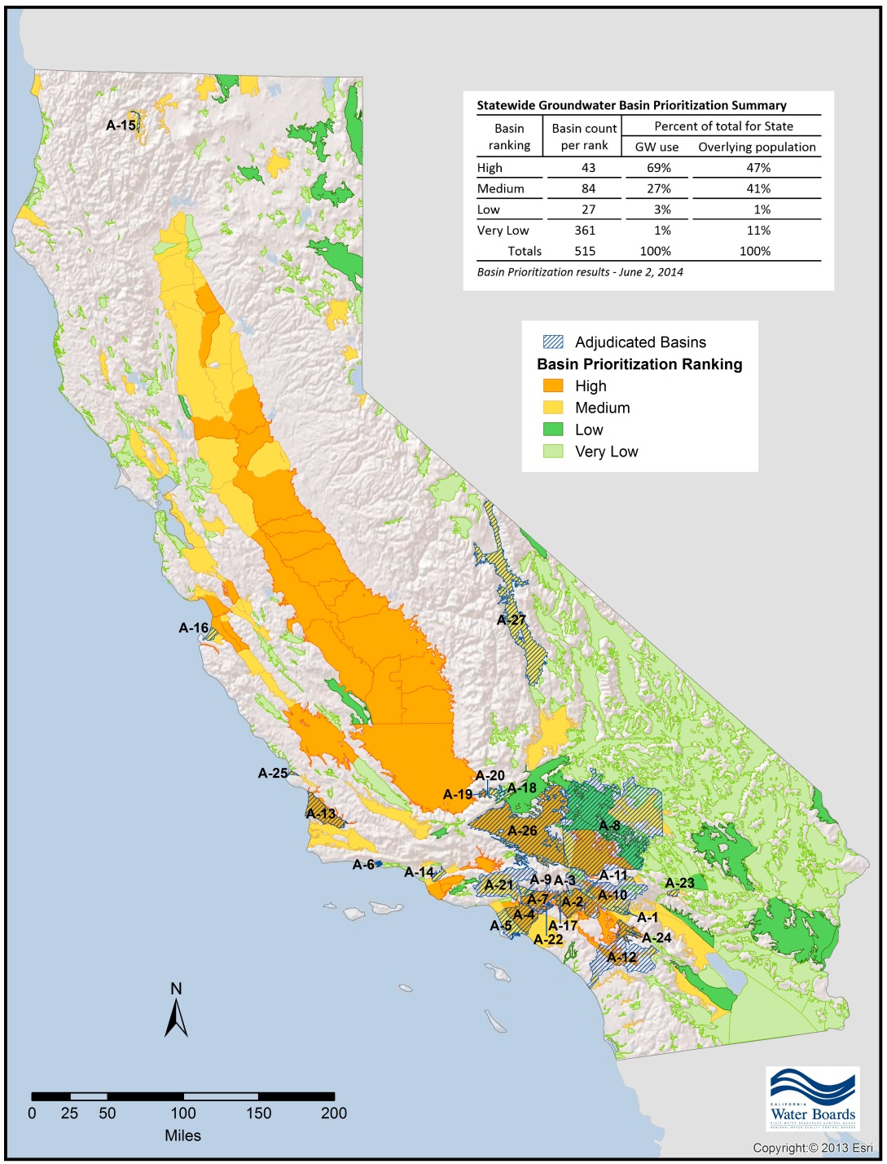
SGMA
Requires groundwater sustainability plans (GSP) in high- and medium-priority basins
must be adopted and submitted by:
January 31, 2020 for critically over-drafted basins
January 31, 2022 for all other medium- and high-priority basins
Does not include adjudicated basins

Slide 13
SGMA in 2020
Increase in Outreach and Engagement Efforts:
  Educational Workshops
  GSA Forums
  Groundwater Summit
  Ensure awareness of DWR and other state programs that support
  SGMA implementation
  Create a venue for SGMA practitioners to exchange ideas
  Discuss nexus to Water Resilience Portfolio and other statewide groundwater policies

Slide 14
2020 Water Resiliency Portfolio
In executive order N-10-19 (April 2019), Governor Newsom called for state agencies to create a water resilience portfolio
“ . . . Shall together prepare a water resilience portfolio that meets the needs of California’s communities, economy, and environment . . .”
State Agencies shaped the draft portfolio with public input and an inventory and assessment of various aspects of California water systems.

Slide 15
2020 Water Resiliency Portfolio
The Governor asked that the portfolio encourage:
Projects that offer multiple benefits
Use of natural infrastructure such as forests and floodplains
Innovation and new technologies
Regional approaches among water users
Examination of successful models from outside California
Integration of investments, policies, and programs across state government
Partnerships with local, federal and tribal governments, water agencies and irrigation districts, and other stakeholders

Slide 16
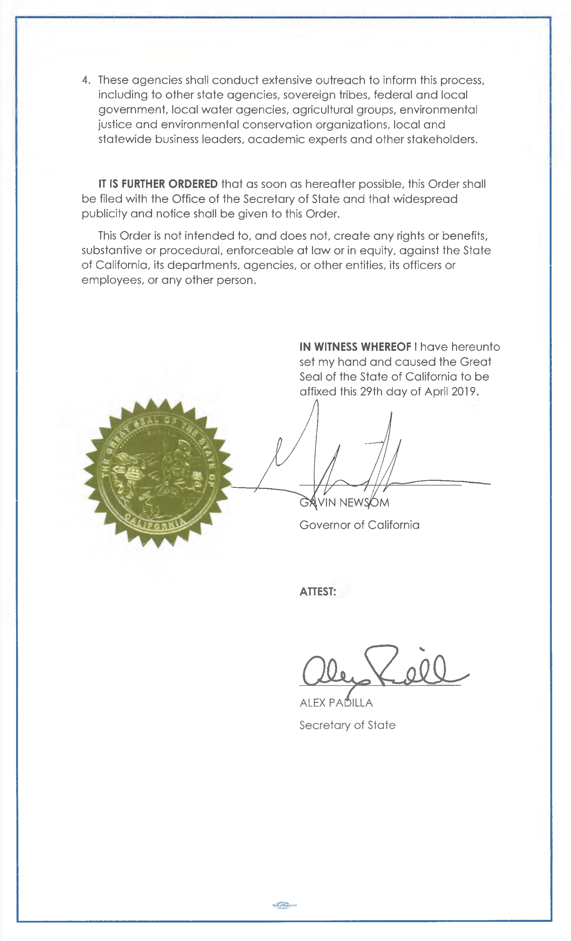
2020 Water Resiliency Portfolio
The draft portfolio, released January 3, 2020,
incudes 133 actions toward these goals:
Maintain and diversify water supplies
Protect and enhance natural systems
Build connections
Be prepared

Slide 17
2020 Water Resiliency Portfolio
California Water Commission assigned primary role in 2 actions:
  Assess State role in financing regional conveyance
  Examine flood insurance beyond the national program
California Natural resources Agency Secretary Wade Crowfoot appeared at February Commission meeting
Commission is making plans to work on State role in financing regional conveyance this year.
  Final Water Resiliency Portfolio due out in March
  Commission will want to move around the State to hear from locals

Slide 18
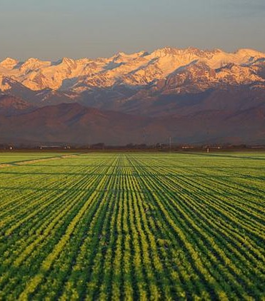
QUESTIONS?

