Slide 1
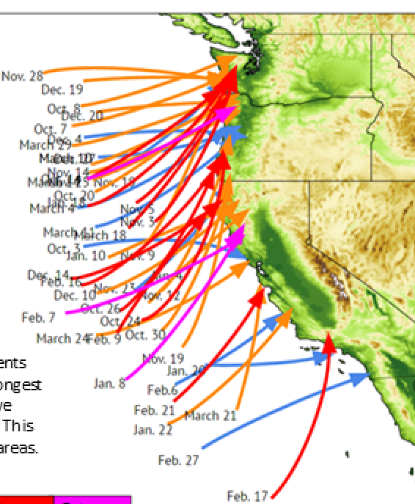
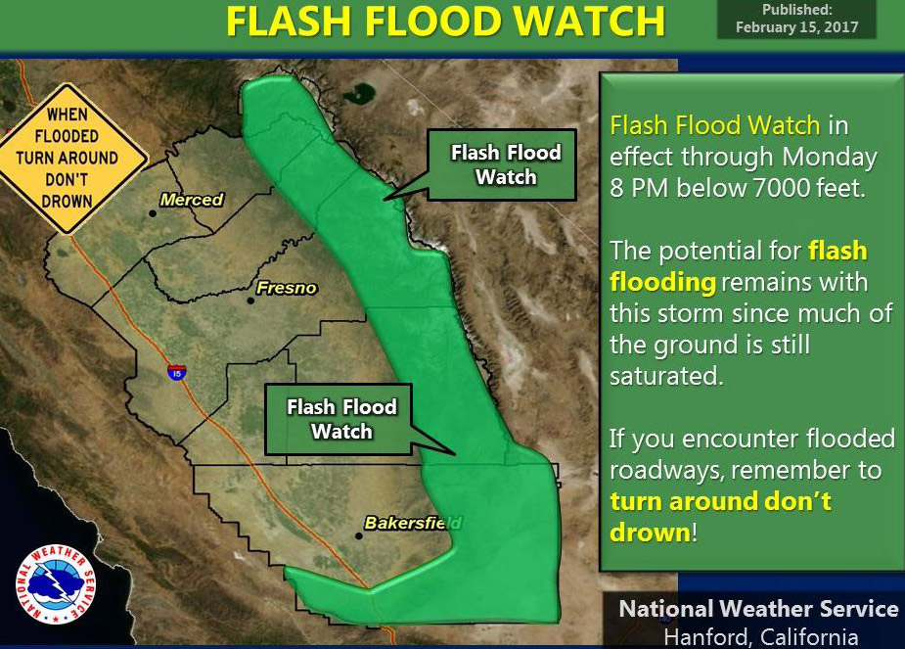



ATMOSPHERIC RIVERS and DROUGHTS, with a dash of climate change
Dr. Michael Dettinger
Senior Research Hydrologist, USGS
Atmospheric-River Landfalls, Winter 2017
Notes:
If you hadn’t heard of “atmospheric rivers” before, you your best shot at that would have been this past winter, when major storms and floods ravaged northern California and threatened the communities downstream from the dam at Oroville. The storminess was due to the arrival more than 45 atmospheric rivers on the West Coast 3-4 of which were quite strong. At Lake Tahoe about 40 inches of rain and snow fell over the course of the winter. I have yet to see reliable numbers regarding the economic losses associated with this wild winter, but a USGS study that I participated in estimated that if the same amount of atmospheric river precipitation arrived in 23 days rather than the 80 days that it took last winter, the losses would ultimately rise to ¾ of a TRILLION dollars. I’ll tell you about how we arrived at that number, but first I need to introduce you to these things called atmospheric rivers.

Slide 2
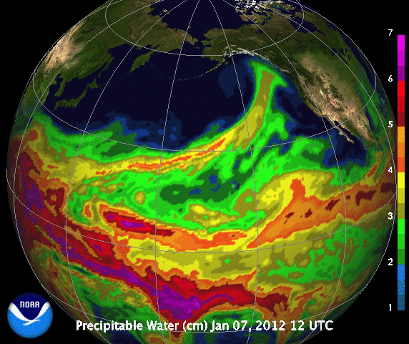
What are these “Atmospheric Rivers”?
Total water vapor, 7-29 January 2012
2.5
Inches of water, if condensed out onto the ground
2.0
1.5
1.0
Atmospheric river: A long, narrow, and transient corridor of strong horizontal water vapor transport…” Glossary of Meteorology, as of May 2017
→ Natural jets of water vapor that are building blocks of global water cycle
Notes:
The animation shows the amounts of water vapor in the atmosphere over the North Pacific Ocean over the course of about 3 weeks in winter 2012; warm colors indicate a lot of water, blues and blacks indicate dry air. Atmospheric rivers are these long skinny corridors of moisture, typically extended from the humid Tropics up into the drier air farther north (in this picture). They are naturally occurring and carry about 90% of all the water-vapor movements outside the tropics. As such they’re the building blocks of the whole water cycle outside of the Tropics. Because they are long and skinny and transport massive amounts of water, we call them “atmospheric rivers”.

Slide 3
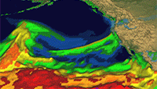
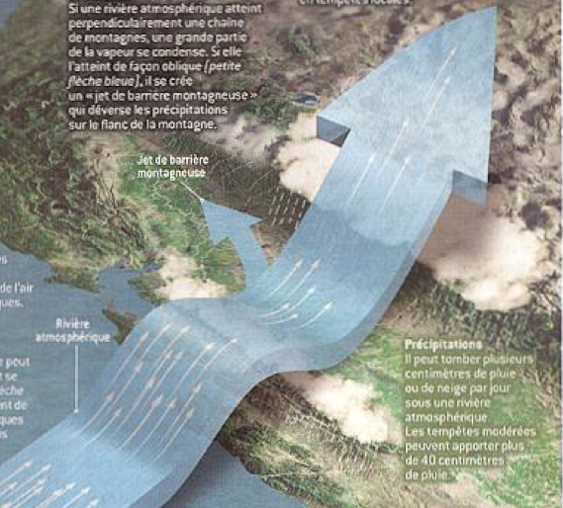
Landfalling Atmospheric Rivers
→ Encountering mountains, ARs are lifted & cooled, extracting massive amounts of rain
Notes:
They move along about a mile above sea level until they encounter a continental and, especially, a mountain range. Then they push up and over the mountains, cooling in the process. When they cool, the water vapor they contain condenses and massive amounts of rain and snow fall from them.

Slide 4
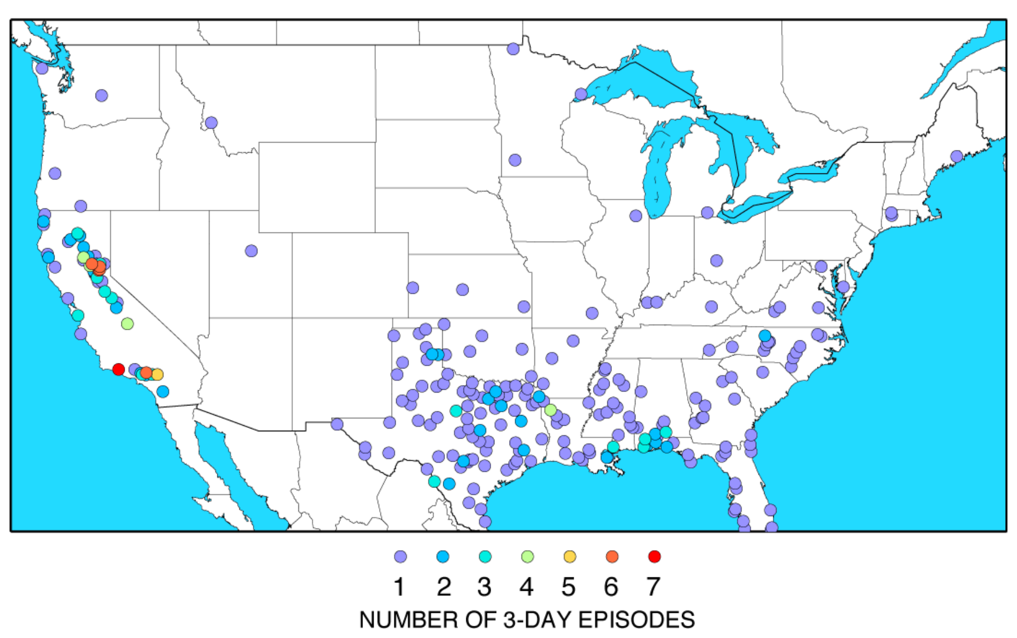
How much precipitation?
Number of occasions, 1950-2008, with more than
16 inches of precipitation in 3 days
92% due to Atmospheric Rivers
32 inches/3 day
Harvey 2017
→ Worst case: As extreme as any storms in the conterminous US !
Notes:
Atmospheric rivers range from weak to very strong. The very strongest of them have dropped as much precipitation as landfalling hurricanes, but on the west coast. This map shows the locations of all Weather Service weather stations that every reported more than 16 inches of precipitation in any 3 day period. Notice that the only areas where such totals have been reported are in the SE where hurricanes make landfall, and in the coastal ranges and Sierra Nevada of California. At least 92% of these most extreme storms in California were atmospheric river storms. So at their extreme end, atmospheric river storms are as wet as any anywhere in the conterminous US, including landfalling hurricanes (except Harvey now).

Slide 5
Historical western floods AND water resources
ARs & Truckee River (Reno) Floods
Rainfed Russian River floods, Ca Coastal Rg
Non AR
AR fed
87%
Snowfed Merced River floods, Sierra Nevada
%Winter Precipitation from Atmospheric Rivers
Spring snowmelt
% Precipitation from Atmospheric Rivers
Spring snowmelt
AR fed
70%
AR fed
(7/10)
→ Both hazards and benefits
Notes:
With such a potential for dropping so much rain, atmospheric rivers account for 70-90% of all major or declared floods in northern California and the Pacific Northwest. However, most atmospheric rivers are not that big, and in fact, are more beneficial than hazardous. Along the West Coast, they drop 30-60% of all precipitation, and account for a comparable fraction of all surface-water runoff into rivers and reservoirs. Considered on the whole, atmospheric rivers are either hazards or resources, depending on the strength of the atmospheric river (how much moisture it is carrying) and on the setting that they are raining on.

Slide 6
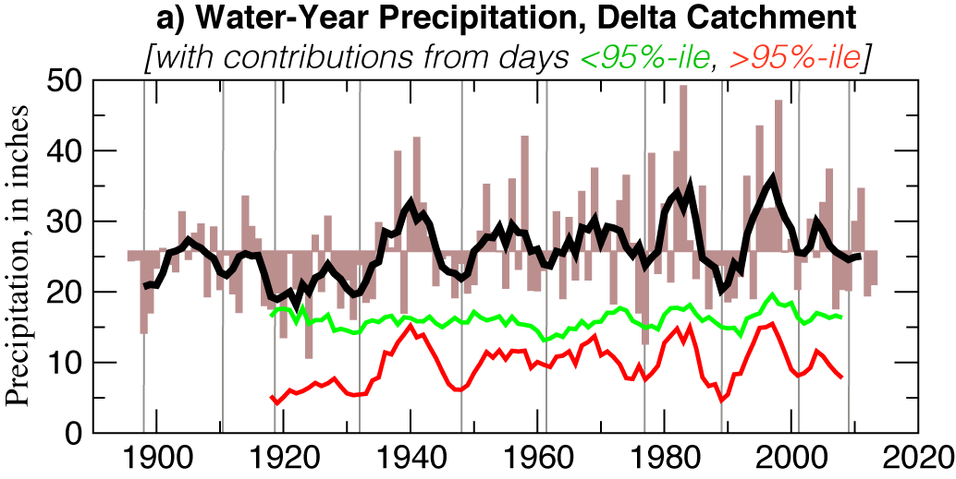
HOW ARE EXTENDED CALIFORNIA DROUGHTS MADE?
Total wy precip
All other wet days
Wettest 5% of wet days
Droughts ← lack of large storms, rather than lack of medium storms
Dettinger & Cayan, SFEWS, 2014; Dettinger, SFEWS, 2016

Slide 7
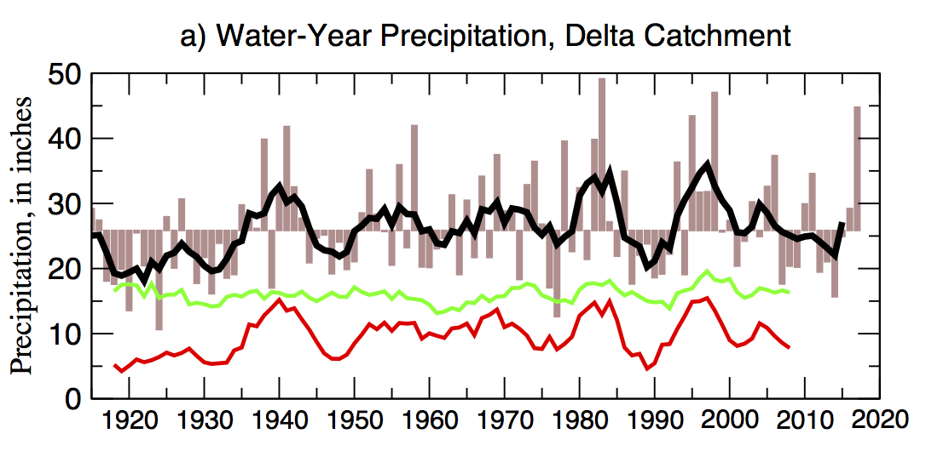
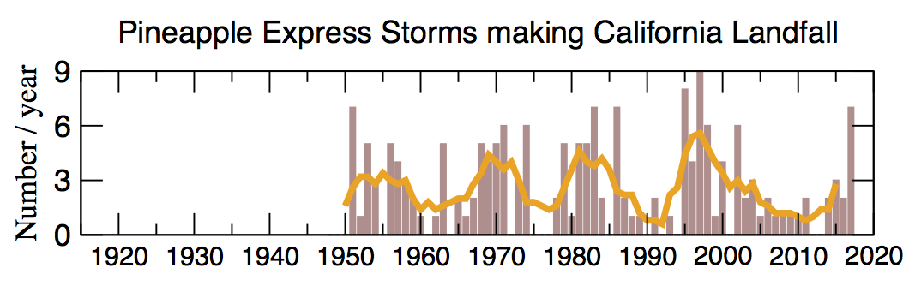
PINEAPPLE EXPRESSES & PRECIP VARIATIONS
R**2 = 69%
Dettinger, SFEWS 2016

Slide 8
Atmospheric River Benefits, US West Coast
Atmospheric Rivers (ARs) on the West Coast… | Quantitative Finding
Fill reservoirs & provide water supplies | 30-50% of California rain, snow & streamflow from ARs
Sustain wetlands, floodplains & fisheries | 77% of major inundations of Yolo Bypass floodplain, Sacramento R, initiated by ARs
Modify banks & bottom sediments, modulating aquatic fauna in mountain streams | More invertebrate densities & diversity after major atmospheric-river flooding; 10x more in pre-disturbed settings
Water deserts & forests far inland, modulate wildfire risks | Significant relations of ARs with Southwestern summer greenness & areas burned
Freshen estuaries but sometimes threaten estuarine fauna | March 2011 ARs freshened San Francisco Bay by 60%, resulting in wild oyster kill rate of 97-100%

Slide 9
Atmospheric River Hazards, US West Coast
Atmospheric Rivers (ARs) on the West Coast… | Quantitative Finding
Cause the heaviest rains | 92% of West Coast’s heaviest 3-day rain events fed by ARs
Bring warmest winter storms & snowmelt flooding | Average >50% more precipitation & 2.5ºC warmer than other Sierra storms
Cause West Coast floods | 40-90% of major floods in West Coast rivers have been fed by ARs
Yield extreme coastal winds | 20-50% of extreme coastal-wind episodes associated with ARs
Cause coastal storm surges | 15-50% of annual sea-level maxima are associated with ARs
Breach levees | 81% of Central Valley levee breaks, since 1948, happened during ARs
Cause landslides, debris flows & avalanches | ARs cause 68% of postfire debris flows in southern California

Slide 10
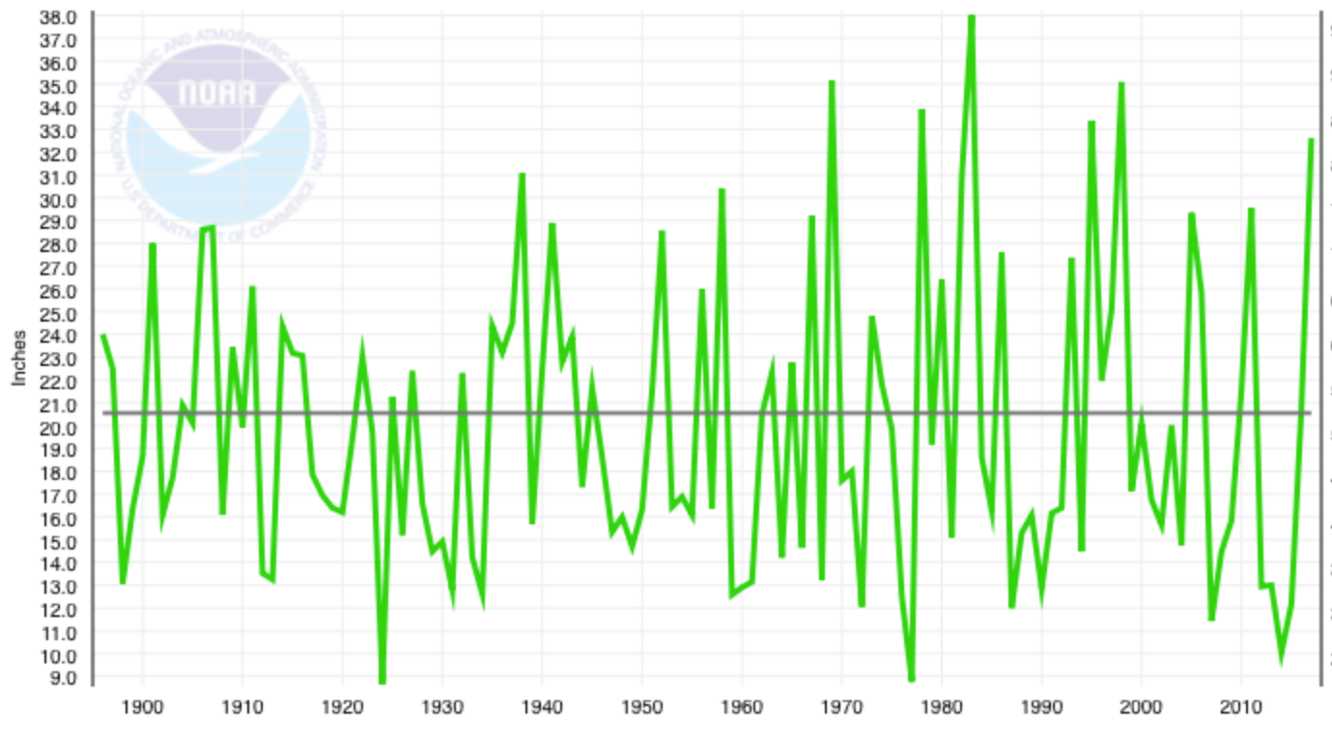
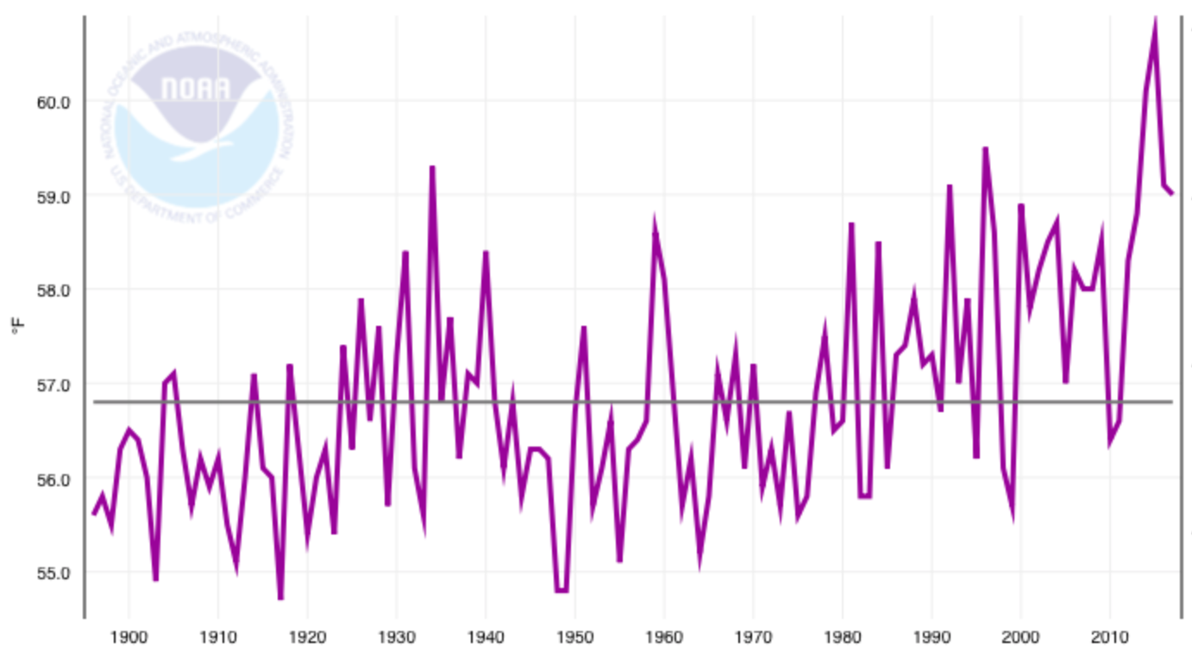
RECENT DROUGHT, SAN JOAQUIN DIVISION
Inches
36
WY Precipitation
24
12
1900
1930
1960
1990
WY Temperature
2040
59
Degrees F
2020
61-member ensemble
2005
57
55
1900
1930
1960
1990
2010

Slide 11
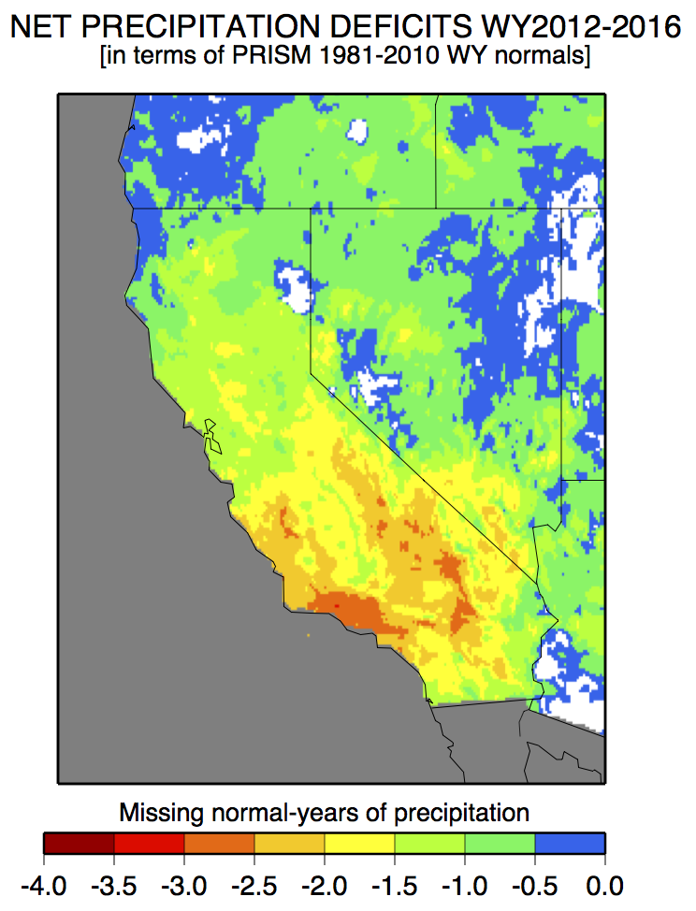
MISSING PRECIPITATION
<δPrecip>_{Delta} = -309 MAF
= -1.3 yr
Data source: www.prism.oregonstate.edu

Slide 12
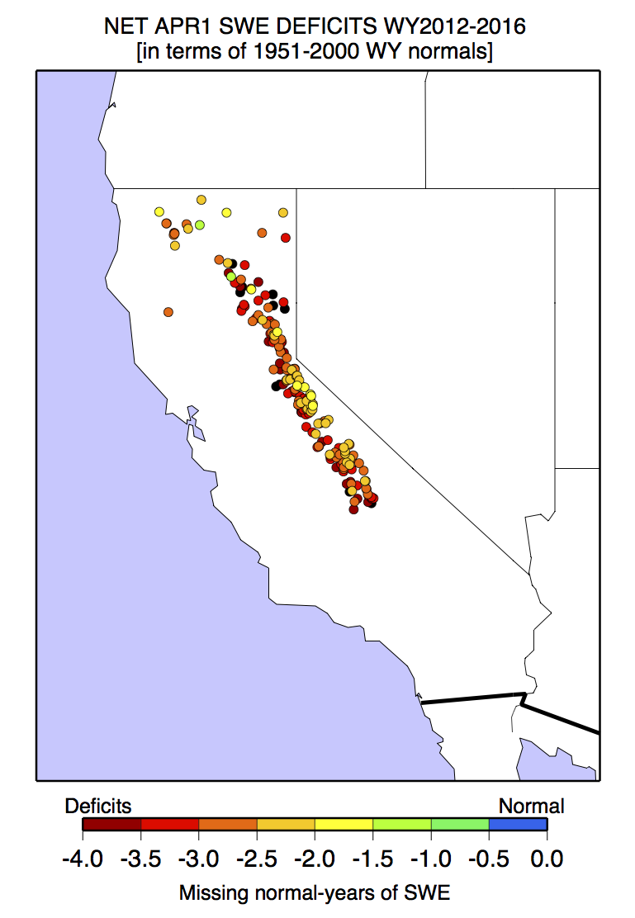
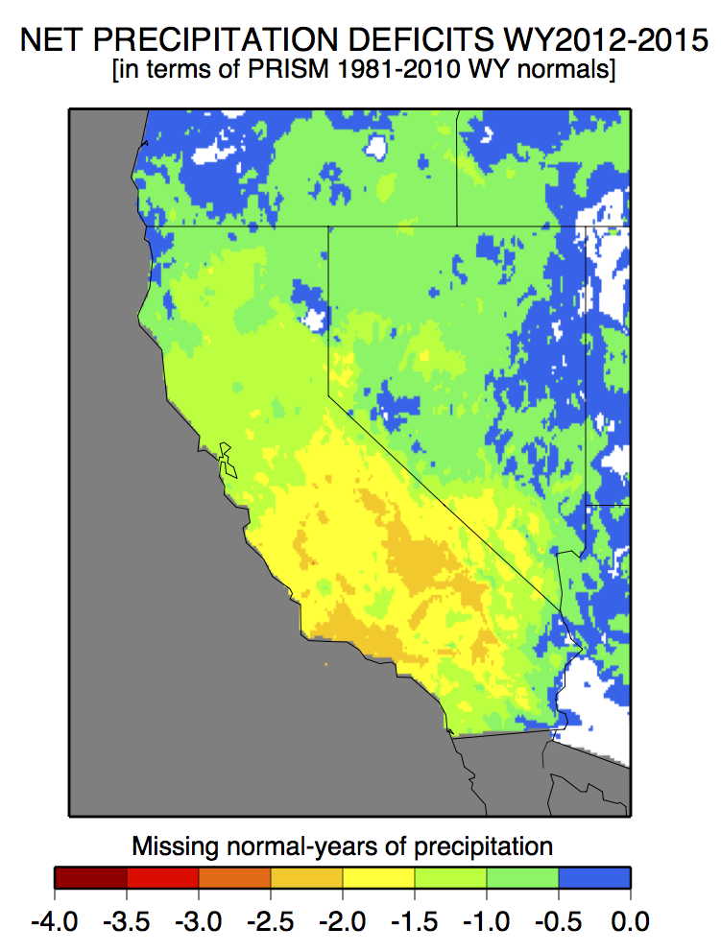
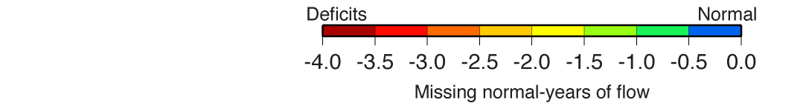
SNOWPACK
<dSWE_{Apr1}> = -2.8 yr
[Margulis: <dSWE_{peak}> = -2.6 yr]
<dSWE_{Apr1}> = -50 MAF
[Margulis: <dSWE_{peak}> = -46 MAF]
<dPrecip>_{Delta} = -1.3 yr
= -309 MAF
http://cdec.water.ca.gov/snow/current/snow/

Slide 13
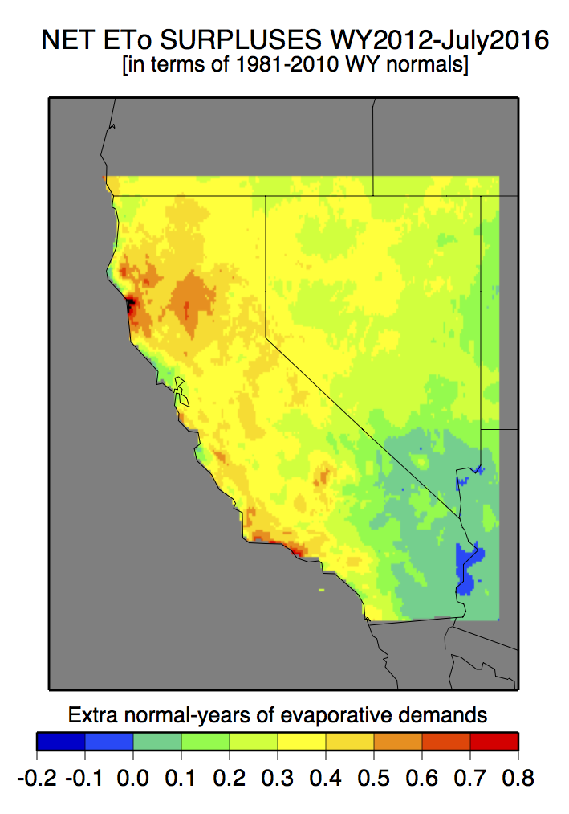
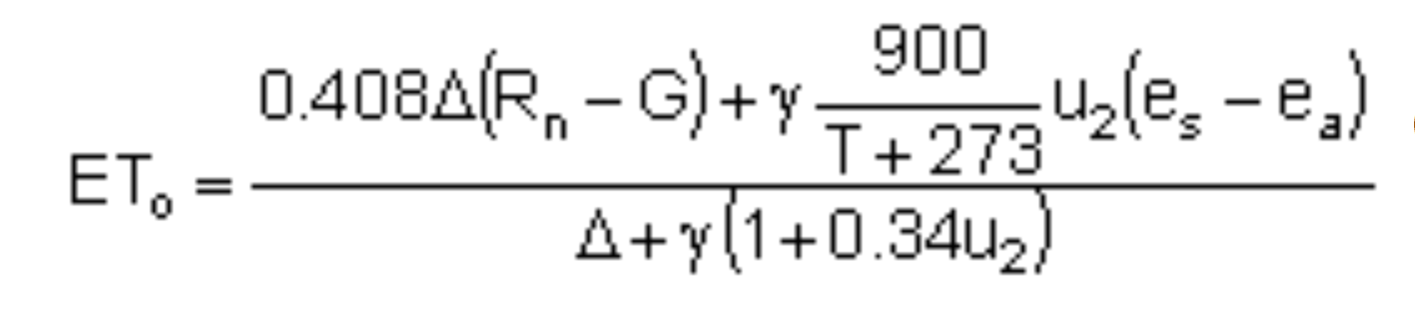
EVAPORATION DEMAND
Net radiation
Ground-heat flux
Air temperature
Vapor pressure
Wind
<dPrecip>_{Delta} = -309 MAF
<dETo>_{Delta} = +167 MAF
Data from (& in collab w/) D. McEvoy & J. Huntington, DRI

Slide 14
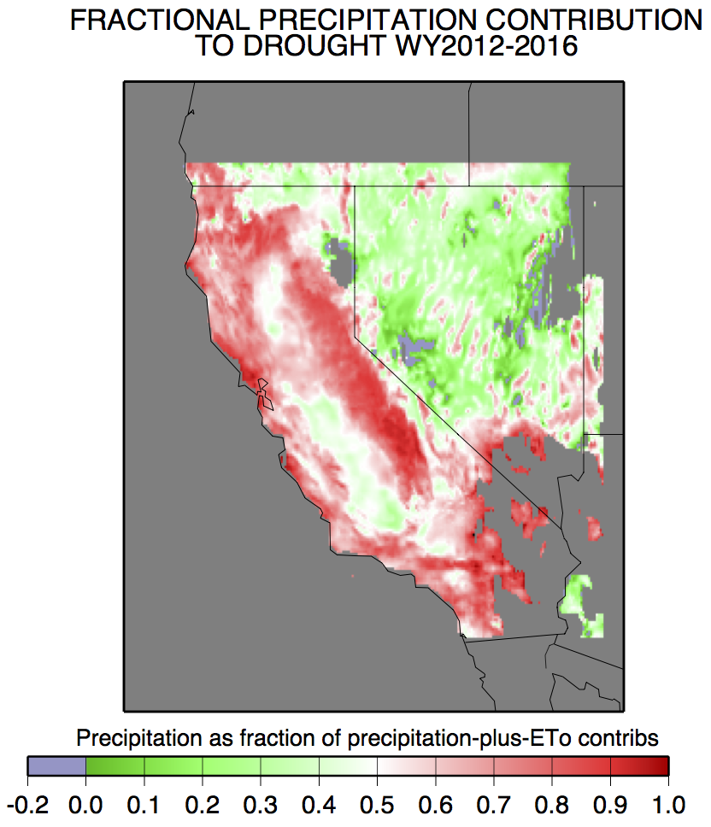
CONTRIBUTIONS TO 2012-2016 DROUGHT FROM PRECIP-DEFICIT & EXTRA EVAPORATIVE DEMAND

Slide 15
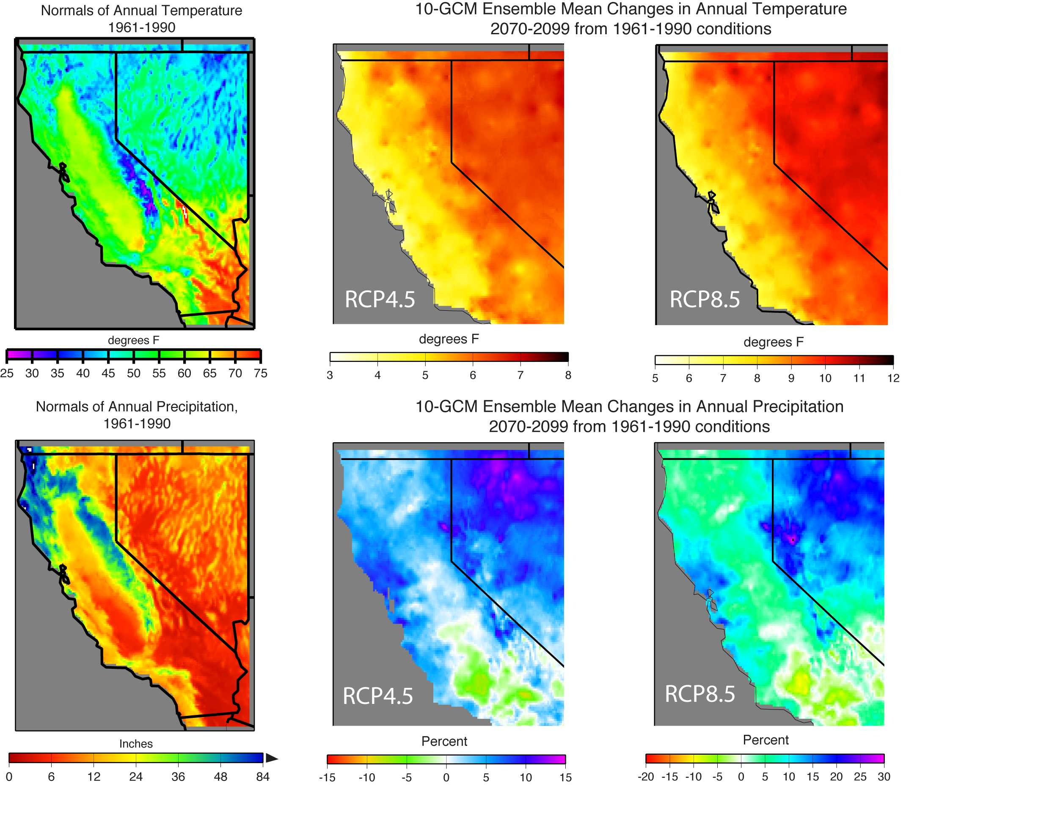
PROJECTED CLIMATE CHANGES, CA
Bakersfield
change in temperature:
+5F to +8F
By end of century
Cool end
Warm end
Temperature
Cool end
Warm End
Precipitation
Bakersfield
change in precipitation:
-5% to -10%
By end of century

Slide 16
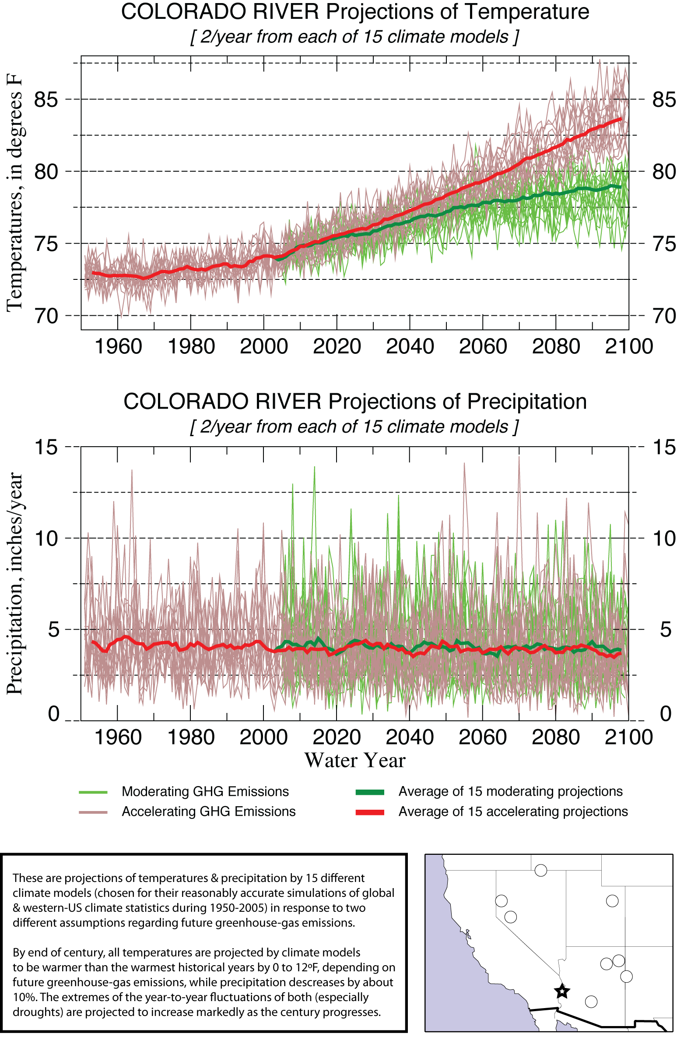
PROJECTED CLIMATE CHANGES, CA
Cool end
Warm end
Temperature
Temperature
Cool end
Warm End
Precipitation
Precipitation

Slide 17
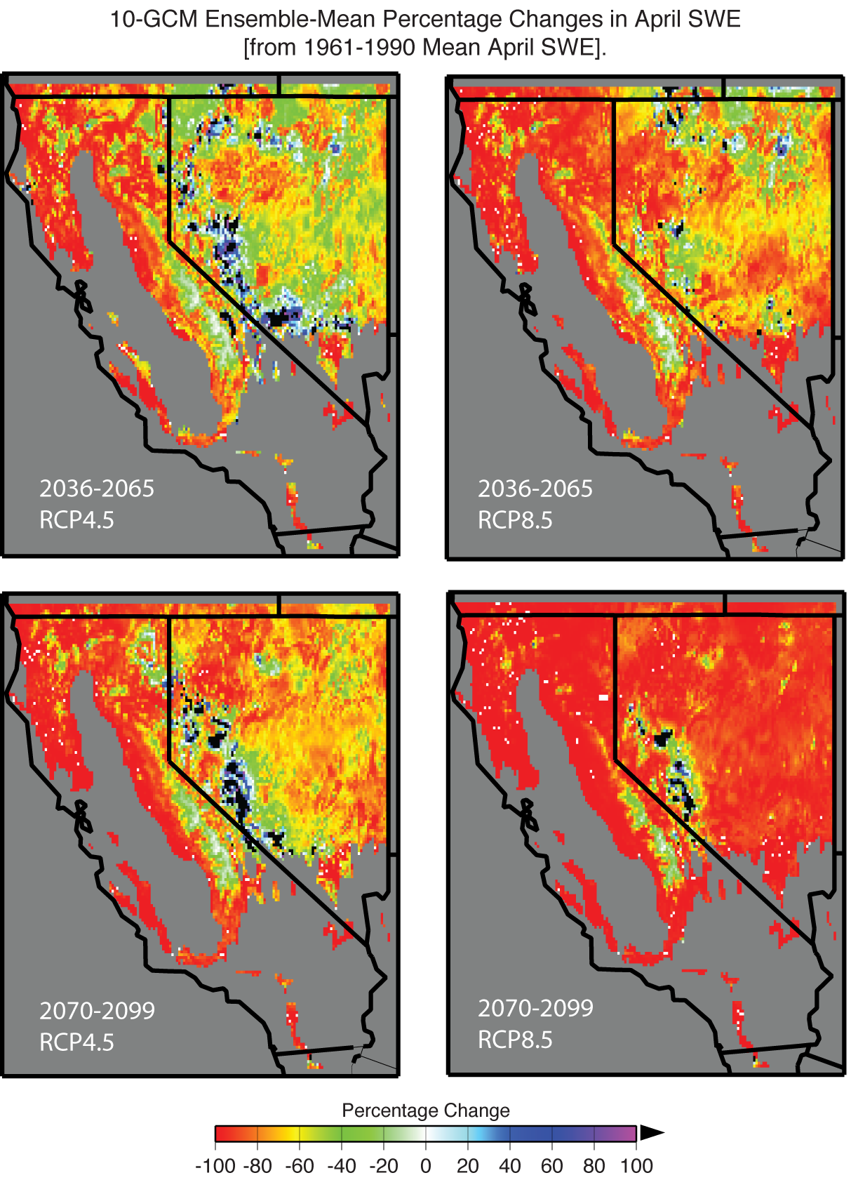
PROJECTED SNOWPACK CHANGES
10-GCM Ensemble-Mean Percentage Changes in April SWE
2070-2099 vs 1961-1990
Cool End
Warm End
Src: California 4th Climate Assmt (Sierra Nv regional report), in progress

Slide 18
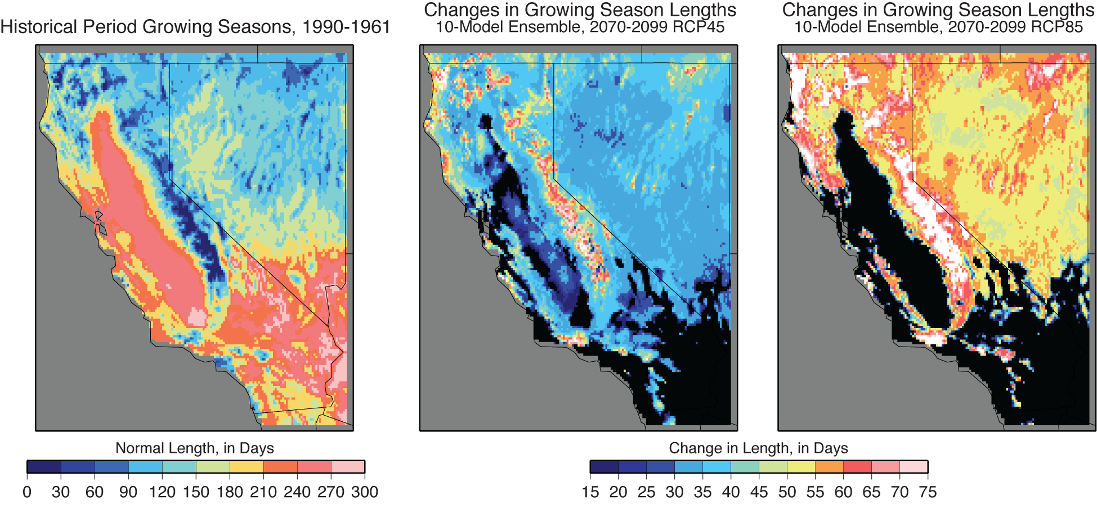
PROJECTED CHANGES IN GROWING-SEASON LENGTHS
Historical
Cool End
Warm End
MAXED OUT
Growing season = Season between last 6-day period
< 50ºF in spring and first 6-day period < 50ºF in autumn

Slide 19
CONTRIBUTIONS TO 2012-2016 DROUGHT FROM PRECIP-DEFICIT & EXTRA EVAPORATIVE DEMAND
Same slide as I showed earlier

Slide 20
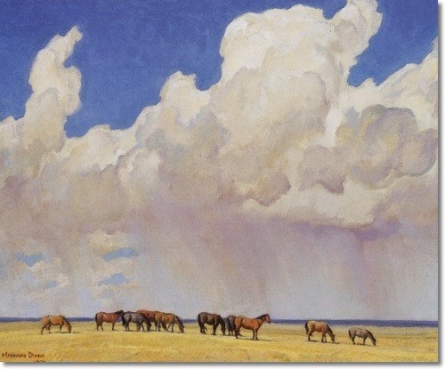
ATMOSPHERIC RIVERS, DROUGHTS & SOME CLIMATE CHANGE
Atmospheric rivers, droughts & some climate change
ATMOSPHERIC RIVERS play crucial roles in California storms, floods, water-supplies & droughts
Recent drought was an almost even mixture of precipitation deficit & evaporative-demand surplus
EXPECT WARMING & increased evaporative demands, longer growing seasons, less snowpack
Future precipitation projections are much less confident, but trends probably small compared to trends
Extreme precip years will be even more extreme
© Maynard Dixon 1927

Slide 21
Questions?
© Maynard Dixon 1927

