Slide 1
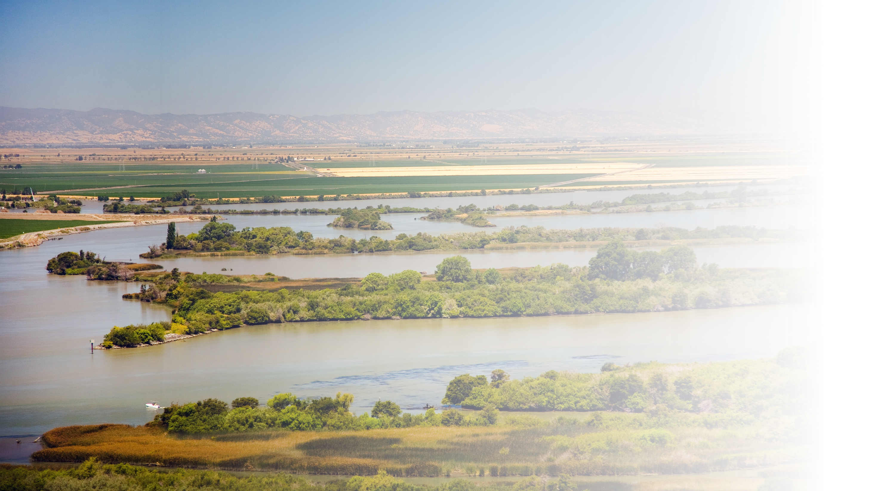
Update on California
WaterFix Activities
Water Association of Kern County - Water Summit - March 7, 2018
Notes:
New (website) Boundary Map

Slide 2
History of Declining Water Supplies
Background
Loss of water supply began in 1980s
Affects both SWP and CVP
Likely to continue
Notes:
New (website) Boundary Map

Slide 3
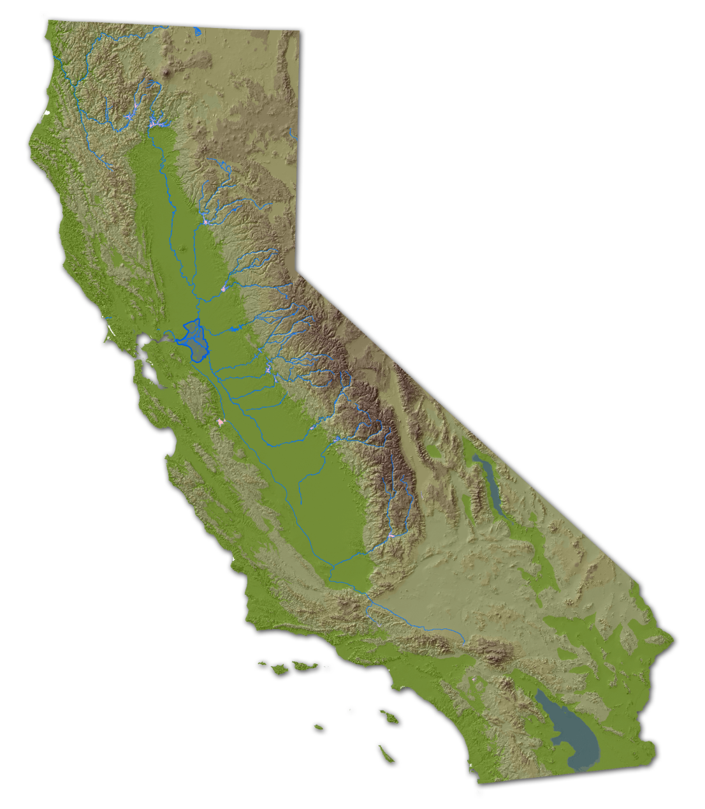
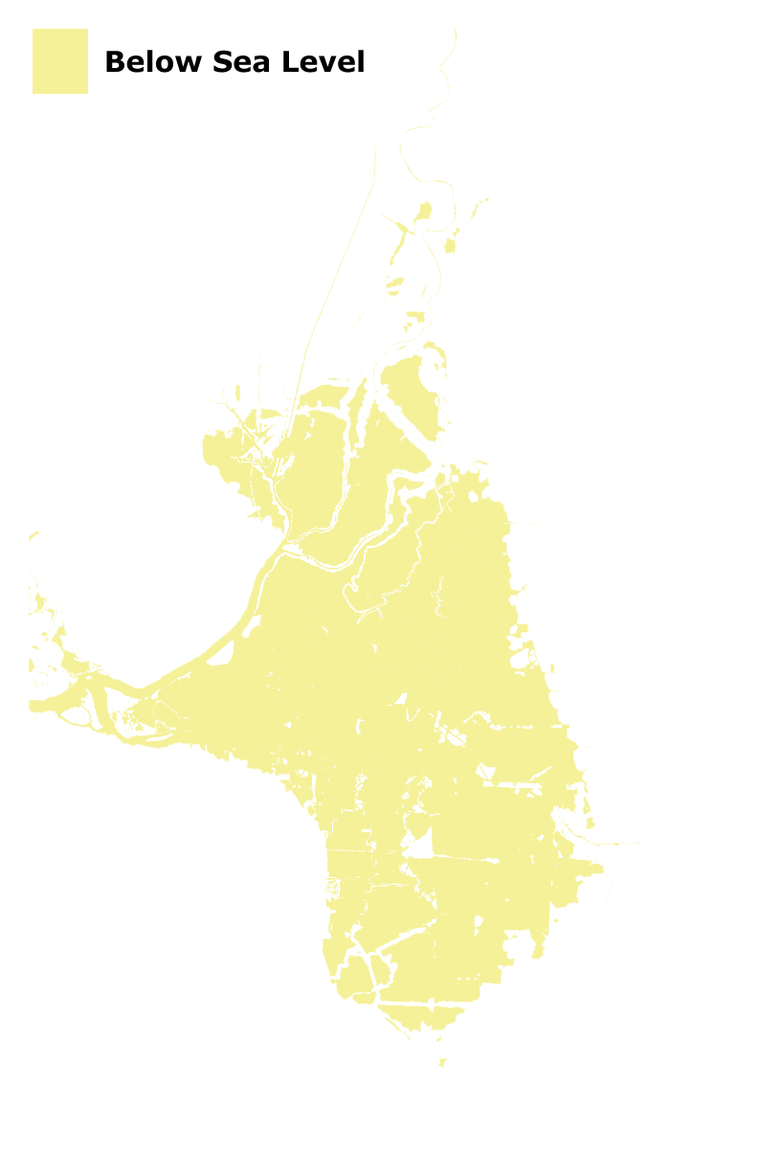
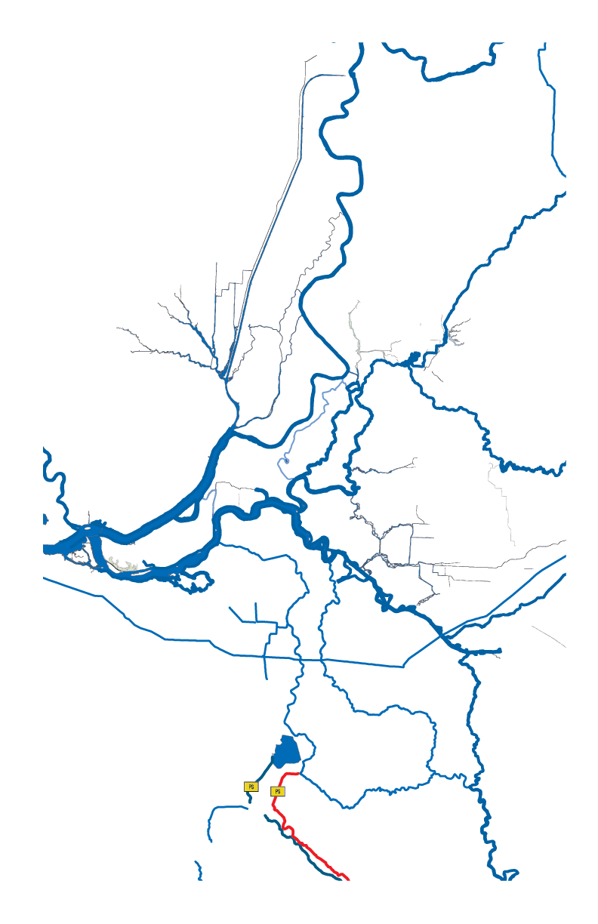
A Water Future in Decline?
Nearly 60% of Kern County’s surface water supply is linked to the health of the Delta.
Conveyance of water through the Delta is limited by State and federal regulations.
Conveyance of water through the Delta remains at risk of further reductions.
Sacramento River
To San Francisco
l Stockton
Clifton Court Forebay
California Aqueduct
San Joaquin River
The Delta

Slide 4
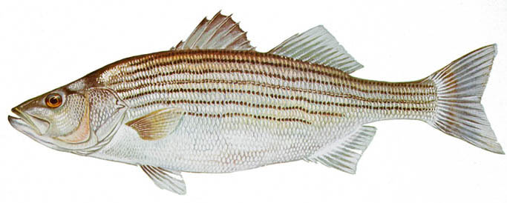
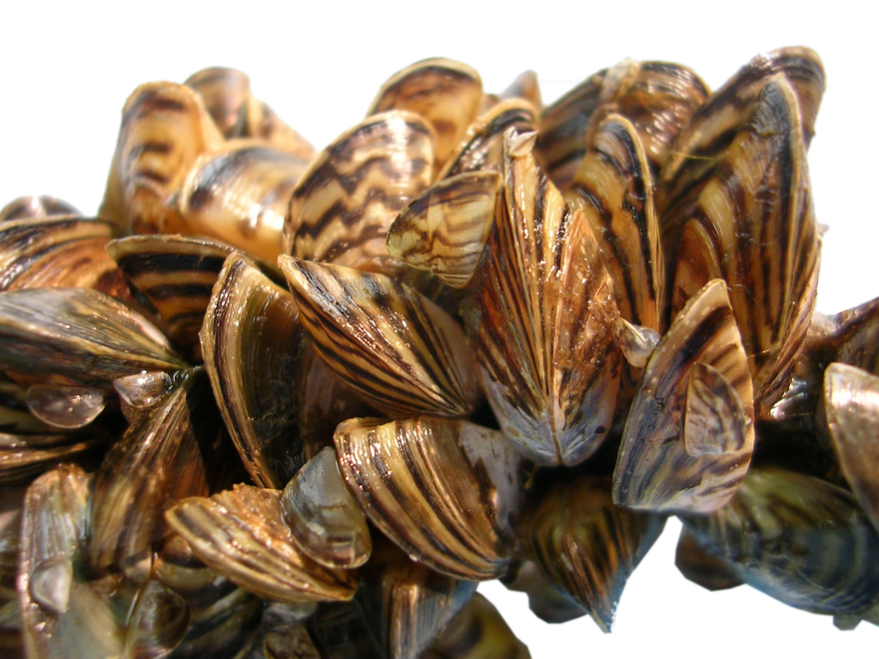
The Decline of the Delta
Endangered Species
Invasive Species
Predation
Contaminants
Other Diversions
Subsidence
Earthquake Risks
Notes:
I like having a single slide, but this attempt is also a bit crowded/bulky looking. Maybe the Cal WaterFix documents have a graphic we can use.

Slide 5
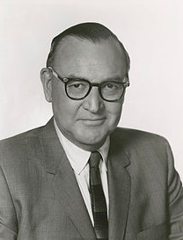
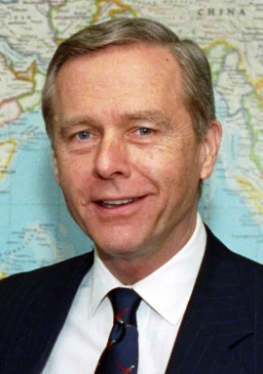
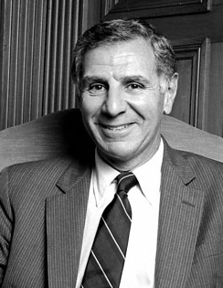
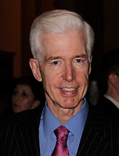
The History of Delta Decisions
This is Not a New Problem
1960
1970
1980
1990
2000
2010
2020
What will the next administration do?
Notes:
I like having a single slide, but this attempt is also a bit crowded/bulky looking. Maybe the Cal WaterFix documents have a graphic we can use.

Slide 6
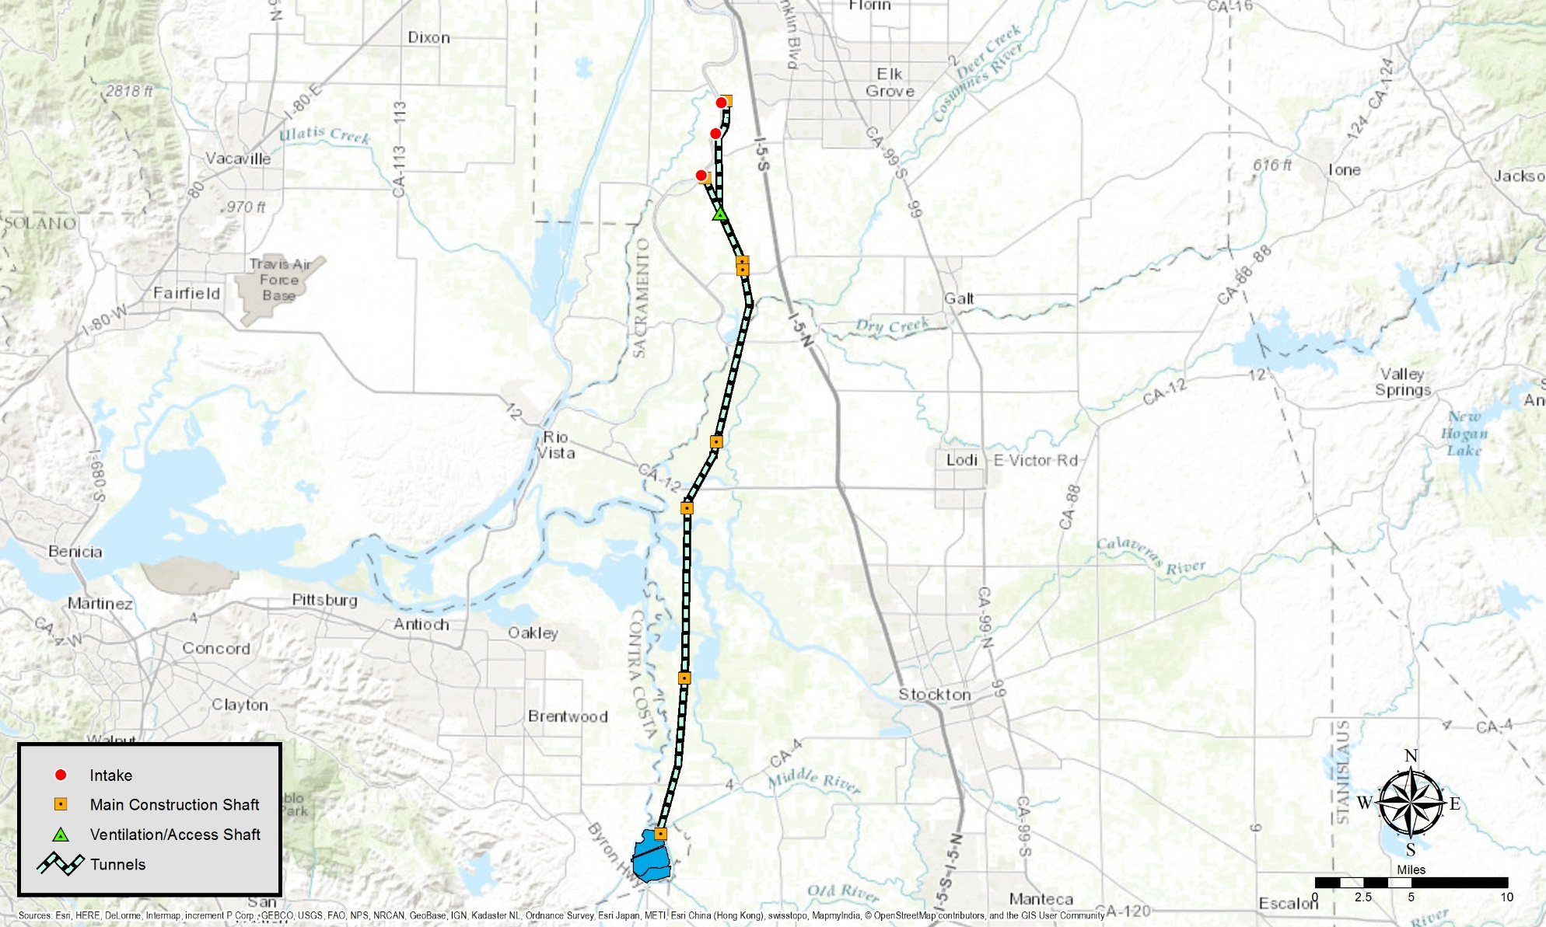
California WaterFix Facilities
Major Components
Intakes
North Tunnels
Intermediate Forebay
Main Tunnels
Clifton Court Forebay Connection
Sacramento
Intakes
Intakes
Intakes
North Tunnels 13.5 miles
Intermediate
Forebay
Main Tunnels 30 Miles
Clifton Court
Pumping Plant
Stockton
Notes:
New (website) Boundary Map

Slide 7
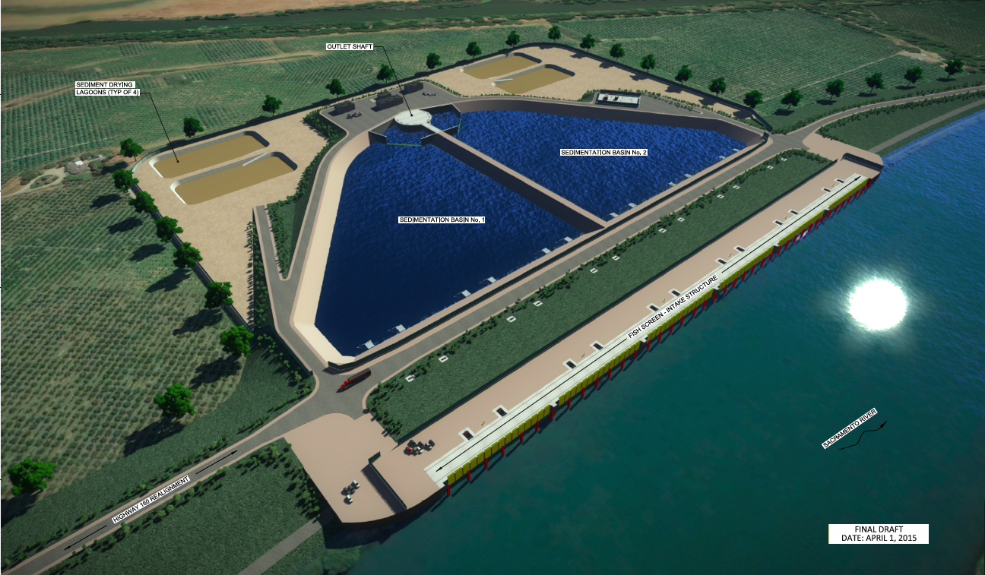
3 New Intakes on the Sacramento River
3 New Intakes
Each 3,000 cfs
On-bank, screened
Gravity-fed
Sized to protect fish – 0.2 fps
Sedimentation basins protect tunnels
Outlet Shaft
Sediment Drying Lagoons (Typ of 4)
No. 2
Sedimentation Basin No. 1
Fish screen intake structure
Sacramento River
Notes:
New (website) Boundary Map

Slide 8
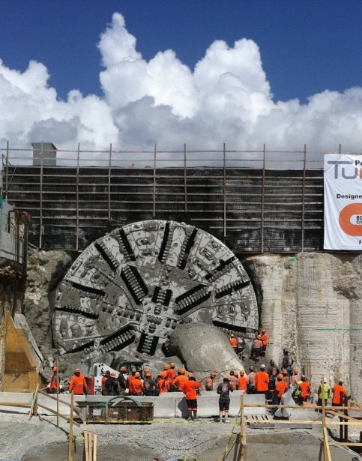
3 North Tunnels and Main Tunnels
Tunnel Features
100-year life
Twin bore main tunnels
150 ft. below grade
Concrete segmental liner
Pressurized face Tunnel Boring Machine construction
45-ft. excavated diameter
40-ft. finished internal diameter
Notes:
New (website) Boundary Map

Slide 9
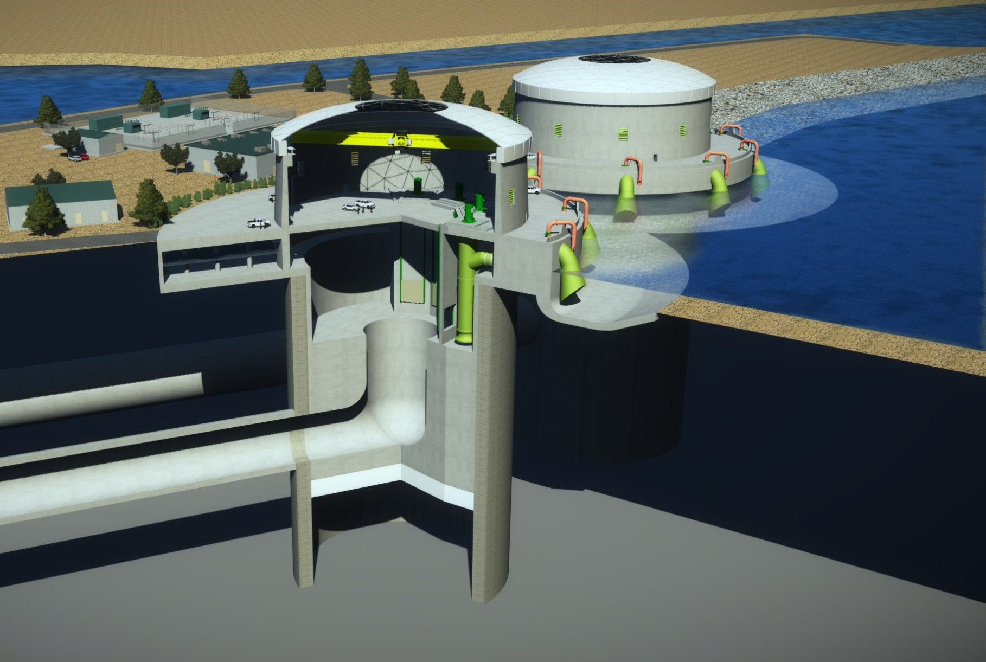
Clifton Court Forebay Improvements
2 New Outlets
Create 2 forebays
North CCF
South CCF
Expand South CCF
Existing CCF gates used for South CCF
Tunnels discharge into North CCF
Gravity-fed or pumped
North Clifton Court Forebay
Gravity discharge
Pump Discharge
Flow
Vertical Turbine Pump Unit
40-foot Main Tunnel
Notes:
New (website) Boundary Map

Slide 10
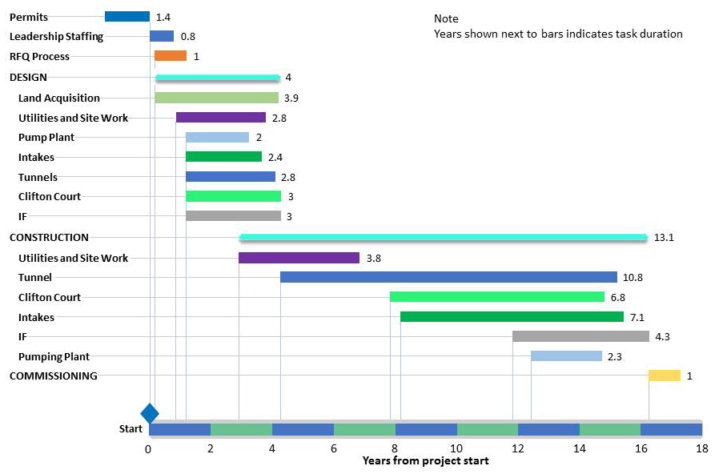
Construction
Schedule
May begin after permits are received
3 Phases:
Pre-construction (2 yrs)
Design (4 yrs)
Construction (13 yrs)
Estimate based on:
2015 Conceptual Engineering Report
Data from other large scale projects
Notes:
New (website) Boundary Map

Slide 11
Cost Estimate with Risk Mitigation
Item | Risk with Mit. at 75% Confidence Interval ^{1,3} | 5RMK Estimate^{1,2} | Jacobs Eng Estimate^{1, 2}
Construction | $10.66 | $9.50 | $8.86
Contingency |  | $3.38 | $3.15
Construction Subtotal | $10.66 | $12.88 | $12.01
PM/CM/Eng | $1.91 | $1.91 | $1.91
Land acquisition | $0.15 | $0.15 | $0.15
Grand Total | $12.72 | $14.94 | $14.07
Total expenditures after risk mitigation
Amounts in Billions
(1) Program estimates in 2014 dollars
(2) ~36% Contingency on construction for 5RMK and Jacob Engineering estimates
(3) Based on risks known at time of assessment
Notes:
New (website) Boundary Map

Slide 12
Modeling
SWP-CVP Capability (MAF)
4.7
4.7-5.3
3.5-3.9
Notes:
New (website) Boundary Map

Slide 13
Modeling
Additional Potential Export Under CWF
Storm Flow 1/20/10- 12/7/10- 1/23/12- 12/1/12- 2/9/14- 12/12/14- 1/1/16-
Period: 3/16/10 7/11/11 5/16/12 2/17/13 4/10/14 1/11/15 4/30/16
Notes:
New (website) Boundary Map

