Slide 1
2018 Kern County Water Summit
Navigating Change
“Living and Working with Regulated Groundwater”
“A Colorado Perspective”
March 7, 2018
Robert T. Sakata
Presented by the Water Association of Kern County

Slide 2
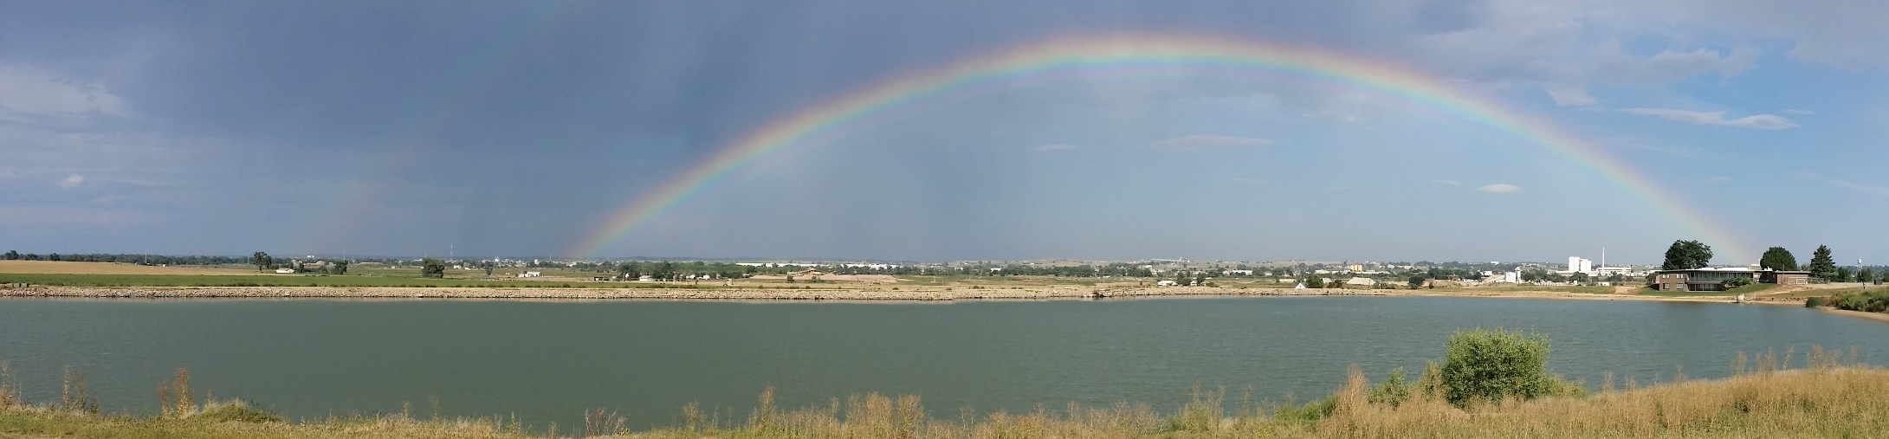
Sakata Farms, Brighton, CO
3,000 Irrigated Acres
11 miles north of Denver International Airport
2,000 Acres with senior surface water rights
300 Acres with only alluvial ground water rights
860 Acres with both groundwater and surface water
Presented by the Water Association of Kern County

Slide 3
Colorado Water Development History
1876: Article XVI of the Colorado Constitution set up water administration by prior appropriations: First in time first in Right
Hundreds of irrigation ditches were constructed between 1860-1890 along the
South Platte River: only small hand dug wells were of little concern
Alluvial wells were drilled in the early 1900’s and after the droughts in the
1930’s and 1950’s were even encouraged to be drilled as an alternative to
surface water.
In 1965 the Colorado Legislature voted to NOT allow new wells and required
alluvial well owners to comply with the Doctrine of Prior Appropriations
From 1968 to 2001 farmers argued that they should be not be included in surface water administration

Slide 4
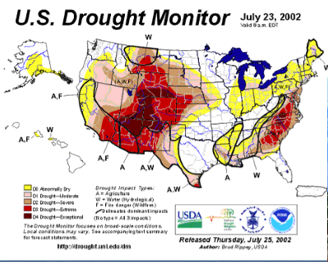
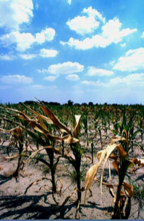
2003 the perfect Non-storm
1980-2000: twenty wettest recorded years in Colorado History
2002: Driest recorded year in over 300 years
2002: 85% of irrigated agricultures in Colorado impacted
2002: City of Aurora was down to a 6 month supply of water
Presented by the Water Association of Kern County

Slide 5
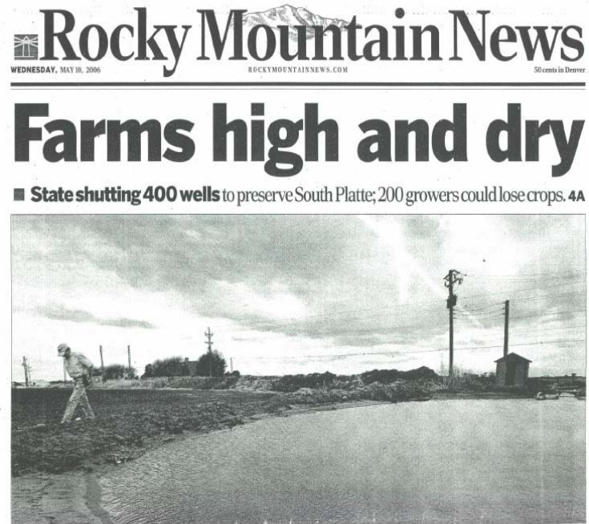
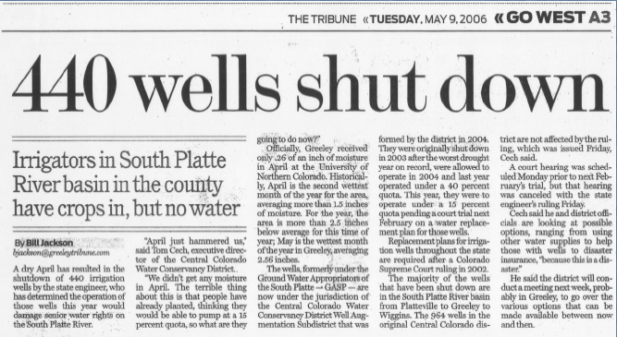
Presented by the Water Association of Kern County

Slide 6
2003 – Well Curtailment Begins
Approximately 3,000 wells are not allowed to pump – Decision of the
Colorado State Engineer (Division of Water Resources)
Decision reached to comply with the Doctrine of Prior Appropriation
No Compensation to well owners
Lawsuits begin, some well owners pump illegally
Initial public meeting with the governor of Colorado, draws over 700 ag producers
Growers scramble to try and find surface water to augment their pumping
Cropping systems changed as land that relied on groundwater suddenly were dried vs land with surface water
Presented by the Water Association of Kern County

Slide 7
Administration of Groundwater different across the state
Alluvial vs Designated confined aquifer
Compact requirements with other states:
Arkansas River Irrigation Efficiency Rules
Since the South Platte River Basin well shut down in other river basins some water districts have been formed to prevent what happen in the S. Platte and are working to prevent the involuntary shut down of ground water wells:
San Luis Valley sub-district project
$75/acre foot pumped to fund projects to reduce water use
The Colorado State Engineers office administers water distribution
Under water decrees that have been approved through water court
Well decrees can be very expensive
Presented by the Water Association of Kern County

Slide 8
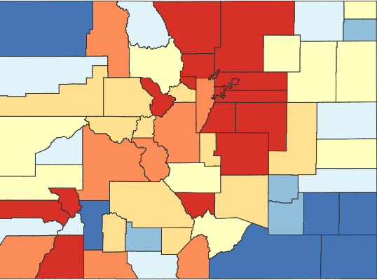
The Water Crisis
2017 Colorado population 5.68 million
8th fastest growth rate in U.S. (Denver Post)
Colorado Water Plan: 700,000 acres of irrigated farmland could be dried up
Presented by the Water Association of Kern County

Slide 9
Living with groundwater regulations today
Your augmentation plan determines how much water you can pump each season
This amount isn’t determined until Spring of the growing season
All wells have registered meters
They must be inspected once every three years
Most now have real time cellular telemetry
Monthly pumping reports must be submitted
Most surface water rights are now more valuable than groundwater
More predictable supply from year to year since most are senior water rights
Presented by the Water Association of Kern County

Slide 10
Living with groundwater regulations today
4,500 acres down to 3,000 acres
Total fresh vegetable production continuing to decrease
Lack of dependable water supplies
Food Safety water quality concerns with surface water
Grain crops and dryland crops production increases
100% fresh vegetables to now 30%
Land sold for development
Limited water efficiency measures implemented
Colorado water law based on Consumptive Use
Obligations for historic return flows
Presented by the Water Association of Kern County

Slide 11
Living with groundwater regulations today
South Platte River alluvial groundwater mapping restricts water transfer from well to well
Three strikes and you are out…FOREVER!!!
Wells now used sparingly only as a last resort on land that has surface water
Surface water supplies are diminishing
Exploration of Alternative Transfer Methods (ATMs)
Rotational Fallowing
Super Ditch
Deficit Irrigation
Ag Water Protection Water Right
Presented by the Water Association of Kern County

Slide 12
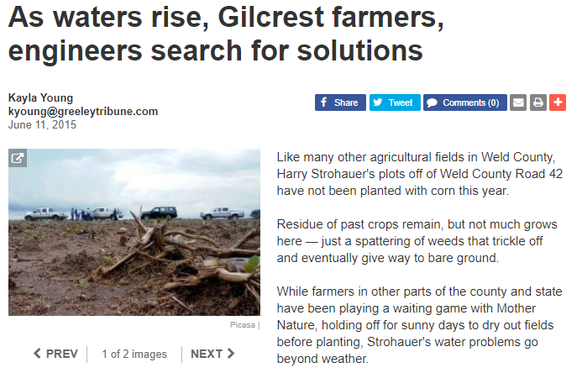
Living with groundwater regulations today
Construction of artificial recharge ponds to offset groundwater pumping
Damaging High Groundwater Levels
Presented by the Water Association of Kern County

Slide 13
Lessons Learned
Don’t stick your head in the sand and think they will never shut your well down
Find legislative solutions that bring all parties to the table and avoid water court
Special water districts
Be careful in designing and using artificial recharge basins
Become a water attorney or water engineer
Presented by the Water Association of Kern County

Slide 14
Online Resources
Water Education Colorado
https://www.yourwatercolorado.org/
Colorado Water Congress
http://www.cowatercongress.org/
Colorado Water Institute
http://www.cwi.colostate.edu/
Colorado Department of Natural Resources
https://cdnr.us/
Colorado Agriculture Water Alliance
https://www.coagwater.org/
THANK-YOU
Presented by the Water Association of Kern County

