Slide 1
Jim Mayer, CA Fwd
Kern Water Summit 3.7.18

Slide 9
Will CA be
first failed state?
Political gridlock
Red ink
State-local conflict

Slide 10
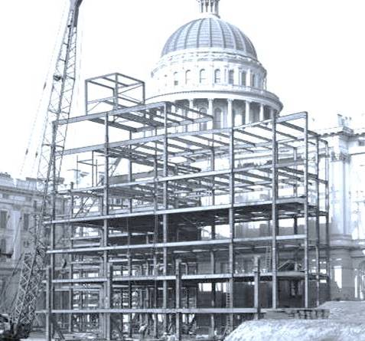
Democracy is a construction zone
Political reforms have eased gridlock
Fiscal reforms better manage volatile revenue
New state-local structures emerging

Slide 11
Better prepared for big challenges

Slide 12
Advanced Technology

Slide 13
Global Markets

Slide 14
Global Finance

Slide 15
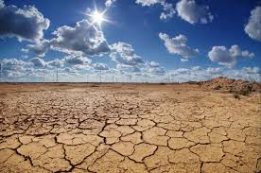
Climate Change

Slide 16
Changing Demographics

Slide 17
Growing Inequality

Slide 18
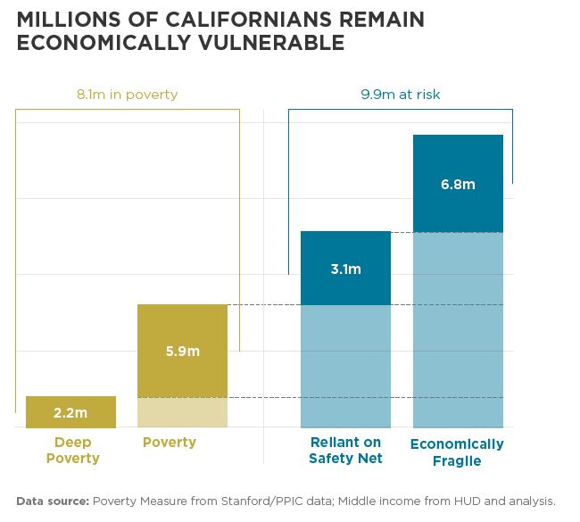

Slide 19
CA’s Poverty Problem
CA poverty rate—with housing costs included

Slide 20
Two Californias?
% below federal poverty

Slide 21
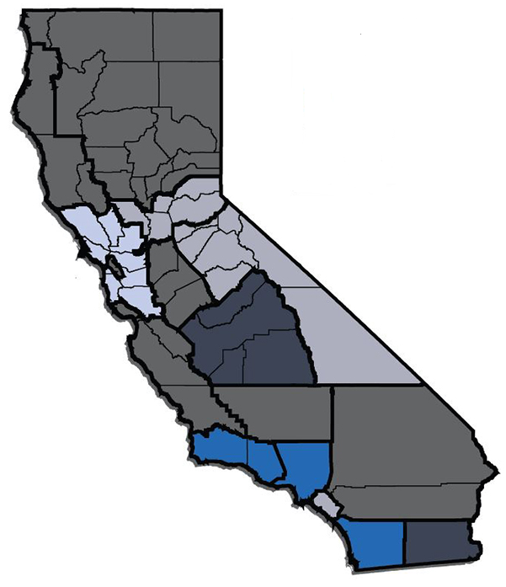
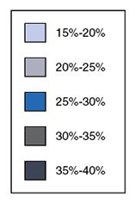
Missing median-wage jobs
Earning < $12.50 an hour

Slide 22
CA Economic Summit

Slide 23
CA Economic Summit
Planet
Profit
People

Slide 24
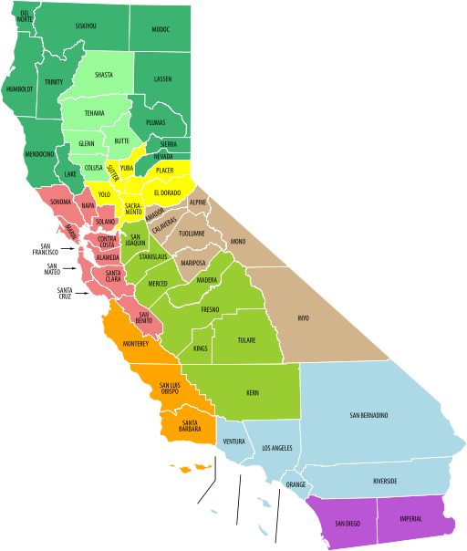
CA Economic Summit
Planet
Profit
People

Slide 25
CA Economic Summit
Planet
Profit
People

Slide 26
www.CAeconomy.org/endorse

Slide 27
253
Number of days to 2018 CA Economic Summit

Slide 28
One Million Challenges

Slide 29
Skilled Workforce Aligning education & employment
Strong Workforce Program: $200M steering $2B spending on CTE
Partnerships between industries and institutions
Technology to reach “stranded workers”

Slide 30
All of the Above Framework to reduce the cost and increase the supply of housing
2017 Roadmap to Shared Prosperity
Fiscal incentives to encourage housing near jobs and transit
Production incentives for eligible projects | Program incentives for affordable housing |  | Regulatory incentives to lower costs and accelerate development
Increased accountability to ensure local govts. contribute
Strengthen planning and regulatory statutes |  | Improve approval and permitting rules; increase enforcement

Slide 31
Water Encouraging Integrated Projects
Enhanced Infrastructure Financing Districts
Multiple agencies, multiple funding streams
Otay Mesa, West Sacramento… and LA River

Slide 32
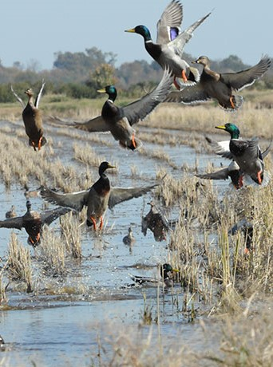
Water Encouraging Integrated Policies
Elevate economics of working landscapes
Develop tools to assess agricultural value
Document benefits of ecosystem services
Connect researchers and practitioners

Slide 33
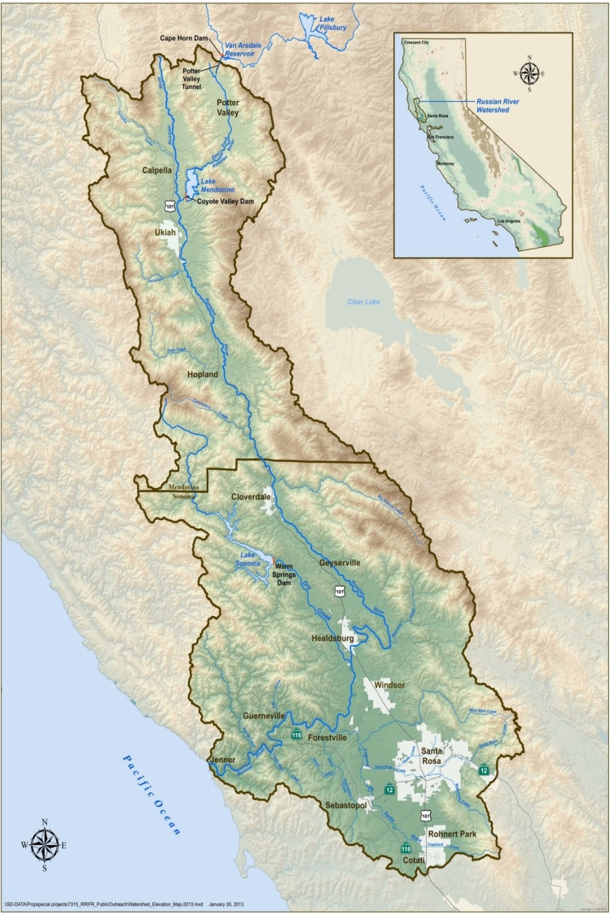
Water Encouraging Regional Innovations
Figure 1- - Russian River Watershed
Help the State help regions
Enable public partnerships
Curb regulatory barriers
Develop financing models

Slide 34
So how can we Elevate all of CA?
Equitable, Prosperous, Sustainable

Slide 35
Go forward knowing that you are greater than the challenges of your time. Leon Panetta

Slide 36
An Invitation
Participate: register at www.caeconomy.org
Sign up at CAFwd.org
Give me your ideas: Jim@cafwd.org

