Slide 1

2018 Kern County Water Summit
Wednesday, March 7, 2018
Bakersfield, California
YOUR GROUNDWATER RIGHTS versus SGMA
Roger K. Masuda, Attorney at Law
rmasuda@calwaterlaw.com
Griffith & Masuda,
A Professional Law Corporation
517 E. Olive Street,
Turlock, CA 95380
(209) 667-5501
www.calwaterlaw.com
Founded 1920
© 2019 Griffith & Masuda, A Professional Law Corporation

Slide 2
1. Introduction
Focus
Perceptions & Mental Filters
Key Ideas
Presented by the Water Association of Kern County

Slide 3

Everyone is Focusing on SGMA
And Not on SGMA’s Groundwater Rights Foundation
Presented by the Water Association of Kern County

Slide 4
Perceptions
Think about your existing worldview of SGMA and your groundwater rights.
As you are listening to this presentation, be aware that you normally filter new information to fit your worldview.
Presented by the Water Association of Kern County

Slide 5
The Whole Truth
Presented by the Water Association of Kern County

Slide 6

The “Legal Pheonix” Truth
Presented by the Water Association of Kern County

Slide 7
Presented by the Water Association of Kern County

Slide 8
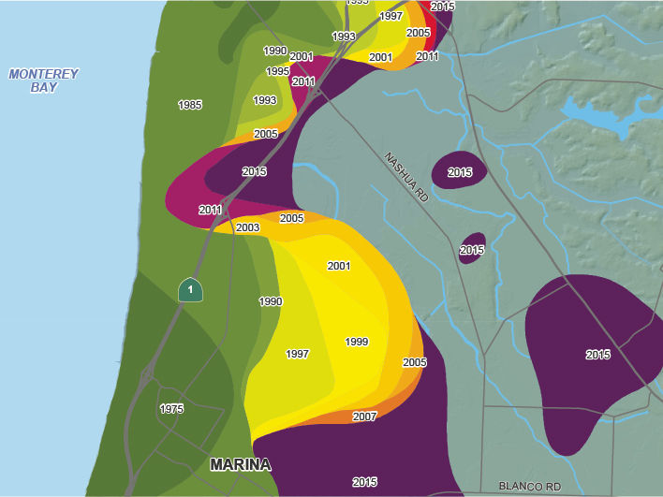
Reference: Official Monterey County Seawater Intrusion Map for 400 foot aquifer, October 2017
Presented by the Water Association of Kern County

Slide 9
Marina
Source: Preliminary Interpretation of SkyTEM Data Acquired in the Marina Coast Water District by Ian Gottschalk and Rosemary Knight June 16, 2016 Page 15 figure 10 ; see video explaining this Airborne Electromagnetic survey at www.mcwd.org.
Presented by the Water Association of Kern County

Slide 10
Airborne Electromagnetic (AEM)
groundwater profile
Monterey County seawater intrusion map
Presented by the Water Association of Kern County

Slide 11
Key Ideas
Location, Location, Location
Groundwater is very subbasin specific and fact specific. Don’t get lazy and assume that you
are protected by some general groundwater rule you hear about here or elsewhere.
Documentation/Proof
You have no groundwater rights if you don’t measure and
If you can’t document what you have pumped.
The “Whole Truth”?
Presented by the Water Association of Kern County

Slide 12
2. Your DWR Basin or Subbasin
Presented by the Water Association of Kern County

Slide 13
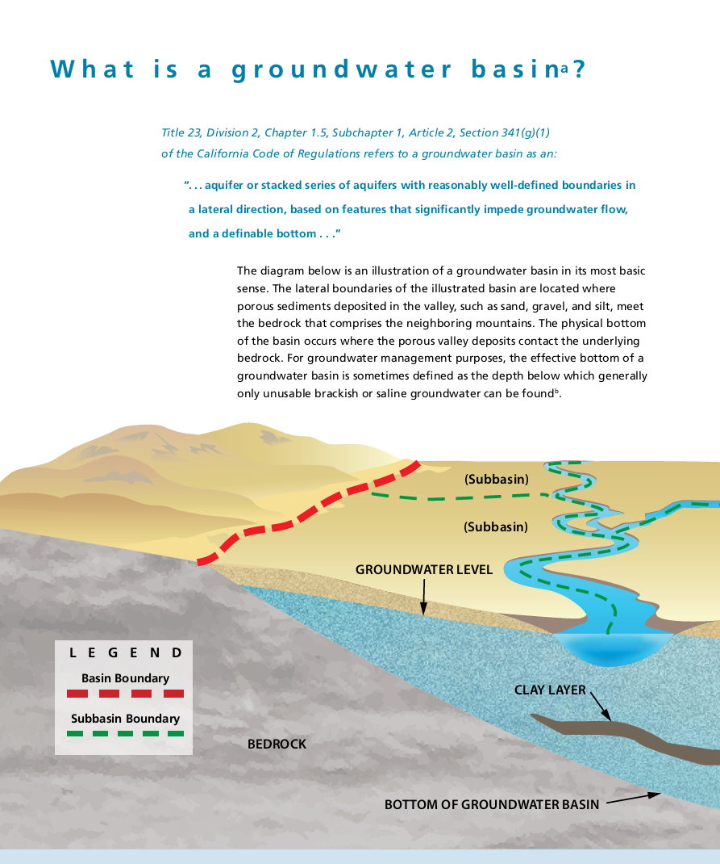
Typical textbook depiction.
Don’t assume that your subbasin looks anything like this.
Presented by the Water Association of Kern County
Reference: California’s Groundwater Bulletin 118 Interim Update 2016 page 4

Slide 14
In SGMA
BASIN = SUBBASIN
Presented by the Water Association of Kern County

Slide 15
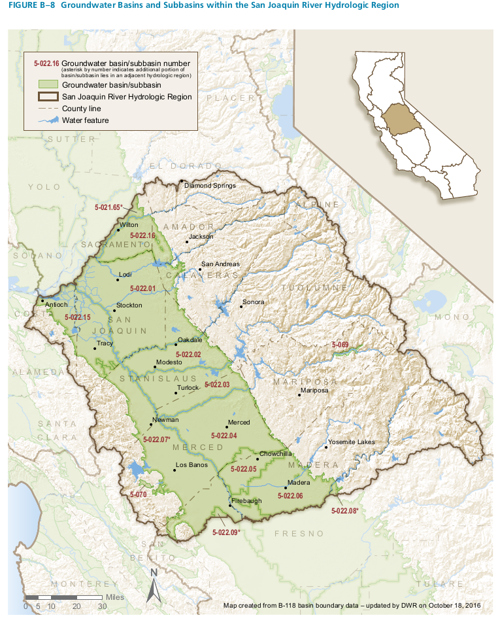
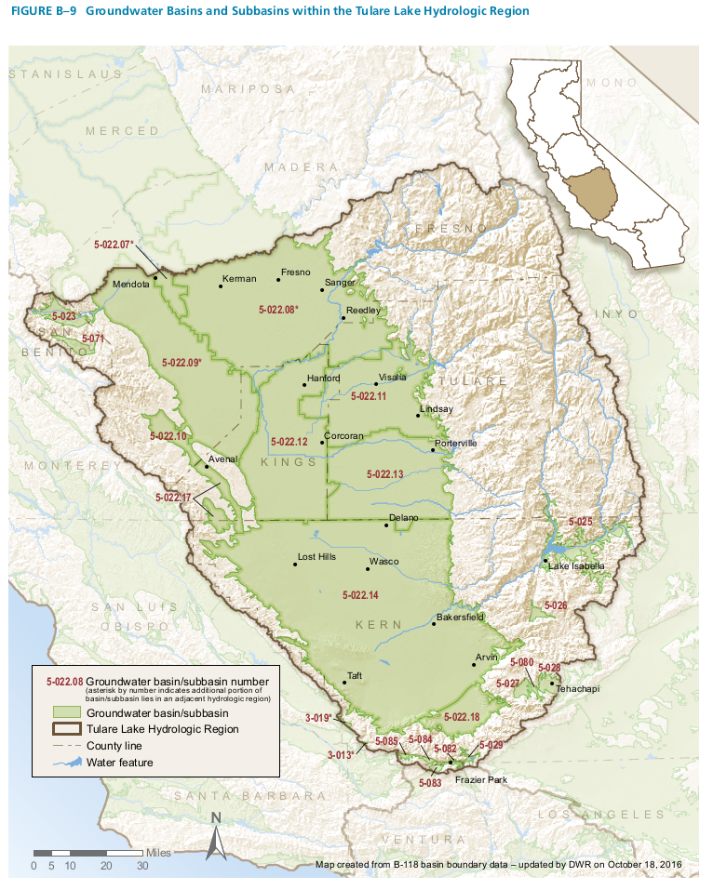
Presented by the Water Association of Kern County
Reference: California’s Groundwater Bulletin 118 Interim Update 2016 page 41 and 42

Slide 16
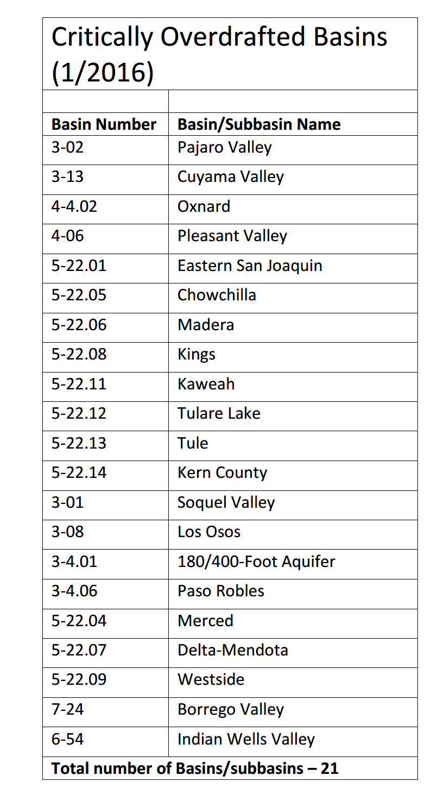
Presented by the Water Association of Kern County
Notes:
Discuss Merced subbasin – El Nido v Stevinson

Slide 17
3. Types of Groundwater Rights
Presented by the Water Association of Kern County

Slide 18
TYPES OF GROUNDWATER RIGHTS
3.1. Pueblo Groundwater Rights.
The most senior groundwater right.
Only the Cities of Los Angeles and San Diego currently have adjudicated Spanish/Mexican pueblo water rights.
3.2. Federal Reserved Groundwater Rights for a Military Reservation, National Park or Forest, or Native American Reservation. Agua Caliente Band of Cahuilla Indians v. Coachella Valley Water District.
If groundwater was envisioned as necessary for the reservation’s primary purpose at the time the reservation was created, the reservation has a groundwater right as of the creation date.
Preempts conflicting California law.
3.3. Surface Water Importer – The Right to Recapture Imported Water.
The right to recapture the net amount of groundwater recharge resulting from the imported water.
Amount or percentage of the groundwater resulting from imported surface water v. native groundwater.
Presented by the Water Association of Kern County

Slide 19
TYPES OF GROUNDWATER RIGHTS
3.4. Overlying User.
The right to pump water from the ground underneath your land for use on land within the subbasin.
The right is based on your ownership of the land.
As between overlying users, the rights are correlative (like with riparian surface water right holders). If groundwater quantity is insufficient, each overlying user is limited to the pumper’s proportionate fair share of the total amount available for the pumper’s reasonable and beneficial uses.
Historically the proportionate share of each owner is based not on the pumper’s past use, nor on the date pumping was commenced, but solely on the pumper’s current reasonable and beneficial needs for groundwater.
3.5. Appropriator.
The use of water for non-overlying purposes such as exportation to lands outside the subbasin or for water district or municipal use within the subbasin.
Unlike the correlative rights among overlying pumpers, appropriative rights like appropriative surface water rights are based upon the principle of “first in time means first in right.”
Presented by the Water Association of Kern County

Slide 20
TYPES OF GROUNDWATER RIGHTS
Prescriptive Appropriative Groundwater Rights Against Overlyers and Other Appropriators:
When a subbasin is in overdraft, there is no surplus water available to acquire or enlarge appropriative rights.
Pumping by an appropriator prescripts (or trespasses) against senior overlyer and appropriative rights if the adverse pumping lasts for at least 5 consecutive years when the subbasin is in overdraft.
Public and private appropriators can obtain prescriptive rights against private overlying users and private appropriators, but private appropriators cannot obtain prescriptive rights against public appropriators.
SGMA Water Code Section 10720.5(a) provides that in subbasins designated medium- or high-priority by DWR, no extraction of groundwater between Jan. 1, 2015, and the date of adoption of a groundwater sustainability plan for the subbasin may be used as evidence of, or to establish or defend against, any claim of prescription.
3.6. Untapped/Dormant Groundwater Rights.
If you fail to exercise your overlying groundwater rights by not drilling a well on your land, then in any groundwater adjudication by a court or extraction limit imposed by your GSA, your rights could be substantially curtailed.
Presented by the Water Association of Kern County

Slide 21
4. Groundwater Rights Priorities
Presented by the Water Association of Kern County

Slide 22
GROUNDWATER RIGHTS PRIORITIES within an Overdrafted Subbasin/Basin
The table does not address Pueblo rights or Federal reserved groundwater rights.
A pumper’s actual legal priority as to each right will depend upon LOCATION and DOCUMENTATION/PROOF.
© Griffith & Masuda – Provided for informational purposes only, not as legal advice. (Revised 6/9/2017)
Most Junior Right | Untapped/Dormant Appropriator
 | Untapped/Dormant Overlyer
 | Junior Appropriator (2nd in Time = 2nd in Right)
 | Senior Appropriator (1st in Time = 1st in Right)
 | Overlyer and Prescripting Appropriator
Most Senior Right | Surface Water Importer
Presented by the Water Association of Kern County

Slide 23
Presented by the Water Association of Kern County

Slide 24
Presented by the Water Association of Kern County

Slide 25
HYPOTHETICAL SAN JOAQUIN VALLEY SUBBASIN
Surface Water Importer and Overlyers
Surface Water Importer:
Irrigation District brings surface water into area where it would normally not have reached the groundwater but for the irrigation district’s constructed irrigation system.
Overlyers:
Right is based on the ownership of land and the use of underlying groundwater on that land. Possible question as to Pump #8, where well and overlying land is jointly owned by Farm A and Farm F. Contrast with Farm D’s grapes located outside of subbasin.
Rights are correlative, meaning in times of overdraft each overlying pumper is limited to its proportionate fair share of the water that is physically available.
Right not based upon the date you started pumping. Farm C (2017) has the same “priority” as Farm A (1935).
Right not based upon your past pumping but your past pumping is an important factor in determining your proportionate fair share.
Right is senior to Appropriators and Untapped/Dormant Overlyers.
Presented by the Water Association of Kern County

Slide 26
Presented by the Water Association of Kern County

Slide 27
HYPOTHETICAL SAN JOAQUIN VALLEY SUBBASIN
Appropriators and Prescription
Appropriators:
Groundwater pumped by a water district or a city for non-overlying uses. Exception would be where city has a well on city park lands used to irrigate the park, thereby constituting an overlying use.
Irrigation District Well Pump #9 (1935) – Even though one of the oldest right in the Example, it is junior to all Overlyers except to the extent its recovering Imported Surface Water or has prescripted against Overlyers.
City X (1940), City Y (1950), and City Y (1960), but note that cities normally build up pumping rate over time as the city grows thereby potentially prescripting against Overlyers.
Water delivered to Farm D’s grapes (1983) is an appropriated use because in-subbasin water is exported for use outside of the subbasin and is the most junior appropriator.
Presented by the Water Association of Kern County

Slide 28
Presented by the Water Association of Kern County

Slide 29
HYPOTHETICAL SAN JOAQUIN VALLEY SUBBASIN
Untapped/Dormant Rights, Groundwater Dependent Ecosystems, and Interconnected Surface Water
Untapped/Dormant Rights:
Farm E dry farms and does not a pump or a surface water supply.
Farm F has no well on the farm, but relies on surface water from the irrigation district and groundwater water from a jointly owned well and an irrigation district well.
If you don’t drill a well on a parcel, then your dormant overlying right could be substantially curtained in a groundwater adjudication or by your GSA.
Groundwater Dependent Ecosystems (GDEs):
• GDEs are ecosystems that rely upon groundwater for their continued existence, e.g., vernal pools and wetlands.
• Groundwater pumping lowers the water table level upon which the GDE depends.
Interconnected Surface Water:
6th Undesirable Result. SWRCB staff has indicated that this could be used by the SWRCB to regulate both stream flows and groundwater pumping within a subbasin.
Presented by the Water Association of Kern County

Slide 30
Presented by the Water Association of Kern County

Slide 31
5. SGMA and Your Groundwater Rights
Presented by the Water Association of Kern County

Slide 32
SGMA by and large does not significantly alter groundwater rights law,
but more importantly, SGMA subjects groundwater extractions and pumpers to much greater regulation.
Presented by the Water Association of Kern County

Slide 33
SGMA & YOUR GROUNDWATER RIGHTS
Summary of Water Code Section 10720.5:
(a) Groundwater management under SGMA requires that all groundwater must be used reasonably and beneficially. Nothing in SGMA is intended to modify rights or priorities to use or store groundwater for reasonable and beneficial purposes, “except that in basins designated medium- or high-priority basins by the department, no extraction of groundwater between January 1, 2015, and the date of adoption of a groundwater sustainability plan pursuant to this part . . ., whichever is sooner, may be used as evidence of, or to establish or defend against, any claim of prescription.”
(b) Nothing in this part, or in any groundwater management plan adopted pursuant to this part, determines or alters surface water rights or groundwater rights under common law or any provision of law that determines or grants surface water rights [EXCEPT prescriptive rights in (a) above and UNLESS groundwater pumping has “significant and unreasonable adverse impacts on beneficial uses of [interconnected] surface water,” e.g., salmon habitat or groundwater dependent ecosystems].
(c) Water rights may be determined in an adjudication action pursuant to Chapter 7 (commencing with Section 830) of Title 10 of Part 2 of the Code of Civil Procedure.
Presented by the Water Association of Kern County

Slide 34
SGMA & YOUR GROUNDWATER RIGHTS
Water Code Section 10726.8(b) states in part, “Nothing in this part shall be construed as authorizing a local agency to make a binding determination of the water rights of any person or entity.” BUT, under SGMA, your GSA is granted many powers to regulate your groundwater extractions, including but not limited to the following:
❖ Inspect your land and your pumping facilities to monitor your compliance and for enforcement purposes. If you refuse access, the GSA can obtain an inspection warrant.
❖ Require you to register each of your wells with the GSA.
❖ Require you to purchase and install at your expense a water meter satisfactory to your GSA for each well.
❖ Require you at your expense to periodically calibrate each water meter.
❖ Require you to file an annual statement with the GSA reporting the total extractions in acre-feet from each of your wells during the preceding water year (October 1 through September 30).
Presented by the Water Association of Kern County

Slide 35
SGMA & YOUR GROUNDWATER RIGHTS
Regulate, limit or suspend extractions from your individual wells. BUT “A limitation on extractions by a groundwater sustainability agency shall not be construed to be a final determination of rights to extract groundwater from the basin or any portion of the basin.”
❖ Impose a civil penalty for pumping more than you are authorized by the GSA and for violating any GSA rule, regulation, ordinance or resolution.
❖ Impose regulatory fees to fund a groundwater sustainability program, including paying for the cost to prepare, adopt, and amend a groundwater sustainability plan, and the cost of investigations, inspections, compliance assistance, enforcement, and program administration, including a prudent reserve, without the need to comply with Proposition 218.
❖ Impose fees to pay for projects, such as groundwater recharge projects, which fees are subject to Prop 218.
Presented by the Water Association of Kern County

Slide 36
6. How Groundwater Rights are Determined
[or Unfortunately Numbers are
Very Important]
Presented by the Water Association of Kern County

Slide 37
By an Out-of-County Judge in a Groundwater Adjudication or
By Your GSA for all practical purposes using its SGMA Powers and its Groundwater Sustainability Plan
Presented by the Water Association of Kern County

Slide 38
DOCUMENTING AND PROVING
YOUR GROUNDWATER RIGHTS
Using Code of Civil Procedure §842 for Groundwater Adjudications as a checklist:
(a) Except as otherwise stipulated by the parties or ordered by the court, within six months of appearing in a comprehensive adjudication, a party shall serve on the other parties and the special master, if one is appointed, an initial disclosure that includes all of the following information:
❑ (1) The name, address, telephone number, and email address of the party and, if applicable, the party’s attorney.
❑ (2) The quantity of any groundwater extracted from the [sub]basin by the party and the method of measurement used by the party or the party’s predecessor in interest for each of the previous 10 years preceding the filing of the complaint.
❑ (3) The type of water right or rights claimed by the party for the extraction of groundwater.
❑ (4) A general description of the purpose to which the groundwater has been put.
❑ (5) The location of each well or other source through which groundwater has been extracted.
❑ (6) The area in which the groundwater has been used.
Presented by the Water Association of Kern County

Slide 39
DOCUMENTING AND PROVING
YOUR GROUNDWATER RIGHTS
❑ (7) Any claims for increased or future use of groundwater.
❑ (8) The quantity of any beneficial use of any alternative water use that the party claims as its use of groundwater under any applicable law, including, but not limited to, Section 1005.1, 1005.2, or 1005.4 of the Water Code.
❑ (9) Identification of all surface water rights and contracts that the party claims provides the basis for its water right claims in the comprehensive adjudication.
❑ (10) The quantity of any replenishment of water to the basin that augmented the basin’s native water supply, resulting from the intentional storage of imported or non-native water in the basin, managed recharge of surface water, or return flows resulting from the use of imported water or non-native water on lands overlying the basin by the party, or the party’s representative or agent, during each of the 10 calendar years immediately preceding the filing of the complaint.
❑ (11) The names, addresses, telephone numbers, and email addresses of all persons possessing information that supports the party’s disclosures.
❑ (12) Any other facts that tend to prove the party’s claimed water right.
(Emphasis added.)
Presented by the Water Association of Kern County

Slide 40
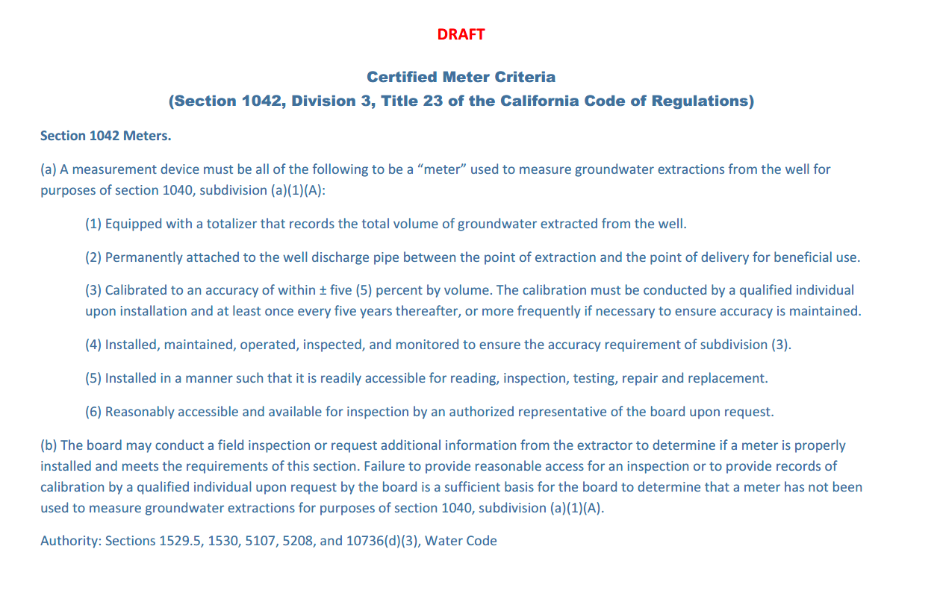
Presented by the Water Association of Kern County
Reference: https://www.waterboards.ca.gov/water_issues/programs/gmp/docs/reporting/guide17.pdf

Slide 41
7. Groundwater Credits for Using Surface Water In-Lieu of Pumping Groundwater
Presented by the Water Association of Kern County

Slide 42
GROUNDWATER CREDITS FOR USING SURFACE WATER IN LIEU OF PUMPING GROUNDWATER
[Statute Assumes Groundwater is your Primary Water Source]
Water Code Section 1005.4 summarized:
(a) If you cease or reduce your pumping by instead using surface water or groundwater from a nontributary source, the amount of groundwater not pumped is a reasonable beneficial use of your groundwater. No lapse, reduction or loss of your right to pump groundwater shall occur under such conditions. The is generally referred to as “in lieu groundwater recharge.”
(b) If you want to claim a groundwater credit for not pumping because you used from an alternative source, you should report to the SWRCB on or before December 31st of each calendar year, on the required form, the amount of your reduced pumping as a result of instead using water from the alternative source during the next preceding water year (October 1st to September 30th). The section states that “failure to file such a statement shall in no way affect the right of a user to claim the benefit of this section” but it is prudent to do so when applicable.
(c) This section applies to every county, except the Counties of San Luis Obispo, Santa Barbara, Ventura, Los Angeles, Orange, San Diego, Imperial, Riverside, and San Bernardino.
(d) “nontributary source” includes [1] water imported from another watershed or [2] water conserved and saved in the watershed by a water conservation plan or works without which such water of the same watershed [2a] would have wasted, or [2b] would not have reached the underground source of supply of the owner relying upon this section.
Presented by the Water Association of Kern County

Slide 43
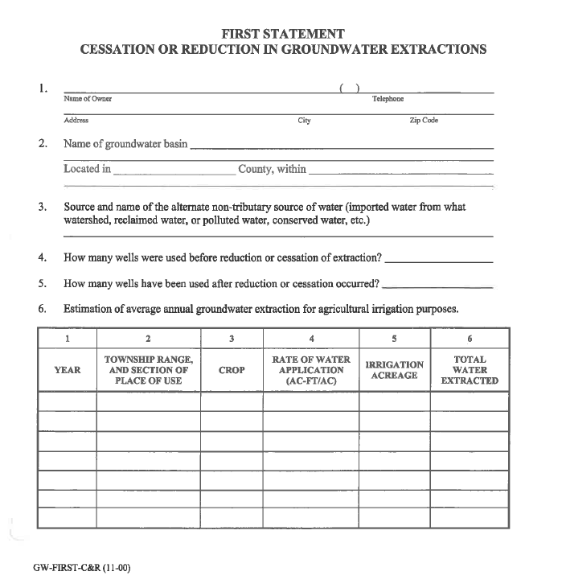
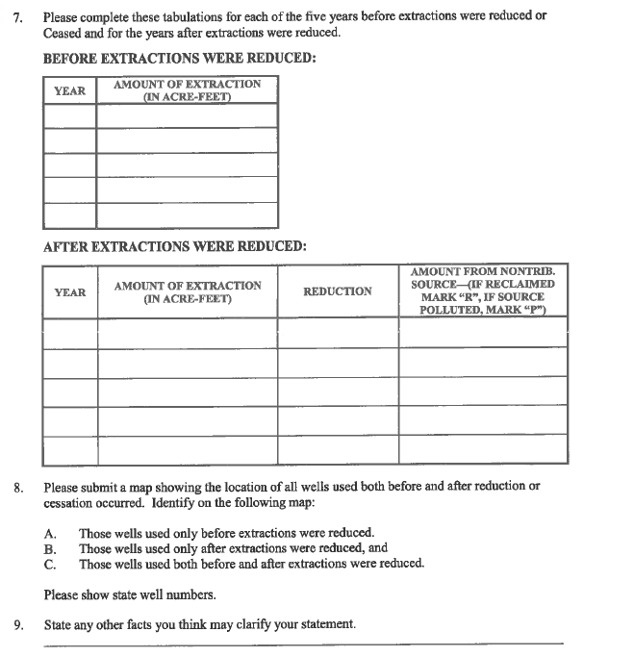
Presented by the Water Association of Kern County

Slide 44
QUESTIONS?
Presented by the Water Association of Kern County

