Slide 1

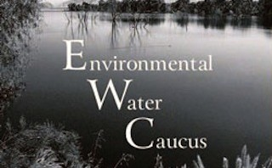
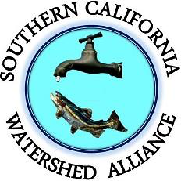
2018 KERN COUNTY WATER SUMMIT

Slide 2
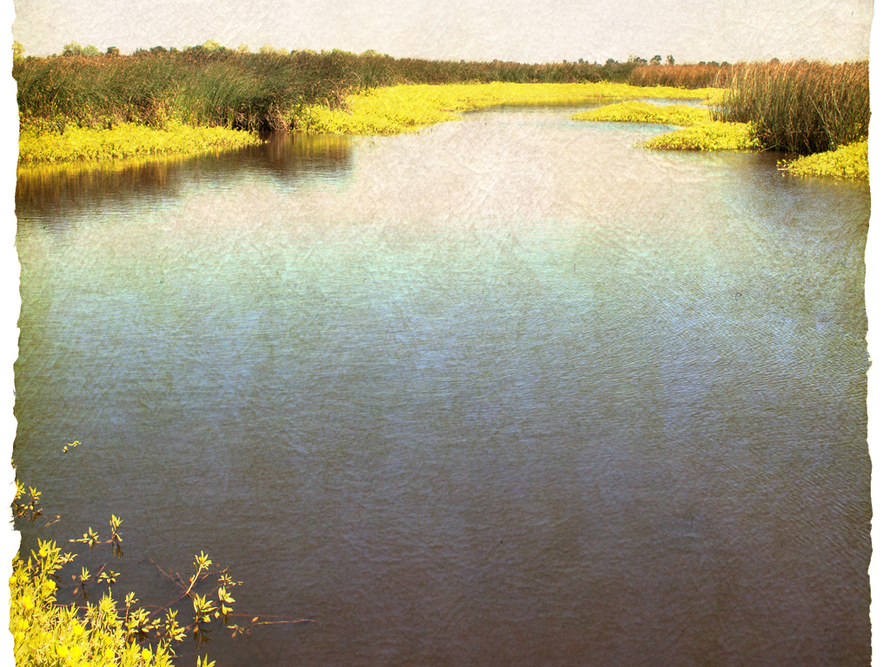



Who We Are
WHO WE ARE
CONNER EVERTS
Facilitator:
Environmental Water Caucus
Executive Director:
Southern California Watershed Alliance
Connere@gmail.com
(310) 804-6615
BARBARA BARRIGAN-PARRILLA
Executive Director:
Restore the Delta
Barbara@RestoretheDelta.org
(209) 475-9550
Barbara Barrigan-Parrilla
Executive Director
Barbara@RestoretheDelta.org
(209) 479-9550

Slide 3
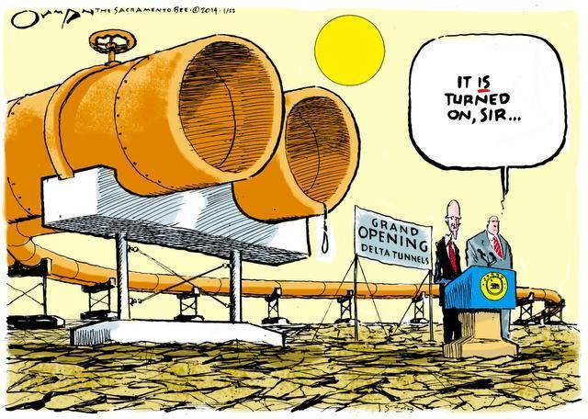
Notes:
As of today, California WaterFix has only modeled water availability with climate change through 2025. USGS said 40% reduction in Delta watershed runoff.

Slide 4
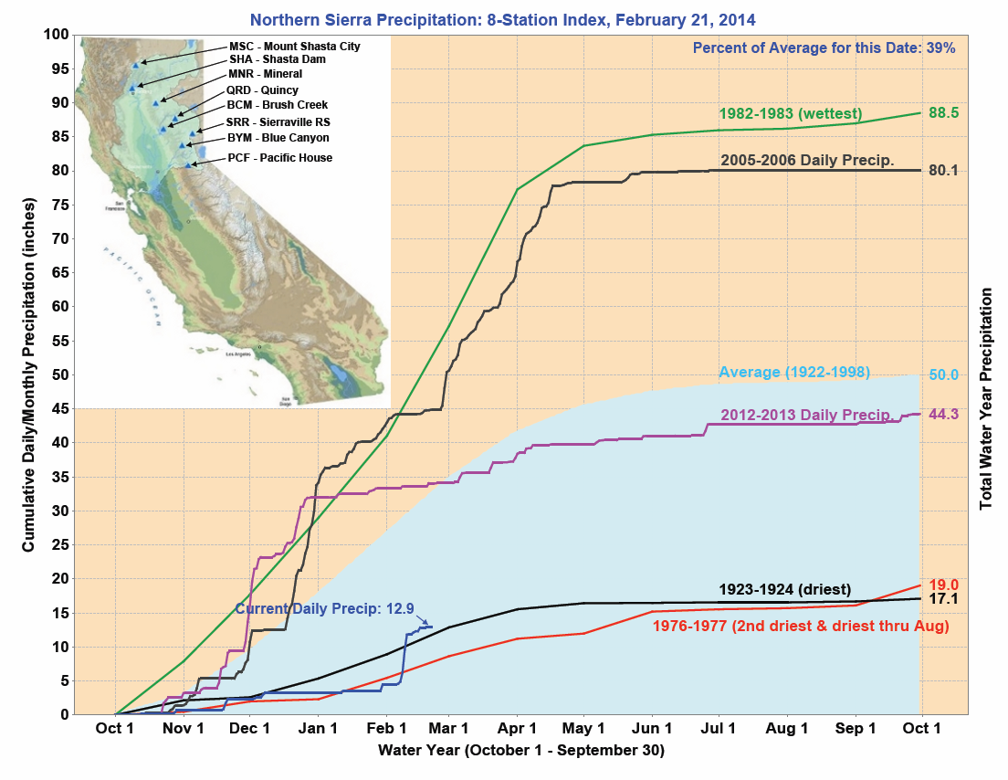

Slide 5
Preparing for Drought: Conservation, Storage, and Regional Water Supplies
Source: City of Los Angeles

Slide 6
California’s Water Future
Source: Delta Stewardship Council 2012

Slide 7
Water Use in California
Source: Delta Stewardship Council 2012
Notes:
Ag accounted for 77% of human water use in CA in 2005 - DSC

Slide 8
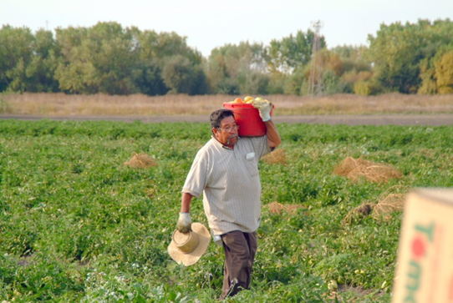
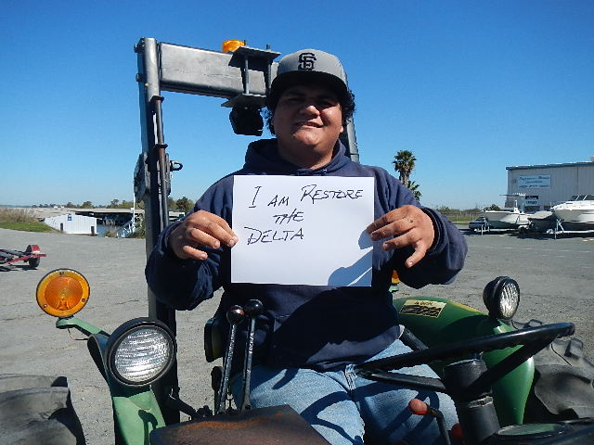
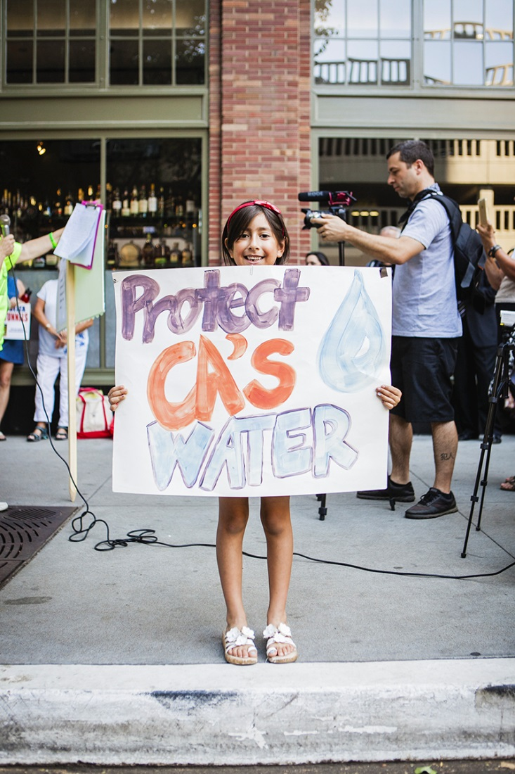
The Delta has 4 million residents. With warmer water temperatures and less runoff into the Delta watershed, health and human safety regulations will become more stringent. This will also reduce water export levels.
Notes:
CA WaterFix adaptive management doesn’t take into account the impacts of toxic algal blooms on health and human safety for Delta residents. Water exporters aren’t just going to have to deal with fish regulations.

Slide 9
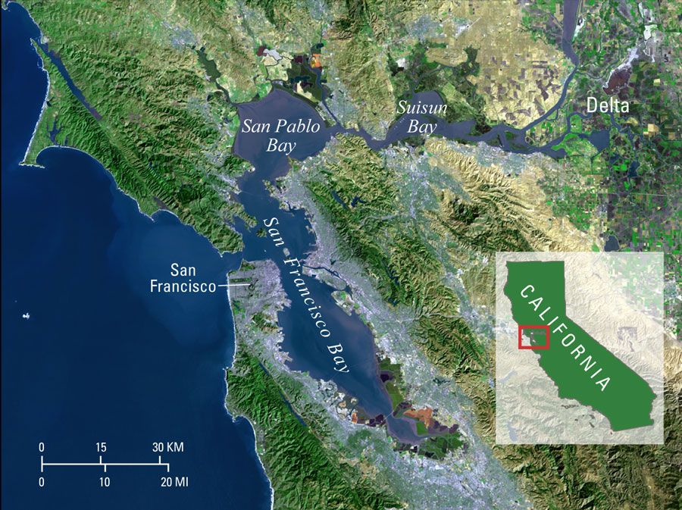
Notes:
One of the major flaws with CA WaterFix is state’s cost-benefit analysis. This analysis has never taken into account the value of fresh water to Bay-Delta tourism, fishing, recreation, and other economic uses.
Water to the ocean is not wasted. It supports fishing economy to Monterey and Washington state.
Protestants will insure the cost-benefit analysis happens.
The value of this Bay-Delta region economy will very likely result in regulations favorable to the Delta because of its powerhouse economy.

Slide 10


WHAT DELTA
SMELT TELLS US
The Delta smelt is the indicator species for the Delta, a “canary in the coalmine.” Only two Delta smelt were identified in the state's last fish survey--the lowest count in 50 years.
The Delta smelt is a native species. They’re endemic to the upper San Francisco Estuary, the upper Sacramento-San Joaquin Delta & Mossdale in the San Joaquin River and Suisun Bay.
While there are problems with water quality, discharge, predation, and invasive species, all problems are exacerbated with unsustainable levels of exports.
Notes:
Delta water use level for agriculture has remained flat or slightly reduced in last 100 years.

Slide 11
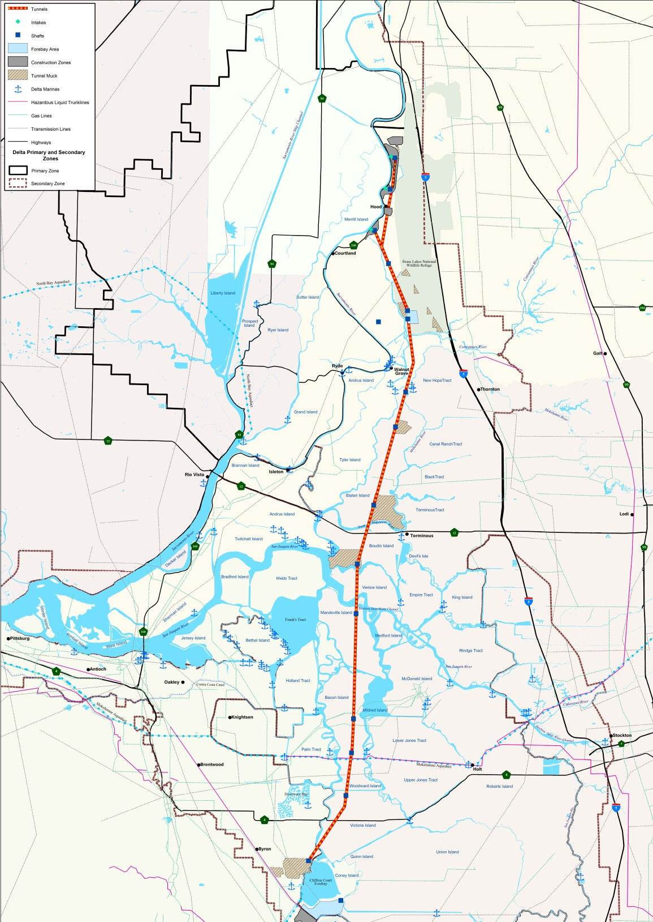
Notes:
We admit this is a dated map. Alignment for tunnels jets a bit more east. We just wanted to remind audience that tunnel construction and impacts will waste California’s largest strip of prime farmland. People have farmed in the river delta historically because of good soil, access to water, and moderate temperatures. Climate change impacts will not be experienced the same way in the Delta as they will in the San Joaquin Valley.

Slide 12
Water Exports from California’s Bay-Delta Estuary – Then and Now

Slide 13
DELTA TUNNELS COSTS:
Cost: $17 billion = 2 tunnels now/$11 billion = 1 big tunnel (phased in project)
Real cost: At least triple the initial capital cost (operations, interest, cost over runs)
Dr. Jeff Michael of University of Pacific said in his recent Valley Economy blog, “90% of the project will have to be paid for by urban ratepayers.”
Constitutional questions if water can be resold to farmers
Notes:
Delta water use level for agriculture has remained flat or slightly reduced in last 100 years.

Slide 14
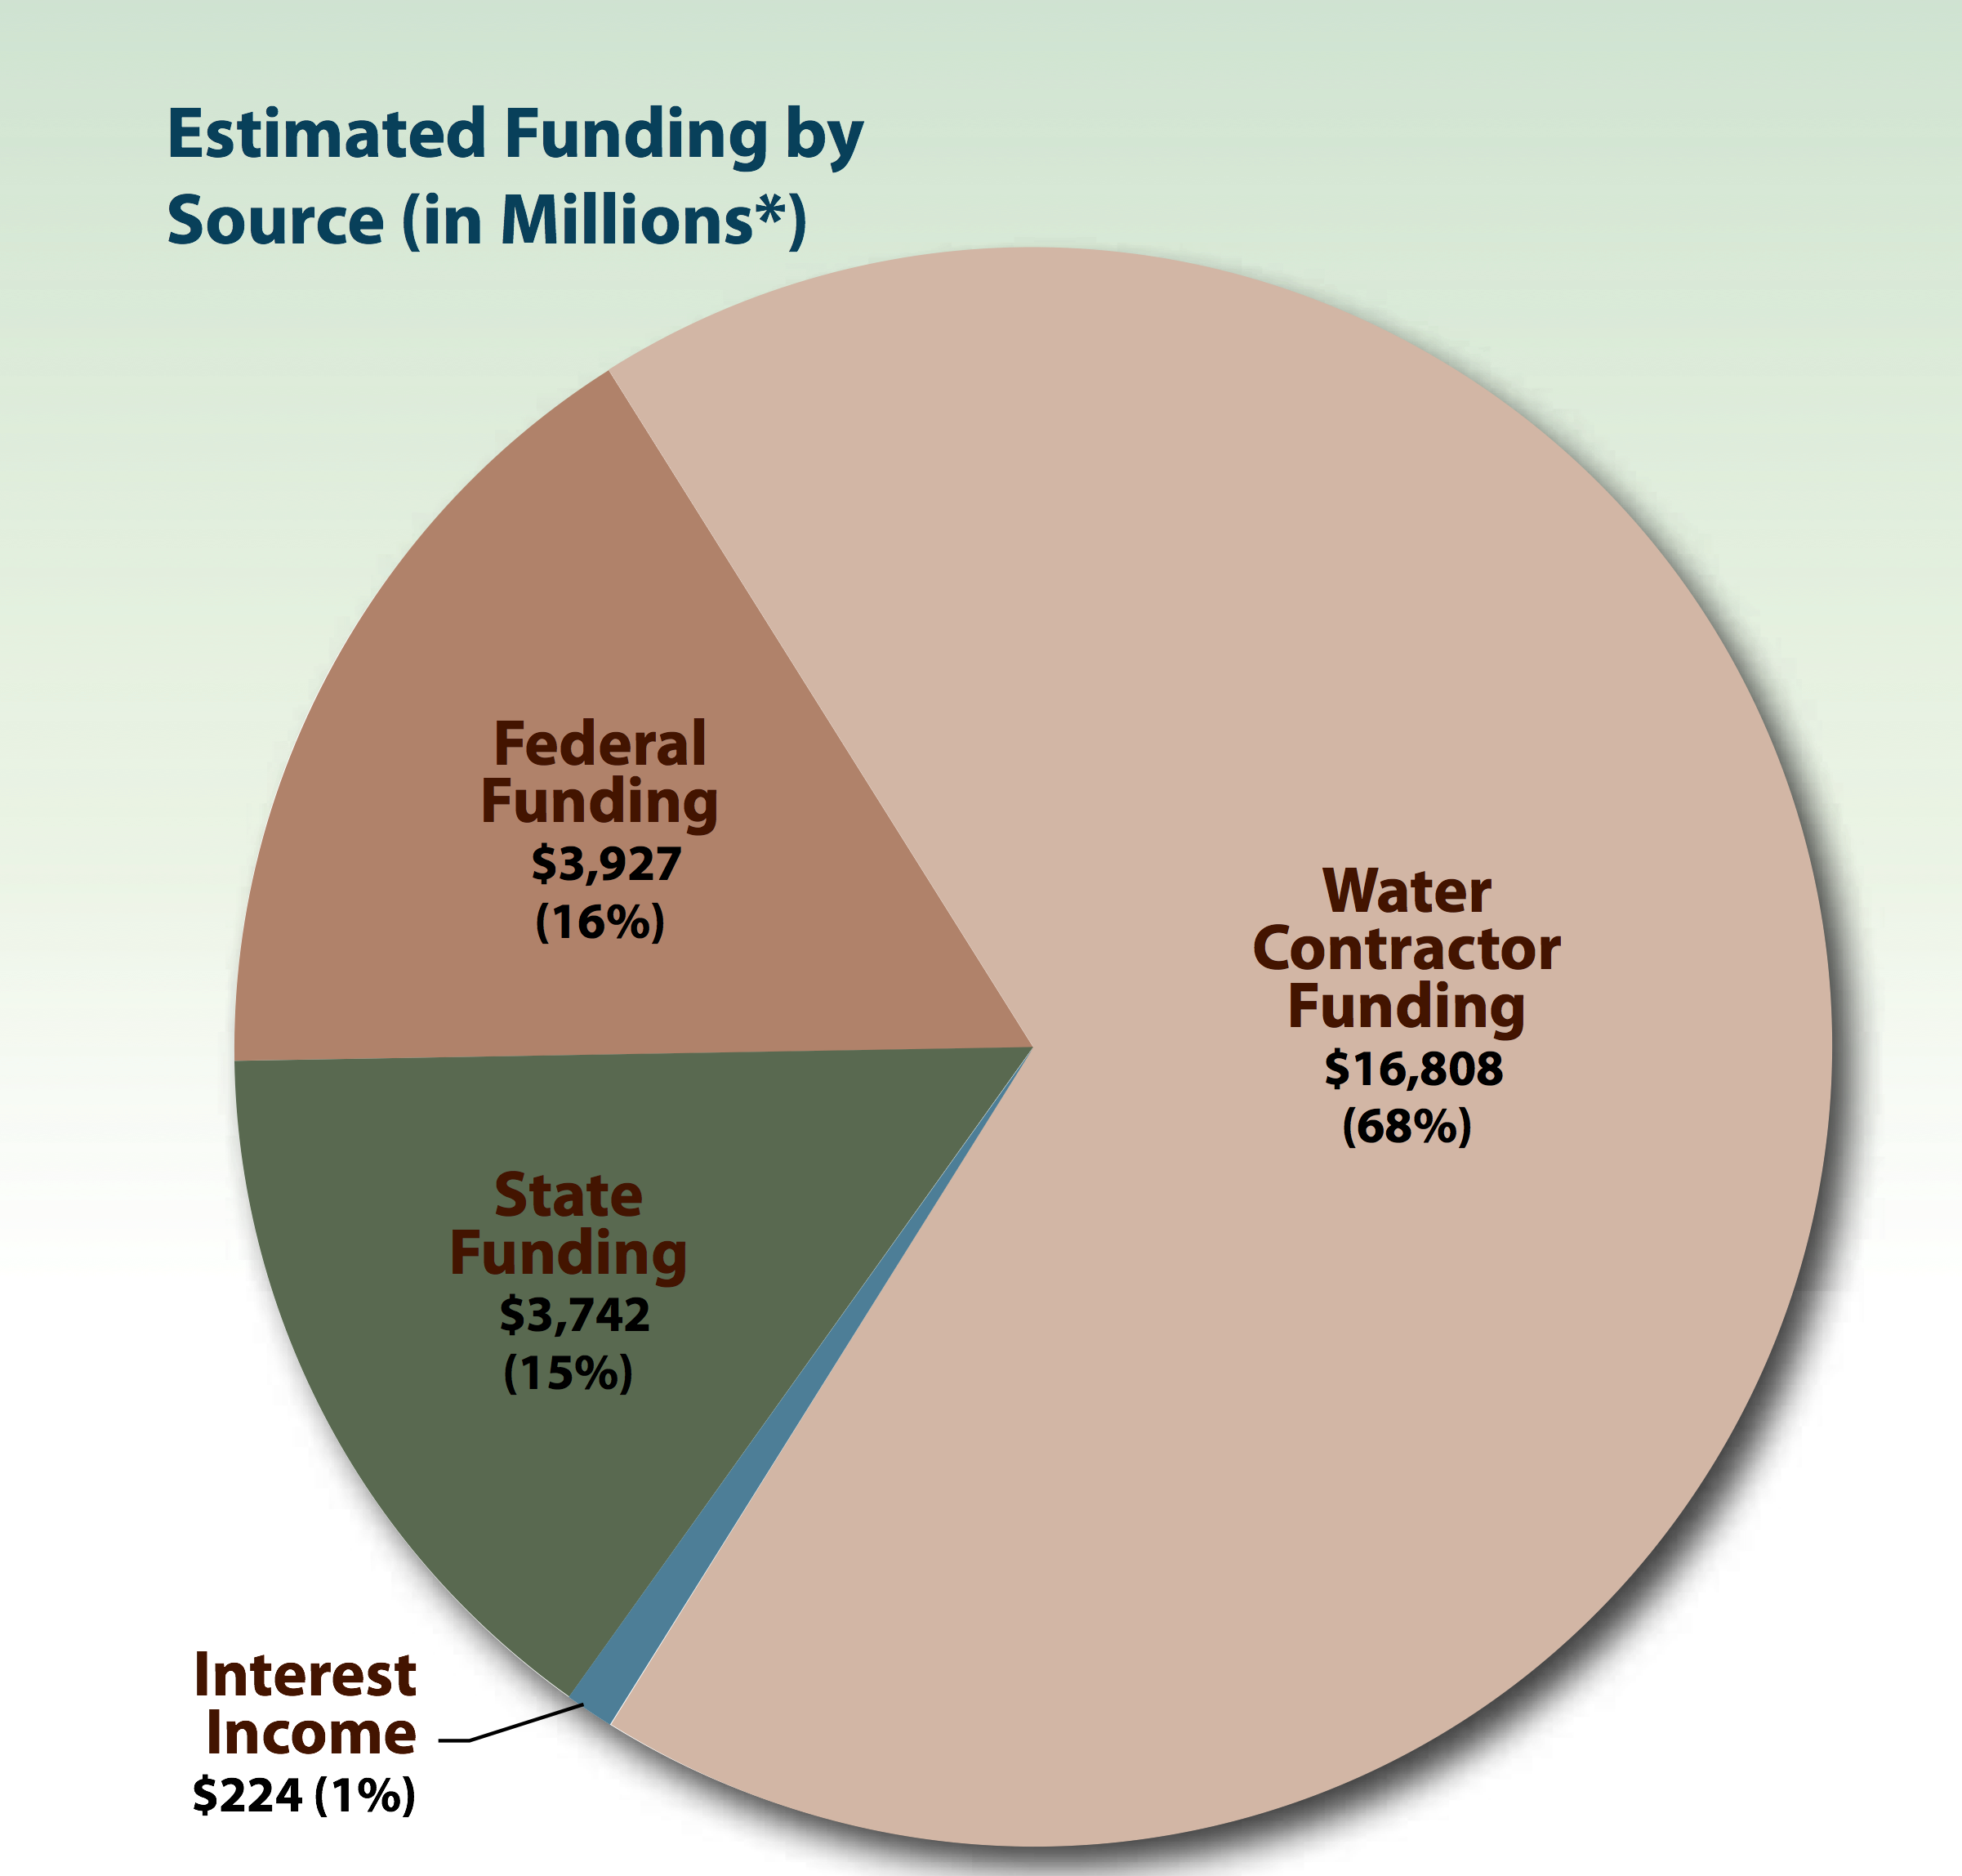
State’s Estimated Funding Sources

Slide 15
ON URBAN RATEPAYERS:
Rate increase of hundreds of dollars per year over 100 years for urban water ratepayers
Increases of property taxes for SoCal Communities
No increase in supply reliability
Fish regulations will not disappear; clean water regulations to protect Delta residents will become more intense
Increased dependence on the Delta

Slide 16
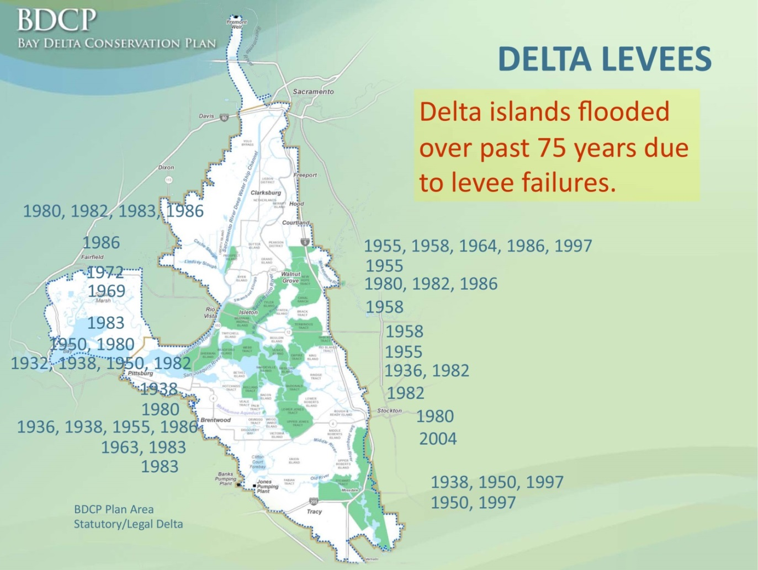
MYTH & REALITIES:
LEVEES
This slide by Delta Tunnels proponents is badly misleading. The threat to Delta levees overstated as a scare tactic.
Notes:
Last 30 years, only significant levee failure was Jones Tract caused by a beaver. Levees can be upgraded for $3-4 billion.

Slide 17
MYTH & REALITIES:
Earthquakes & climate change?
California’s greatest earthquake threats lie outside the Delta
No Delta levee has ever collapsed in an earthquake
Levees move in an earthquake but do not collapse
Climate change projections NOT included
A recent UCLA study found that the Sierra snowpack will decrease by about 30 percent by the end of the century
Irrigated agriculture in arid Valley to become increasingly impractical

Slide 18
Questions about State’s
Delta Tunnels Proposal
Water Reliability
Would it reduce physical vulnerability?
Would it provide improved reliability in droughts?
Would it improve, or worsen, ecosystem health and water quality?
Is it legally permittable?
Ecosystem and Science
Economics
Is it financially feasible?
Is it cost-effective?

Slide 19
Does the Delta Tunnels Improve Water Supply Reliability?
A large facility still relies on south of Delta pumping, so levees are still very important.
Permittable operations will result in lower deliveries in drier years.

Slide 20
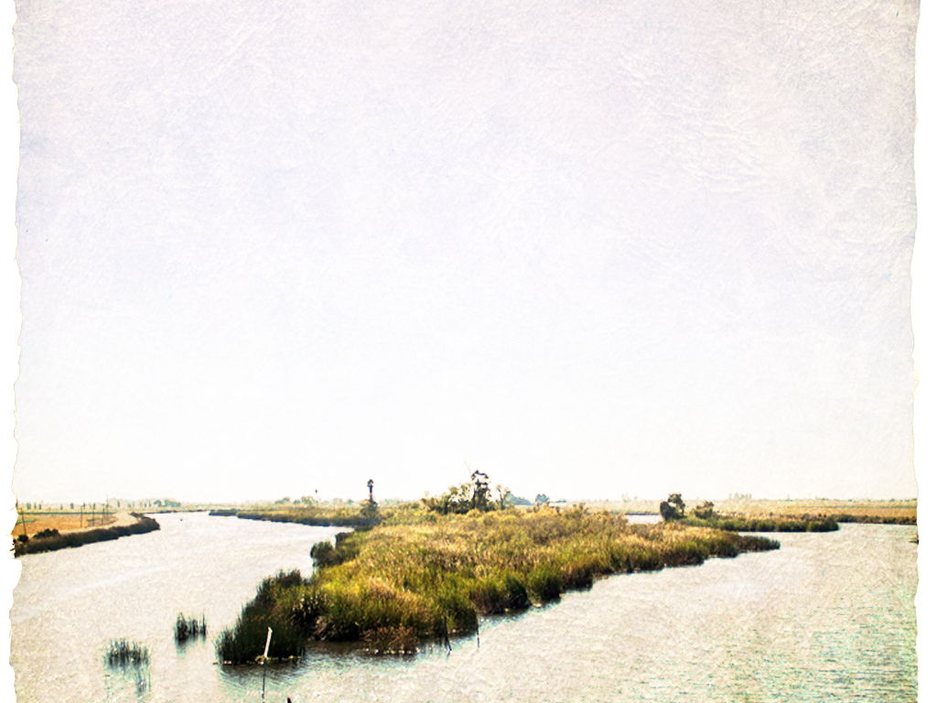

Who We Are
WE HAVE A BETTER SOLUTION
Reduce water exports to 3-3.5 MAF maximum (MWD avg. 770,000 AF /year)
Activate a more aggressive statewide regional self-sufficiency plan
Support regional projects to conserve, recycle, reuse, and capture water
Fix fish screens/pumps at Tracy (known technology)
Upgrade levees to highest standards
Barbara Barrigan-Parrilla
Executive Director
Barbara@RestoretheDelta.org
(209) 479-9550

Slide 21
Improving Agricultural Water Use Efficiency
Source: Public Policy Institute of California, 2012
Notes:
Over the past 40 years, agriculture doubled “Revenue per drop” and significantly improved “Crop per drop” by improving water use efficiency, cropping changes, inflation, etc.
Yet still, more than 50% of all irrigated lands in CA use gravity or flood irrigation systems, rather than efficient irrigation systems.

Slide 22
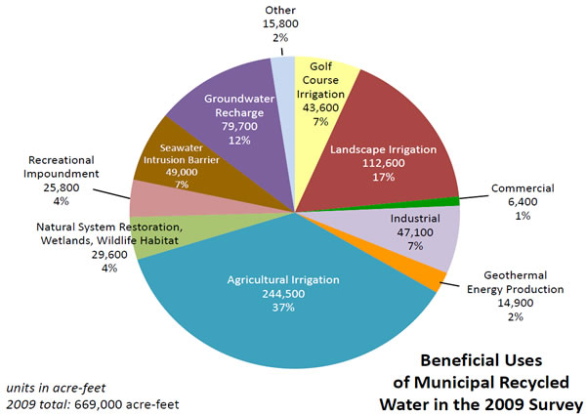
Diversifying Water Supplies:
Use of Recycled Water
Notes:
2030 Goal = 2 million acre feet of recycled water being beneficially used (are we on track)?
Stormwater capture presents similar opportunities and challenges

