Slide 1
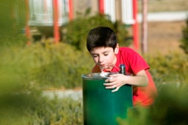
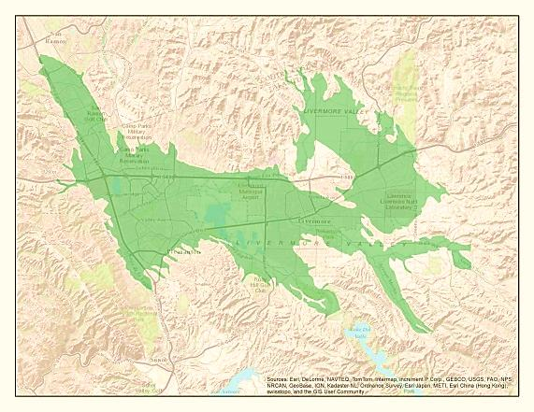

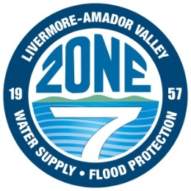
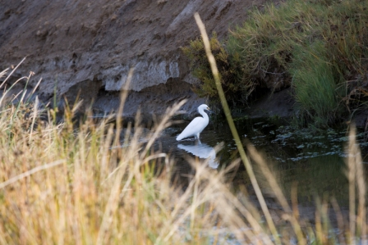
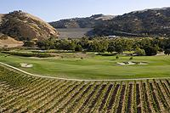
Zone 7 And WaterFix
March 7, 2018
Drinking water for over 240,000 people
Sustainably managing local groundwater basin for 50+ Years
Regional Flood
Protection For
Eastern Alameda
County
Irrigation for viticulture and landscaping

Slide 2
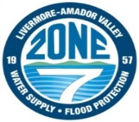
What is Zone 7?
Flood protection and watershed stewardship for Eastern Alameda County (425 square miles)
State Water Project Contractor, importing an average of 48,000 acre feet annually to Valley; remaining demands (averaging 15%) met with local supplies
Treated water wholesaler (45,000 AFA) for over 240,000 residents and businesses served by:
  City of Livermore
  California Water Service Company (portion of Livermore)
  City of Pleasanton
  Dublin San Ramon Services District (including Dougherty Valley under special agreement)
Untreated water supplier (5,000 AFA) for:
  74 agricultural & irrigation customers (3,500 acres)
  Primarily vineyards
  Local wine industry estimated at $200 million/year
Sustainable Groundwater Management Agency (SGMA)
  250,000 AF underground basin with 126,000 AF operational storage
Presented by the Water Association of Kern County

Slide 3
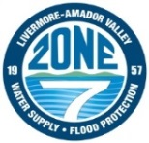
Imported Water => Sustainable Groundwater Management
Historical Groundwater Elevations at a Key Well
Ground Surface
Operational Range
Basin
Overdraft
Basin
Recovery
Sustainably managing the basin to maintain levels above historic lows, while also providing a vital source of drought supply.
Zone 7 Artificial
Recharge started (imported SWP water), 1962
Presented by the Water Association of Kern County

Slide 4
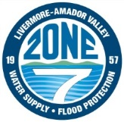
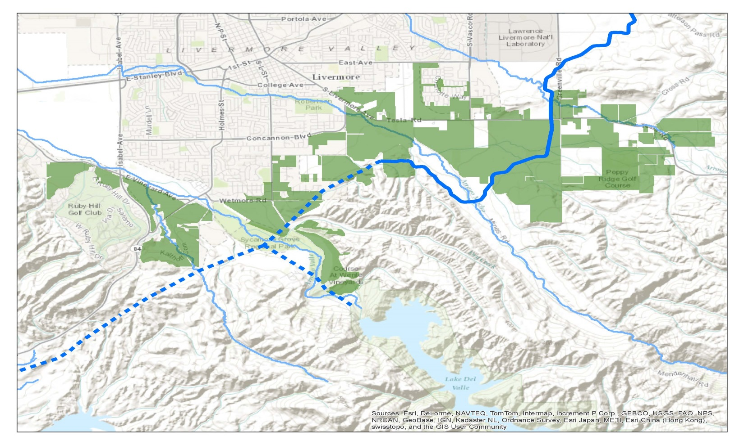
Valley Ag – Concerns with Untreated Water Reliability
Untreated customers
  3,500 irrigated acres, primarily vineyards
  6,000 to 8,300 acre feet per year
Served directly from SBA Turnouts or Del Valle Branch Pipeline
No alternative source/ conveyance other than local wells
Arroyo Seco
Arroyo Mocho
Arroyo Valle
South Tributary

Slide 5

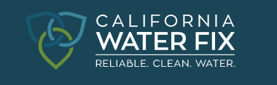
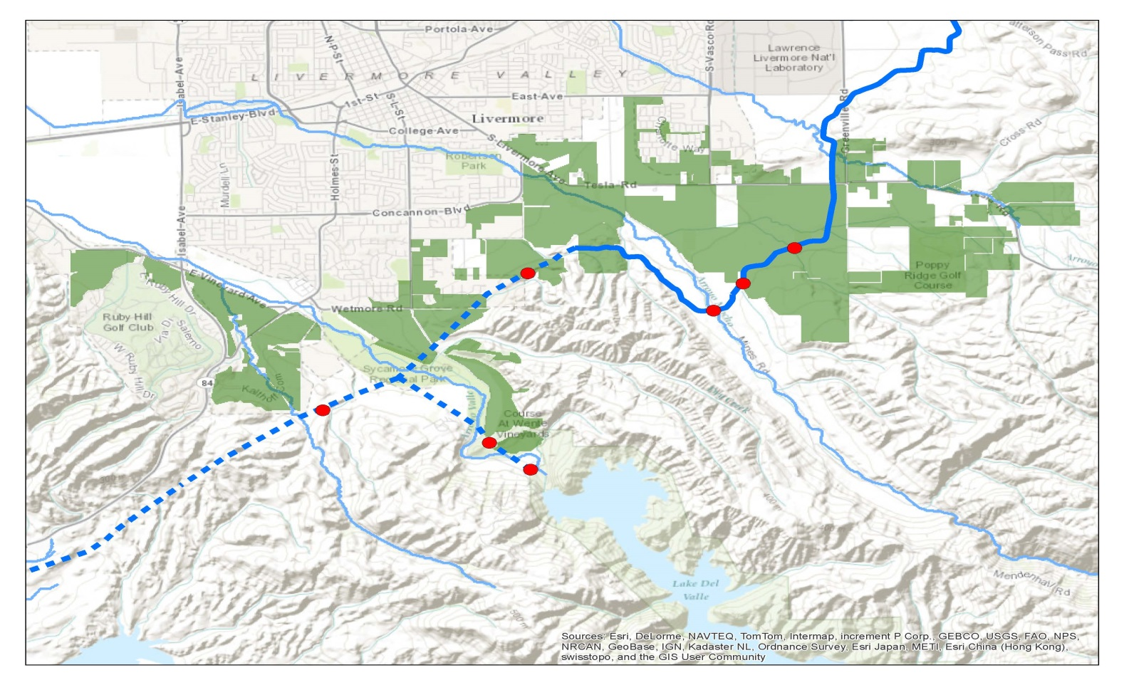
Challenges for Ag Customers
Water Sources:
  State Water Project water delivered via the Delta/SBA
  Private Wells
  Recycling infrastructure lacking & poor WQ for grapes (with boron)
Water Quality:
  Influenced by the Delta
  Statewide & Local Hydrologic Conditions
Reliability:
  Tied to decreasing SWP reliability
  Expect more frequent disruptions in the Delta or the SBA
Arroyo Seco
Arroyo Mocho
Protect existing water supplies
Restore water supply reliability
Improve water quality
Protect water source in case of an earthquake in the Delta
Build on existing infrastructure for Untreated customers
Arroyo Valle
Wente 1
Wente
4/Conc
Corbett-Ising
Arroyo
Mocho
South
Livermore
Wente
5
Arroyo
Valle
South Tributary

Slide 6

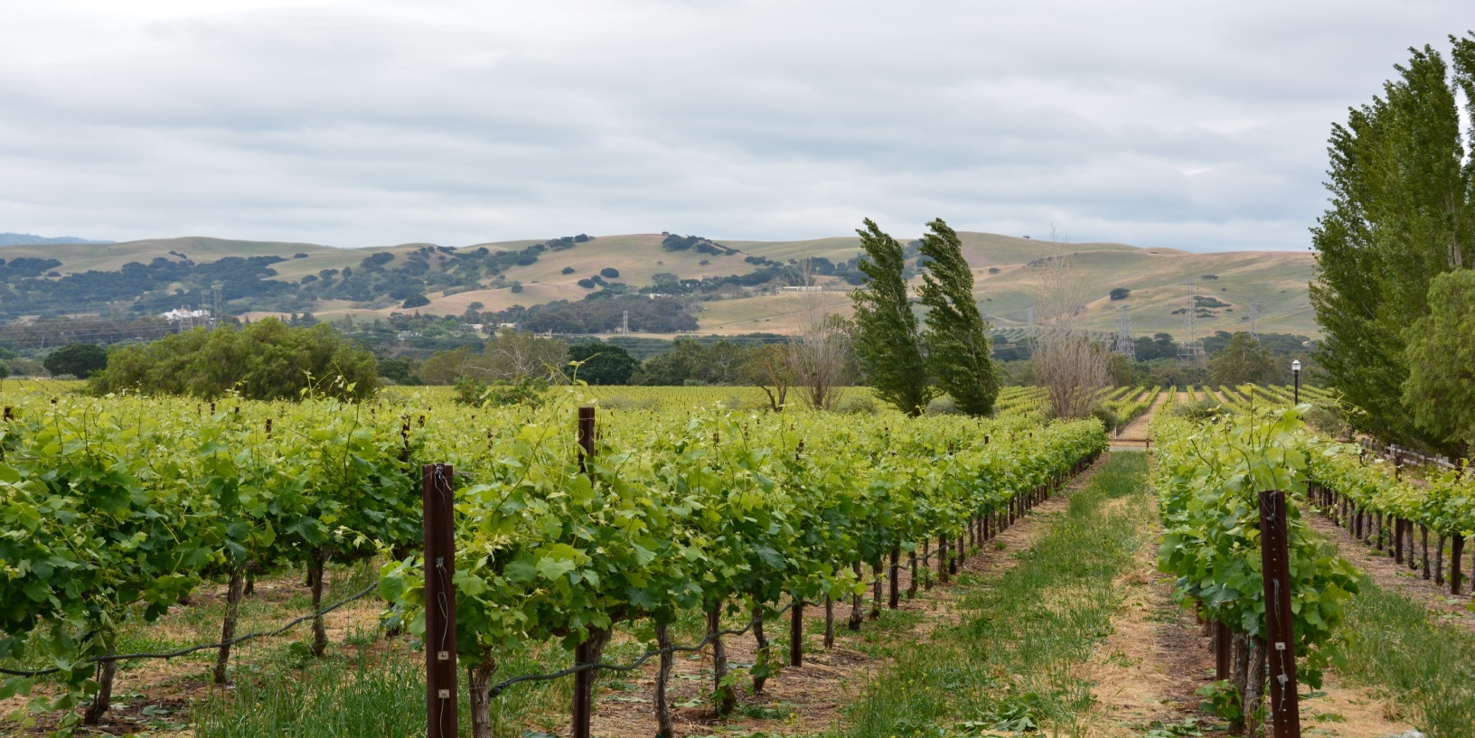
Untreated (Ag) Water Customers
Ag contributes $200 million annually to local economy & enhances the beauty and culture of the Tri-Valley

Slide 7
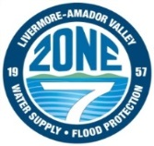
Water Portfolios: Average Water Supply, TAF
Portfolio A
70 TAF
Current Plan
64 TAF
Long-Term Demand = 60 TAF
Portfolio B
Portfolio C
72 TAF
78 TAF
*Note – Portfolio C is the only option supplying enough water without Cal WaterFix

Slide 8

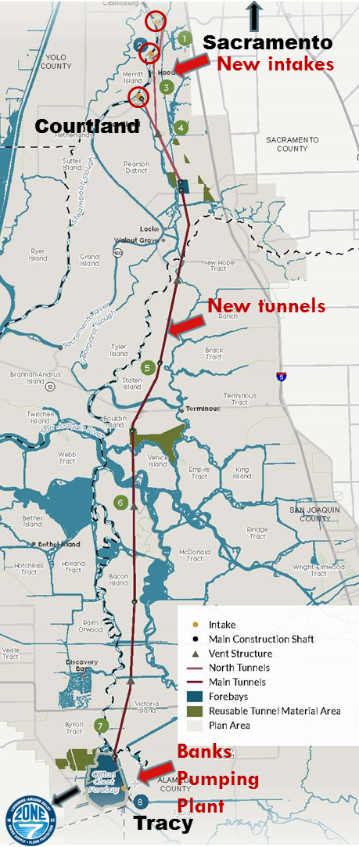
CALIFORNIA WATERFIX
Key component of the California Water Action Plan, the State of California’s blueprint for “a sustainable and resilient future”; Zone 7 passed Resolution of Support in June 2014.
Infrastructure upgrades to the 50-year old through-Delta conveyance of the State Water Project, including three new intakes in the northern part of the Delta and two new tunnels.
Creates a dual conveyance system that enhances the reliability of the SWP and CVP water supplies and protects the Delta’s ecosystem.
July 2017: DWR certified the Notice of Determination, approving the proposed project under CEQA.
Zone 7 Board endorsed project and voted to participate in September 2017
Presented by the Water Association of Kern County

Slide 9
WaterFix Benefits to the Zone 7 Community
Provides operational flexibility to protect listed species while capturing water during high-flow events
Reduces climate change risks from reduced snowpack, extreme events, rising sea level, salinity intrusion
Creates operational redundancy in the event of a seismic event
Improves water quality
Presented by the Water Association of Kern County

Slide 10

Estimated Potential Rate Impacts
(Nearly twice the increase without CA WaterFix)
Presented by the Water Association of Kern County

Slide 11
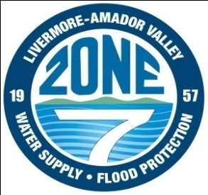
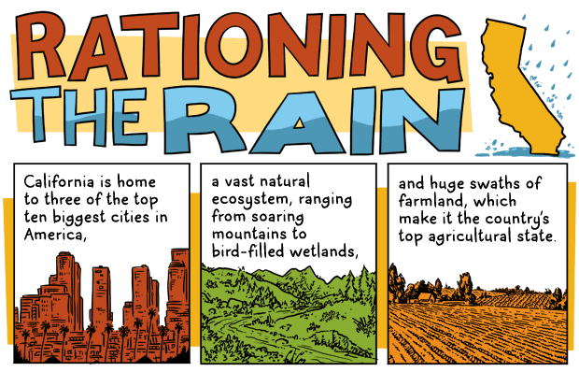
For more information, visit www.Zone7water.com
Presented by the Water Association of Kern County

