Slide 1
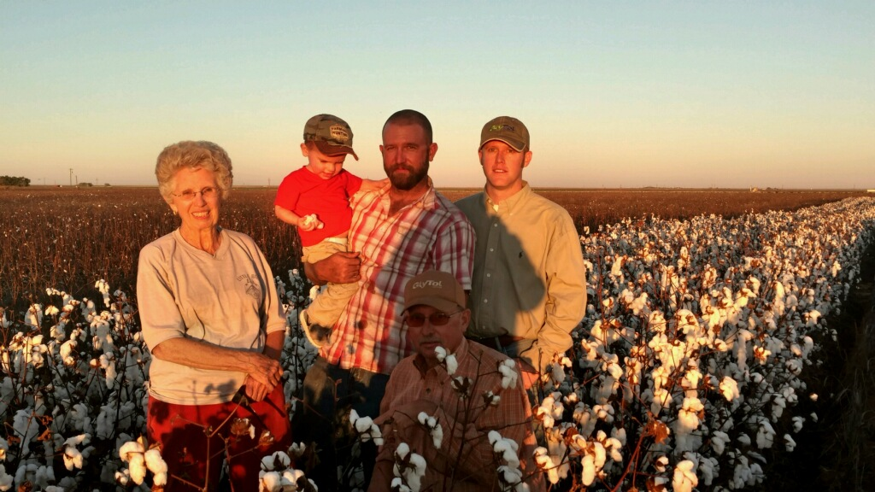

Presented by Kody Bessent with Plains Cotton Growers, Inc.

Slide 2
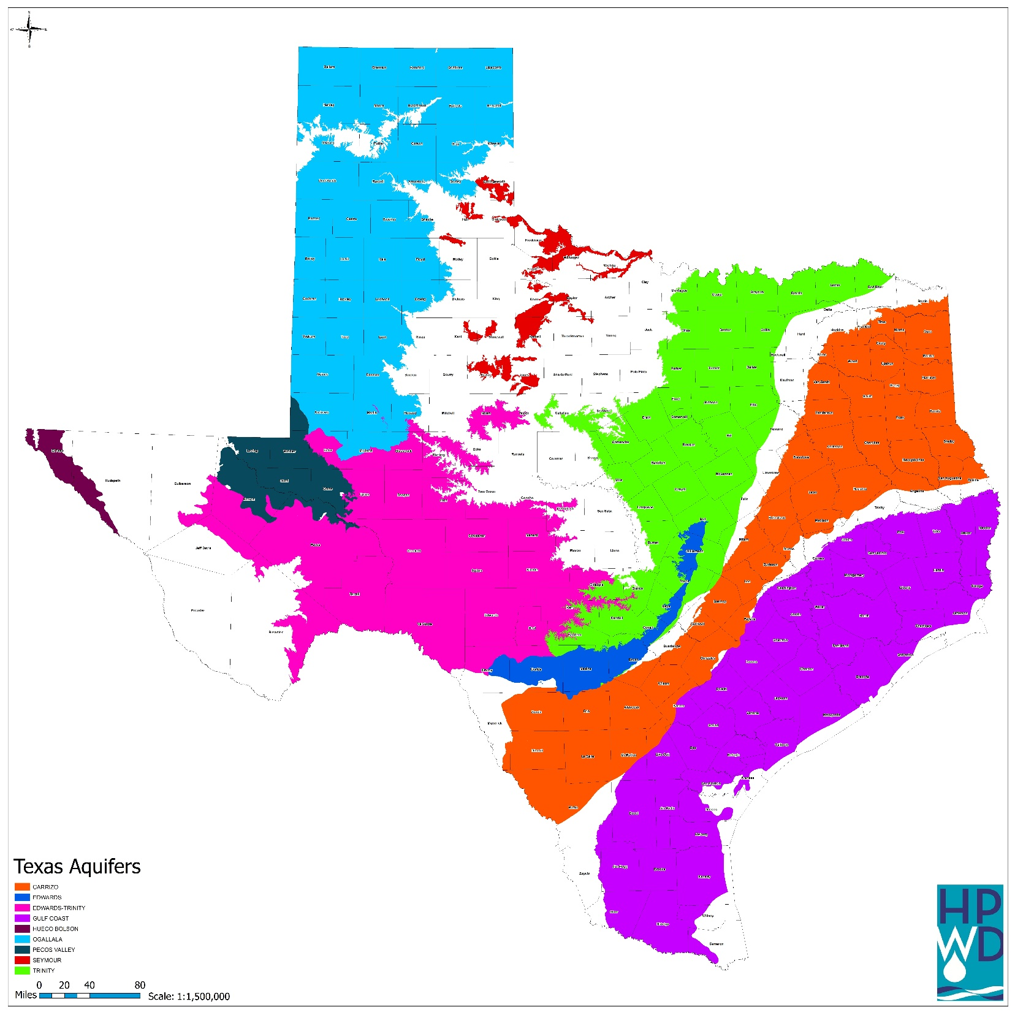
Texas Water Supply
15 major river basins
8 coastal basins
9 major and 21 minor groundwater aquifers.

Slide 3
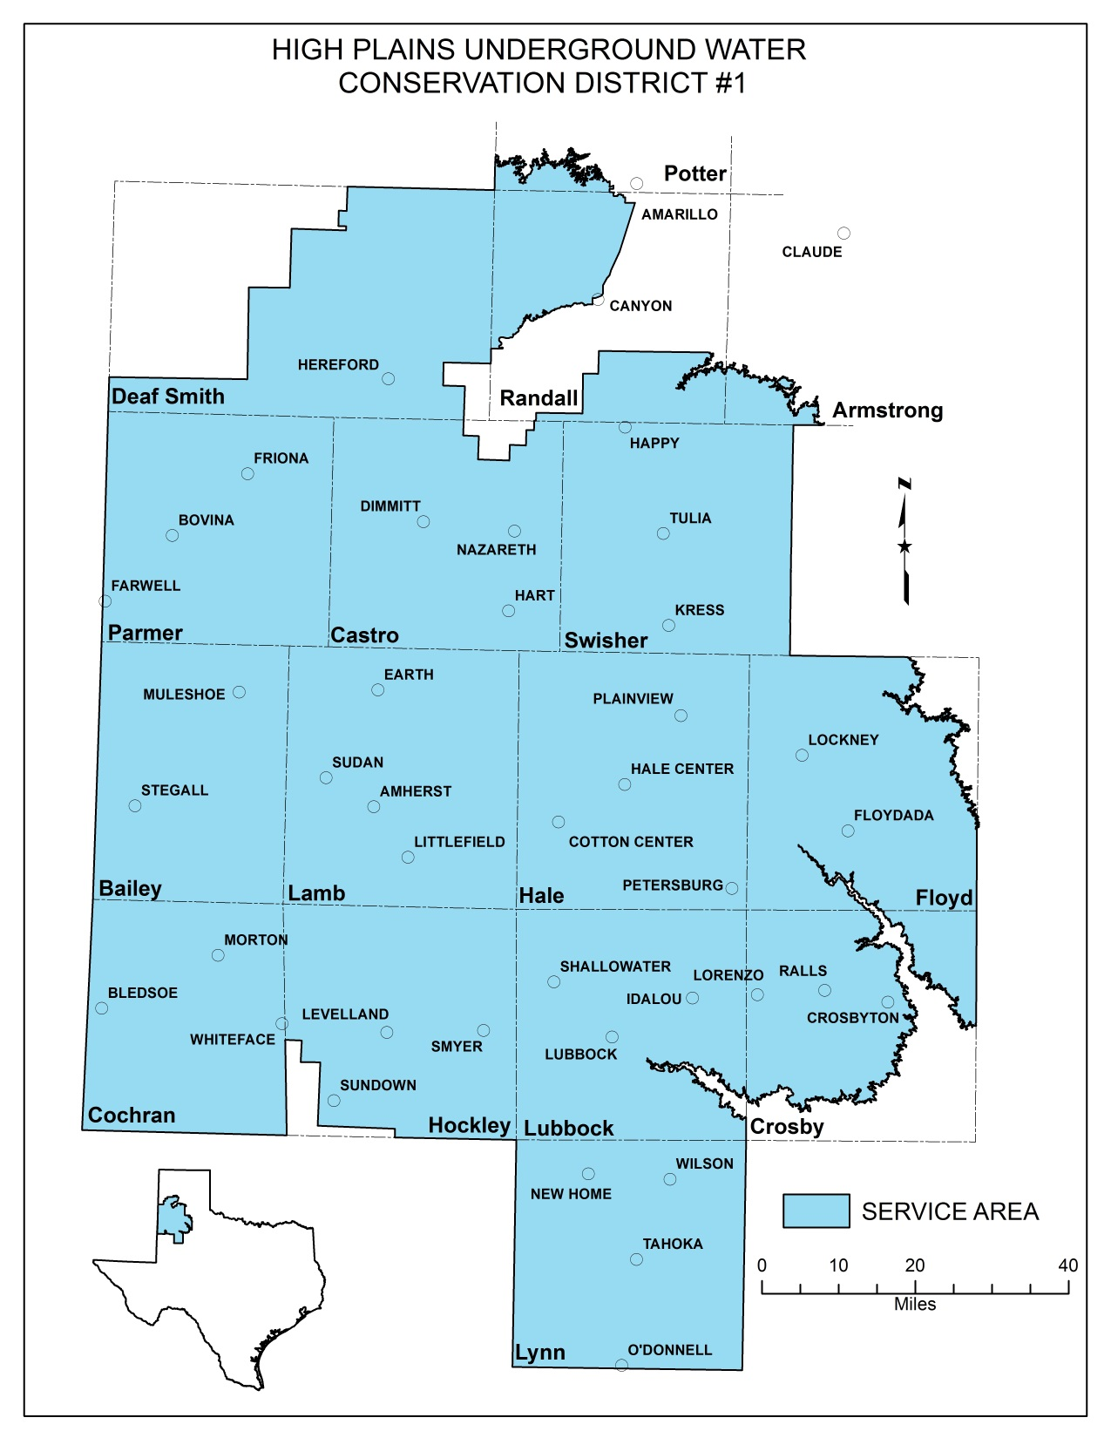

Slide 4
Regional Description
Makes up ≈ 7.5 percent of the state’s land area
≈ 1.9 percent of the state’s total population currently resides within the Region
Semi-arid region ≈ 80 percent of the annual rainfall occurs during the period from May through October.
Major crops grown are cotton, sorghum, corn and winter wheat.
Water demand for agriculture is projected to account for 95 percent of the region’s water use in 2020.

Slide 5
Regional Water Demand Projections

Slide 6
Why the steady decline in irrigated agriculture within the region?
Groundwater availability and recharge rate
Improved conservation technology:
  Irrigation practices
  Seed Varieties
  Management: No Till, Minimum Till, Crop Rotation etc.
Irrigation timing and efficiency

Slide 7
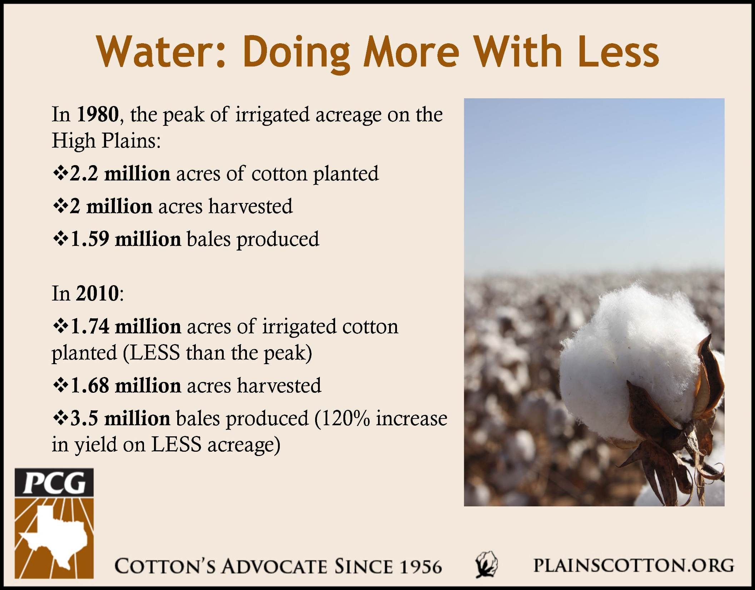

Slide 8
Agriculture Irrigation Efficiency
Irrigation System | Application Efficiency
Subsurface Drip Irrigation (SDI) | 97%
Low Energy Precision Application (LEPA) | 95%
Low Elevation Spray Application (LESA) | 88%
Mid-Elevation Spray Application (MESA) | 78%
Furrow Irrigation | 60%
Source: TAMU AgriLife Extension, “Economics of Irrigation Systems”, B-6113,10/11
Irrigation System | Number of Systems
 | 2012 | 2013
Sub-surface Drip Irrigation (SDI) | 4,268 | 4,313
Center Pivot Irrigation (CPI) | 13,035 | 13,447
Source: High Plains Water District, Jed Leibbrandt, GIS Specialist

Slide 9
Groundwater Resource Management in our region
Recent rules and revised management plan revisions process
  Static 1.50 acre-feet Allowable Production Rate established. Applies to all groundwater users regardless of use category.
  Established a conservation reserve where all or a portion of a users APR maybe reserved
  Recording and reporting options:
    Meter
    One Irrigated Crop Certification
    Energy Consumption Records
    Nozzle Package Measurements
    Confined Animal Feeding Operation multiplier formula
    Maximum Production Capacity Certification not to exceed 0.93gpm
  Voluntary registration of existing exempt use well’s.

Slide 10
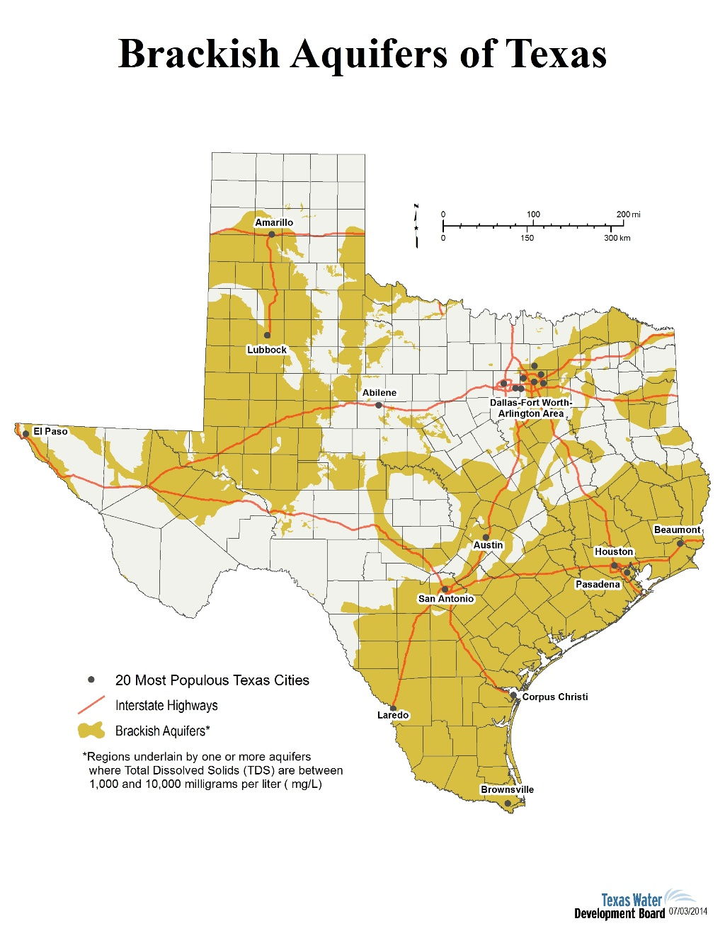
Exploring Additional Water Resources and Efficiencies
Brackish Groundwater Resources
  Majority in region unsuitable for most uses without treatment.
  Cost varies with salinity concentration, plant size and method of concentrate disposal
Aquifer Storage and Recovery

