Slide 1
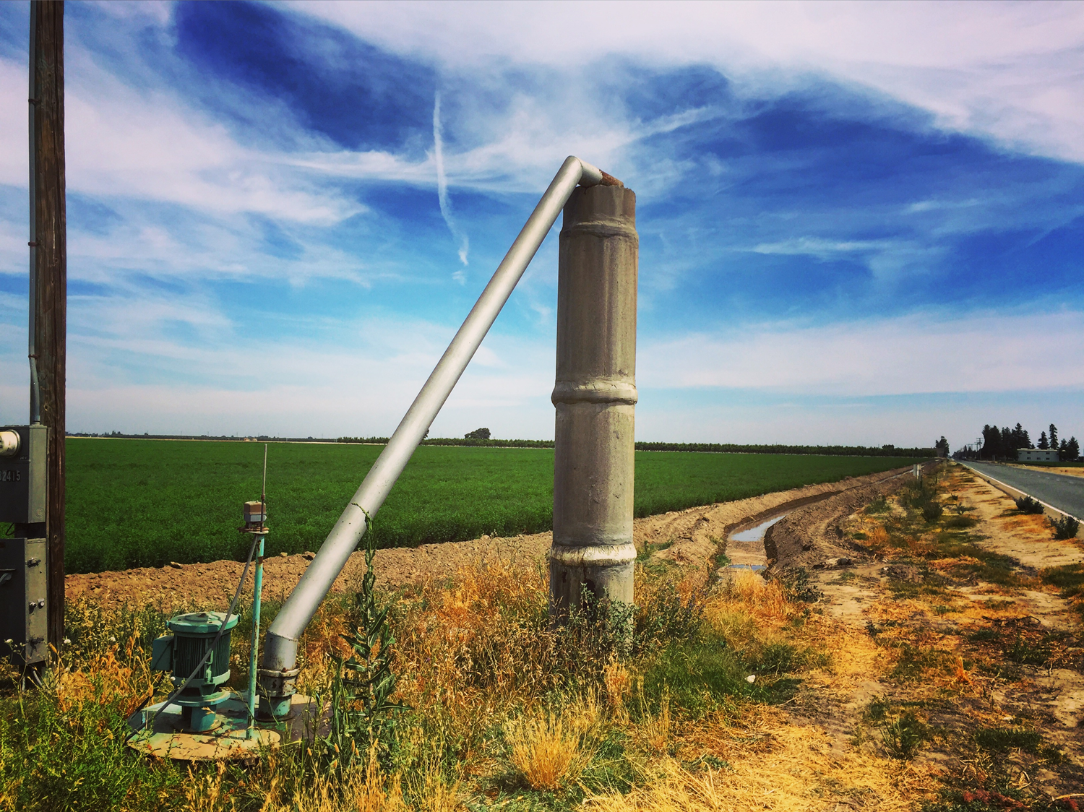


Sharing Groundwater:
A Robust System for Achieving SGMA
Professor Mike Young
Mike.Young@adelaide.edu.au
Cell 857 928 2519

Slide 2
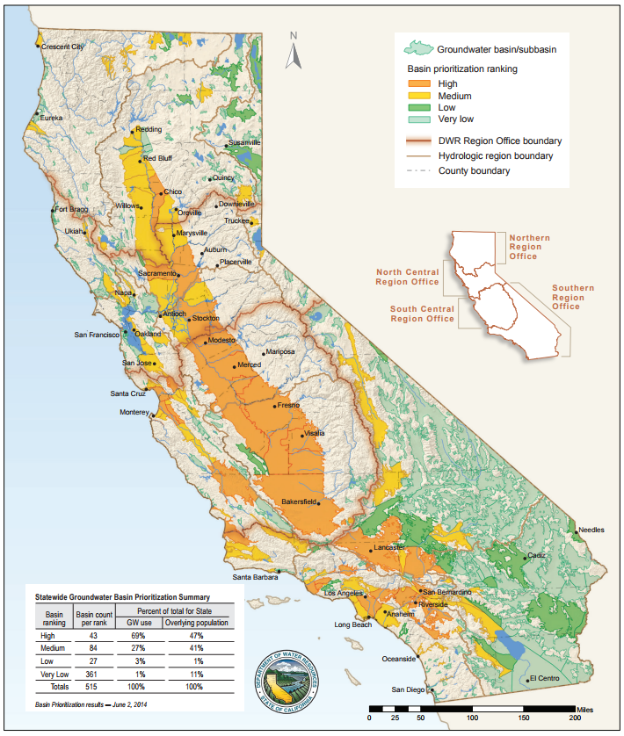
SGMA 101
Significant unreasonable and undesirable results
(1) Depletion of groundwater levels
(2) Reduction of groundwater storage
(3) Land subsidence
(4) Adverse impacts on surface water use
(5) Seawater intrusion
(6) Degradation of water quality
BUT is silent on governance arrangements, water rights, allocation arrangements, administrative structures, enforcement and accounting, etc.

Slide 3
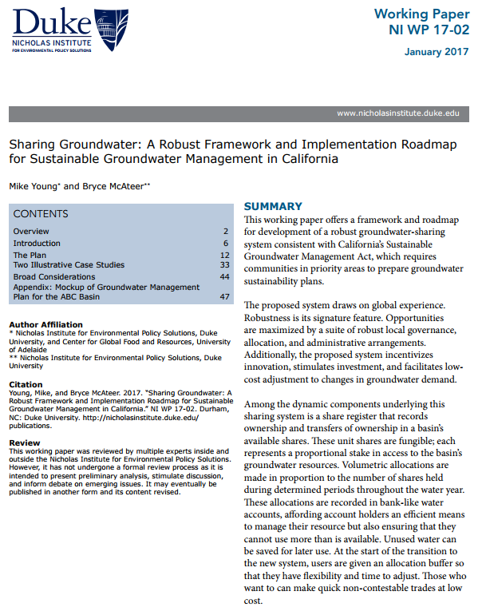
The Roadmap and GSP Mock-up
Issue shares to all existing users
Make Annual volumetric allocations in proportion to shares held
Require users to hold a permit linked to a water account
Unambiguous Statutory Plan
Trusted, independent Basin Authority appointed by GSA
Watermaster as “CEO”
Guaranteed share registers with capacity to mortgage
Bank-like water accounts
Recharge project accounts
Protection for Domestic Users
Low-cost administrative systems
Google “Young McAteer groundwater” to read more

Slide 4
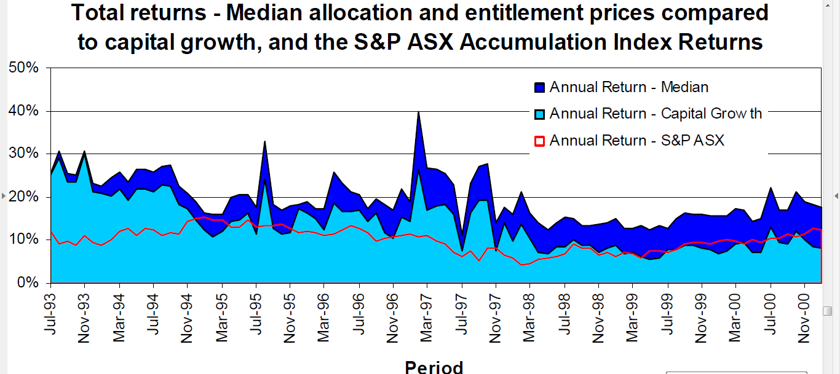
International insights
If you focus on building robust administrative systems
Markets will emerge naturally

Slide 5

Groundwater management is a sharing problem

Slide 6
Suggested Objectives & Goals
Six objectives:
Avoid SGMA’s 6 undesirable groundwater results
Maximize local profits → Economically efficient groundwater use, investment, and SGMA compliance
Encourage and reward water conservation
Facilitate continuous adjustment as conditions change
Provide fair and equitable access for domestic purposes
Maintain local control
One Sustainability Goal
Groundwater use is in balance and free of 6 undesirable results by 2042 (at the latest)

Slide 7
The Sharing System:
An Implementation Overview

Slide 8
GSP Design Strategies
1. Maximize value and investment opportunity
  Guaranteed registers and water accounts
  Shares mortgageable at low cost
2. Avoid massive disruption
  Recognize current use and investments
  A start-up buffer and carry-forward provisions
3. Encourage drought preparedness
  Credit savings and banking water
  Low cost trading
4. Require the State Government (DWR, SWRCB) to make timely & binding decisions
  “Ratify” decisions -- because fiddling & procrastinating decreases confidence
5. Keep it simple and affordable
  “Unbundled” entitlement, allocation, and use management systems
  Depth to groundwater as a proxy indicator of variable sustainable yield
  Adaptive management of allocations

Slide 9
Robust systems require robust solutions
Tinbergen Rule:
For each policy target, there must be at least one instrument
Share | Basin | Zone | Owner | Account
1 | ABC | A | John Doe | XYZ123
2 | ABC | B | Doe Ltd. | MMM456
… | … | … | … | …
Share Register
(single)
Date | Description | Debit | Credit | Balance
… | … | … | … | …
… | … | … | … | …
Water Accounts
Groundwater Use License No. ######
License Holder: John Doe
Linked Water Account: XYZ123
Max Pumping Rate: n/a
Max Annual Extraction: n/a
Groundwater Use Permits/License
(multiple)

Slide 10
GSP Structure
Plan Rules
Appendices
Website
(Very hard to change,
Needs DWR approval)
(Can be adapted by GSA as knowledge improves and careful community consultation.)
(Kept current by Watermaster)

Slide 11
Critical governance considerations
Basin Authority
Executive Board
GM/Watermaster
Groundwater Sustainability Agency
Composed of “GSA-eligible entities”
Duty is to appoint/dismiss board members

Slide 12
Critical local considerations
Current Operations
Existing loans and mortgages of agricultural land, and groundwater-dependent assets
Existing groundwater recharge projects
Existing groundwater banking projects
Local land rating systems
Systems Development
Development, design, ownership, and maintenance of Share Register
Development, design, ownership, and maintenance of Accounting System
Streamlining existing regulation through GSA and GSP Framework
Data-sharing of existing GW and SW monitoring

Slide 13
Management Zones, by Area
Shares are issued in zones
Allocations can be traded 1:1 within zones, and at an exchange rate across zones
Groundwater Use Permits have zone-specific conditions to manage:
undesirable results
3rd party effects
Zone A
Zone C
Zone B
Zone D

Slide 14
Management Zones, by Aquifer
Shares are issued in zones
Allocations can be traded 1:1 within zones, and at an exchange rate across zones
Groundwater Use Permits have zone-specific conditions to manage:
undesirable results
3rd party effects
Key
= Aquifer/Water Bearing Formation
= Aquitard
Zone 1
Zone 2
= Impermeable Rock
Zone 3
Zone 4
= Permeable Sediment
= Groundwater Well

Slide 15
Managing relationships between GSAs
Coordination Agreement established between ABC Basin GSA and DFG Basin GSA agrees to develop individual plans base on
Balance by common date
Common adjustment pathway
To share common development costs
Zone A
Zone C
DFG Basin
Zone B
Zone D

Slide 16
Issuing Shares
Requires careful engagement and consultation
Determining eligibility criteria
Design the share allocation database
Assemble and validate the database
Develop and finalize the allocation formula
(Advised by an independent panel or person)
Build share register and, where appropriate, record financial interests
Confirm accuracy of share register

Slide 17
Indicative Basin Groundwater Allocation Plan
Buffer available for use now or in any future year
Basin Authority invests in groundwater augmentation project on behalf of all share holders
Transition Volume in proportion to current use
Transition = fn current use
Share-based allocation
Preferred Avg. Depth
Preferred Max Depth
Absolute Max Depth

Slide 18

Accounting for Use, Gross v. Net
Gross
Net
Tracks volume extracted
As efficiency goes up, allocations per share go down
Tracks volume consumed
Rely on meters and remote ET
Gross
= 4 AF pumped
Net
= Consumptive Use
(ET) of 3 AF
= Return Flow of 1 AF

Slide 19

Challenges for remote ET accounting

Slide 20
A Mock-Up Water Account
Date | Action or event | Debit | Credit | Balance
1 Oct 2019 | Opening balance |  |  | 0.00
1 Oct 2019 | Start-up buffer |  | +83.33 | +83.33
1 Oct 2019 | Share allocation 10,000 shares at one acre-inch per share |  | +833.33 | +916.66
15 Oct 2019 | Net use—estimated using satellite imagery and land parcel area | -10 |  | +906.66
30 Oct 2019 | Net use—estimated using satellite imagery and land parcel area | -15 |  | +891.66
5 Oct 2019 | Within-zone allocation transfer to M.D. and S.M. Jones | -50 |  | +841.66
20 Nov 2019 | Metered use taken for industrial water use purposes on land parcel (six acre-feet with 50% return following treatment in septic system) | -3 |  | +838.66
25 Nov 2019 | Purchase from D. Smith (Zone 2) 30 acre-feet at 0.8 per acre-foot |  | +24 | +862.66
28 Dec 2019 | Transfer to J.J. Esau | -70 |  | +792.66
30 Mar 2020 | Aquifer recharge using water sourced from the state water project |  | +100 | +892.66
~ |  |  |  | ~
30 Sept 2020 | Closing balance at the closure of the 2019/20 water year |  |  | +892.66
End of year | Amount to be carried forward to the next water year with 10% adjustment for losses | -89.3 |  | +803.36

Slide 21
Accessing Water
Scenario: Account holder wants to access water.
Question: How does one acquire water allocations?
Potential Options:
Hold shares and wait for next allocation
Organize a transfer
Invest in a recharge project
Date | Action or event | Debit | Credit | Balance
1 Oct 2019 | Shares in ABC Basin allocated 0.25 af/share; Water Account holder owns 100 shares |  | +25 | +25
15 Oct 2019 | California Irrigation District Transfers 100 af from recharge project to local landowner’s Water Account |  | +100 | +125
30 Oct 2019 | Water Account holder purchases 20 af from local account holder in same zone |  | +20 | +145

Slide 22
Issues for Discussion
Shares as the long-term entitlement
Water allocations and Water accounting
Governance arrangements (GSA, Authority & Watermaster)
A gross or net accounting system
Metering v. remote ET assessment
Formula for issuing shares
Domestic water-use arrangements
Enforcement
Ensuring register and account integrity
Detail not covered in this presentation
  Zones, boundary modifications, etc.
  Cooperation with other GSAs and managing connections via Coordination Agreements
  GSP’s drought guarantee

Slide 23
The Sharing System:
Further Scenarios

Slide 24
Transferring Allocations
Exchange rates and a maximum annual transfer volume are established for transfers between each zone
Zone | To A | To B | To C | To D
From A | 1 | 0.8 | 0 | 0.6
From B | 0.8 | 1 | 0 | 0.8
From C | 0 | 0 | 1 | 0
From D | 0.5 | 0.8 | 0 | 1
Zone A
Zone C
Zone B
Notes:
Exchange rates determined via groundwater modeling and knowledge of hydraulic conditions
No more than 10% of allocations to a zone may be transferred out without a formal review of its impact.
No transfers of shares between zones allowed
Zone D

Slide 25
Tagged-Trading
Allocations made to a share in one zone are credited to a water account using the allocation in another zone
Scenario in Steps:
Shareholder has 100 Zone A Shares, and designates a tagged trade to Zone B.
Allocations-per-Share in Zone A in WY2018 are 1 AF
Exchange rate from Zone A to Zone B is 0.8
Shareholder immediately receives 80 AF for use in Zone B
Zone A
Zone C
Zone B
Zone D

Slide 26
A Recharge Project
Scenario: An irrigation district constructs a recharge project.
Question: To whom does the volume belong?
Answer:
The Recharge Project is designated a “project” and volume is credited to Irrigation District’s Water Account.

Slide 27
A Seeping Canal
Scenario: A canal is seeping water into the aquifer
Question: To whom does the volume of seeping water belong?
Potential Options:
The Canal is designated a “project” and seeping volume is credited to the Water Account of the canal owner (e.g. Irrigation District)
Seeping water is considered “natural recharge” and is distributed among all shareholders

Slide 28
Managing a Toxic Plume
Scenario: A toxic plume is located in an area of the aquifer.
Question: How do you manage the plume?
Answer:
New conditions are attached to Use Permits for wells overlying the plume to control pumping rates.
Volumetric allocations per share are still made and can be transferred to other locations.

Slide 29
Preventing Cones of Depression
Scenario: Pumping at a high rate may produce a cone of depression causing other wells to fail.
Question: How do you manage the cone of depression?
Answer:
Groundwater Use Permits may contain:
  Maximum pumping rate
  Total annual &/or seasonal extraction limits.

Slide 30
Preventing Land Subsidence Near Critical Infrastructure
Scenario: Local drawdown has generated land subsidence, cracking a surface water canal
Question: How do you protect the canal from further damage
Answer:
Groundwater Use Permits may contain:
  Maximum pumping rate
  Total annual &/or seasonal extraction limits.

Slide 31
Mortgaging Shares
Scenario: A shareholder wants to acquire a loan.
Question: How does the shareholder mortgage their shares as security for the loan?
Answer:
The shareholder authorizes the Webmaster to record a mortgage.
Transfer of a mortgaged share is subject to all the conditions in the mortgage have been met.
ABC Basin
Share #234
Owner: CSE
Mortgaged: Yes
Mortgagee: Bank XYZ
Amount: $200,000

Slide 32
Zonally Variable Rampdowns
Scenario: Adjacent zones have varying depths-to-groundwater
Question: How will a GSA manage uneven groundwater tables
Options:
TAZA is adjusted for long-term stability
Zone A
Avg. Depth -30 ft
Zone B
Avg. Depth -100 ft

Slide 33
ACKNOWLEDGEMENTS
Roadmap co-author and colleague Bryce G. McAteer
Rockefeller Foundation
Water Foundation
Duke University’s Nicholas Institute
Water Funders Initiative
  Rockefeller Foundation
  Pisces Foundation
  Bechtel Foundation
  Walton Foundation
Google “Young McAteer Groundwater” to access our Roadmap

