Slide 1
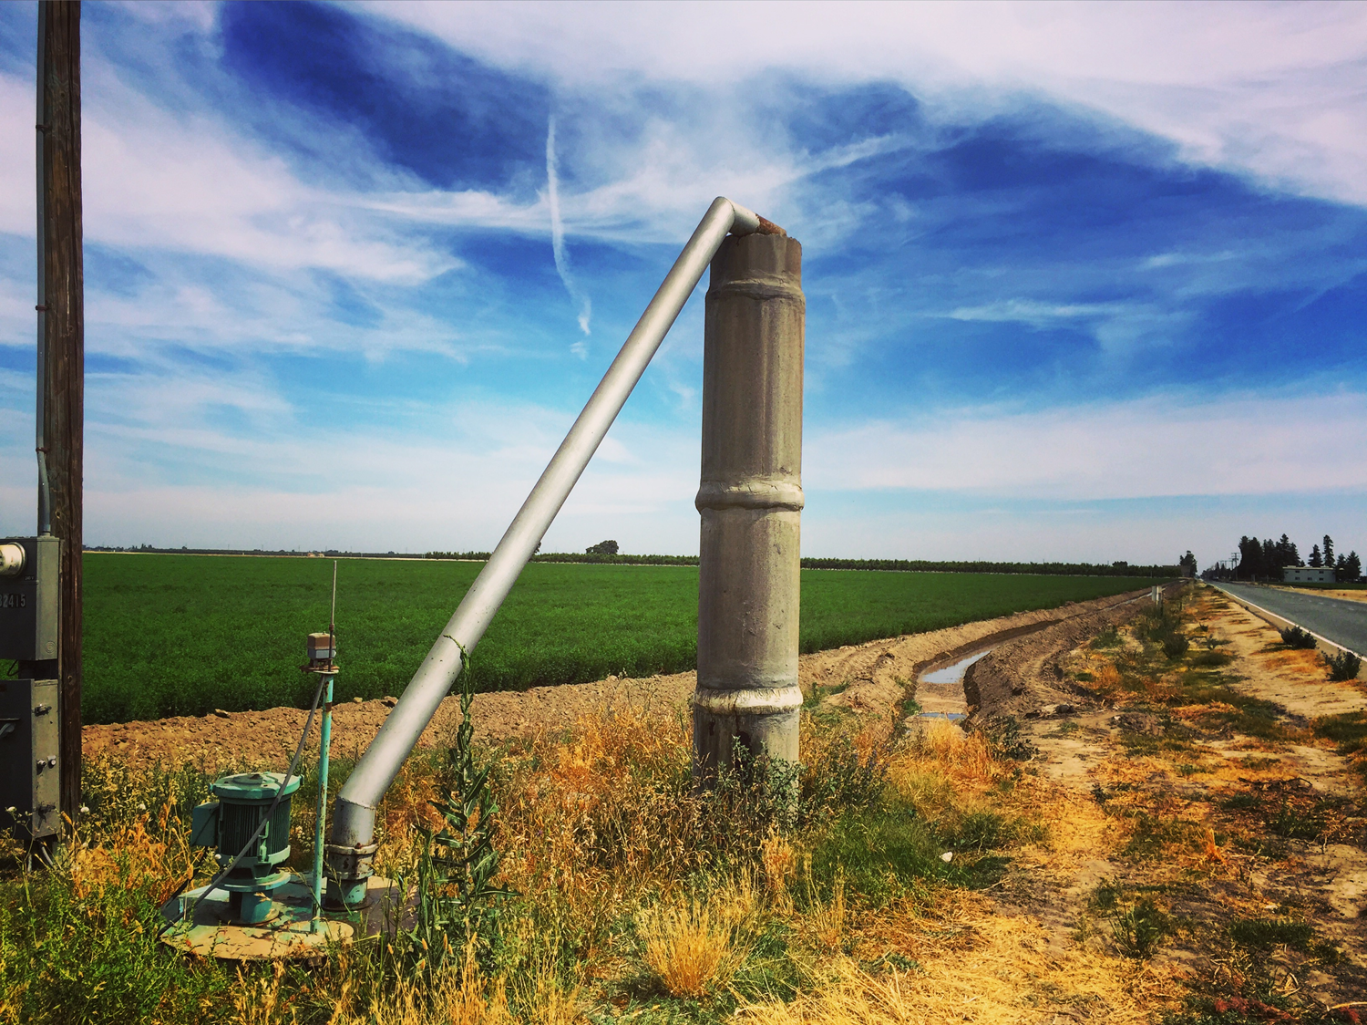


Sustainable Groundwater Management in California: A Framework and Implementation Roadmap
Professor Mike Young
Mike.Young@adelaide.edu.au
Cell 857 928 2519

Slide 2
SGMA 101
Significant unreasonable and undesirable results
(1) Depletion of groundwater levels
(2) Reduction of groundwater storage
(3) Land subsidence
(4) Potentially adverse impacts on surface water use
(5) Seawater intrusion
(6) Degradation of water quality

Slide 3
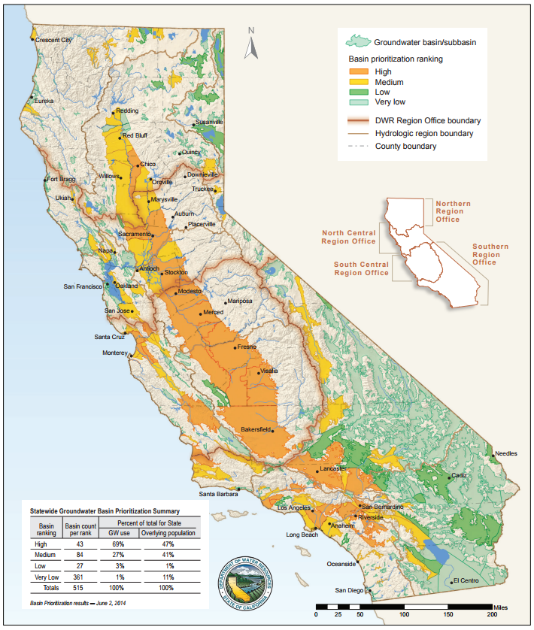
SGMA: An Overview
Challenges local communities to form agencies & prepare plans that prevent 6 “undesirable results” occurring
Leaves the detail to local communities
Is silent on water rights, allocation arrangements, administrative structures, enforcement and accounting, etc.

Slide 4
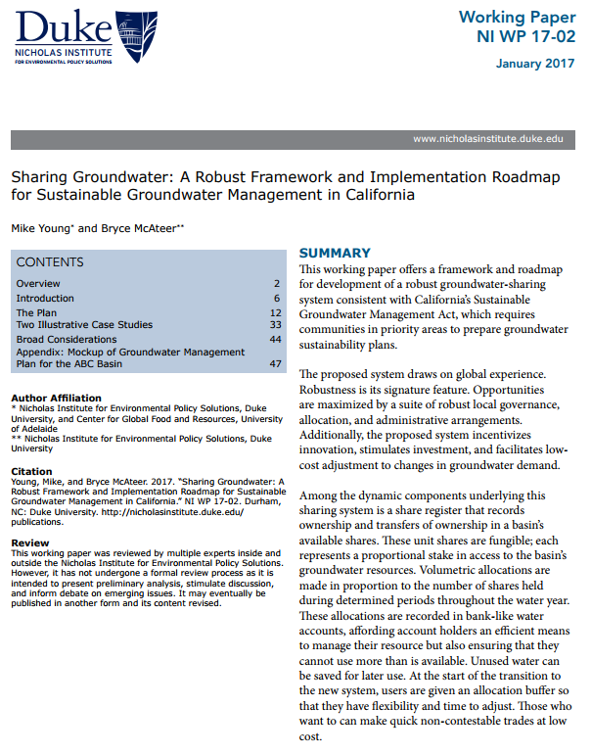
The Roadmap and GSP Mock-up
Offers a mock-up of a GSP ready for DWR approval.
Written to help GSAs
Think through the detail
Understand the state of the art
Avoid making mistakes
Fills in SGMA’s gaps
Envisions SGMA as a pathway to increased prosperity.
Google “Young McAteer groundwater” to read more

Slide 5
Two extracts from the GSP Mock-up
14. Shareholders will be free to choose whether or not to use, save, or, by way of transfer, sell any allocations made to their water account.
Adjusted only for hydrological losses, account holders will be allowed to carry forward unused water allocations from one water year to the next.
15. Share ownership will be defined by reference to the ABC Basin Share Register.
Any claimed interest in an ABC Basin share shall be deemed to be invalid unless it is recorded in the ABC Basin Share Register.

Slide 6
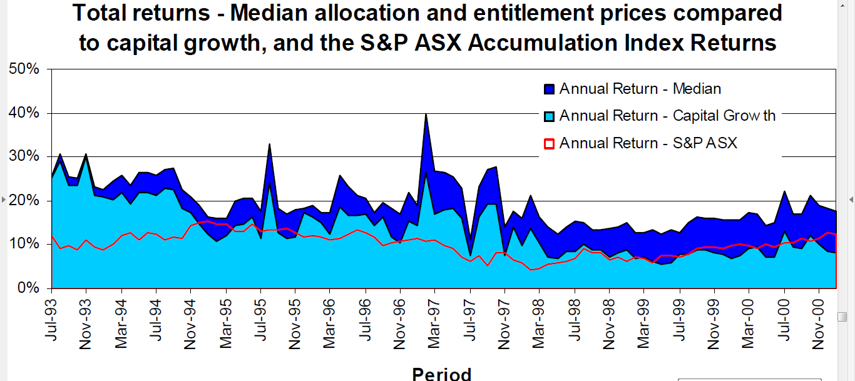
International insights
Markets offer the most efficient known way of managing a access to a limited resource (Avoiding tragedies)
If you focus on building robust administrative systems
Markets will emerge naturally

Slide 7

SGMA invites communities to find a way to share access to groundwater
The value of each water right is determined by the opportunities and risks associated with it.
The better the system, the greater the opportunities and the less the investment risk.
Rather than just doing the required minimum, there is chance to get things right.

Slide 8
The Proposed Sharing Framework
Issue shares to all existing users
Annual volumetric allocations to shareholders
Require users to hold a groundwater permit
An unambiguous Plan with statutory approval
Trusted, independent Basin Authority appointed by GSA
A Watermaster employed by the Authority
Robust value adding share registers and water accounts
Low-cost administrative systems that have integrity

Slide 9
Legal Structure
SGMA enables the development of regulations that sit on top of existing groundwater rights.
Rather than extinguish existing rights, it may be easier to another add another layer.
Under SGMA landowners could be required to
  Have an existing right
    A Land Parcel
    An approved well
  Comply with conditions set out in an approved plan (GSP)
    Have a water account in a positive balance
    Hold a permit requiring compliance with a GSP

Slide 10
Suggested Objectives & Goals
Six objectives:
Avoid SGMA’s 6 undesirable groundwater results
Maximize local profits → Economically efficient groundwater use, investment, and SGMA compliance
Encourage and reward water conservation
Facilitate continuous adjustment as conditions change
Provide fair and equitable access for domestic purposes
Maintain local control
One Sustainability Goal
Groundwater use is in balance and free of 6 undesirable results by 2042 (at the latest)

Slide 11
GSP Design Strategies
1. Maximize value and investment opportunity
  Guaranteed registers and water accounts
  Shares mortgageable at low cost
2. Avoid massive disruption
  Recognize current use and investments
  A start-up buffer and carry-forward provisions
3. Encourage drought preparedness
  Credit savings and banking water
  Low cost trading
4. Require the State Government (DWR, SWRCB) to make timely & binding decisions
  “Ratify” decisions -- because fiddling & procrastinating decreases confidence
5. Keep it simple and affordable
  Unbundled entitlement, allocation, and use management systems
  Depth to groundwater as a proxy indicator of variable sustainable yield
  Adaptive management of allocations

Slide 12
Indicative Allocation Plan
Buffer available for use now or in any future year
Basin Authority invests in groundwater augmentation project on behalf of all share holders
Guaranteed allocation in first two years
Aquifer found to sustain greater use than expected
Preferred Av. Depth
Preferred Max Depth
Absolute Max Depth

Slide 13
Keeping it simple!
Every time depth to groundwater drops, allocations per share must go down by at least 1.5%!
When the absolute maximum depth is reached, allocations per share must go to zero and remain at zero until there is a return to the preferred minimum.
Any water left in any water account may still be used.

Slide 14
A Mock-Up Water Account
Date | Action or event | Debit | Credit | Balance
1 Oct 2019 | Opening balance |  |  | 0.00
1 Oct 2019 | Start-up buffer |  | +83.33 | +83.33
1 Oct 2019 | Share allocation 10,000 shares at one acre-inch per share |  | +833.33 | +916.66
15 Oct 2019 | Net use—estimated using satellite imagery and land parcel area | -10 |  | +906.66
30 Oct 2019 | Net use—estimated using satellite imagery and land parcel area | -15 |  | +891.66
5 Oct 2019 | Within-zone allocation transfer to M.D. and S.M. Jones | -50 |  | +841.66
20 Nov 2019 | Metered use taken for industrial water use purposes on land parcel (six acre-feet with 50% return following treatment in septic system) | -3 |  | +838.66
25 Nov 2019 | Purchase from D. Smith (Zone 2) 30 acre-feet at 0.8 per acre-foot |  | +24 | +862.66
28 Dec 2019 | Transfer to J.J. Esau | -70 |  | +792.66
30 Mar 2020 | Aquifer recharge using water sourced from the state water project |  | +100 | +892.66
~ |  |  |  | ~
30 Sept 2020 | Closing balance at the closure of the 2019/20 water year |  |  | +892.66
End of year | Amount to be carried forward to the next water year with 10% adjustment for losses | -89.3 |  | +803.36

Slide 15
Gross v’s Net Accounting
Gross accounting systems adjust for changes in average return flows
Net accounting systems adjust for changes in return flow at the farm level
Gross accounting systems rely upon meters
Net accounting systems are still in their infancy and rely upon satellite-based estimates of Evapo-Transpiration

Slide 16
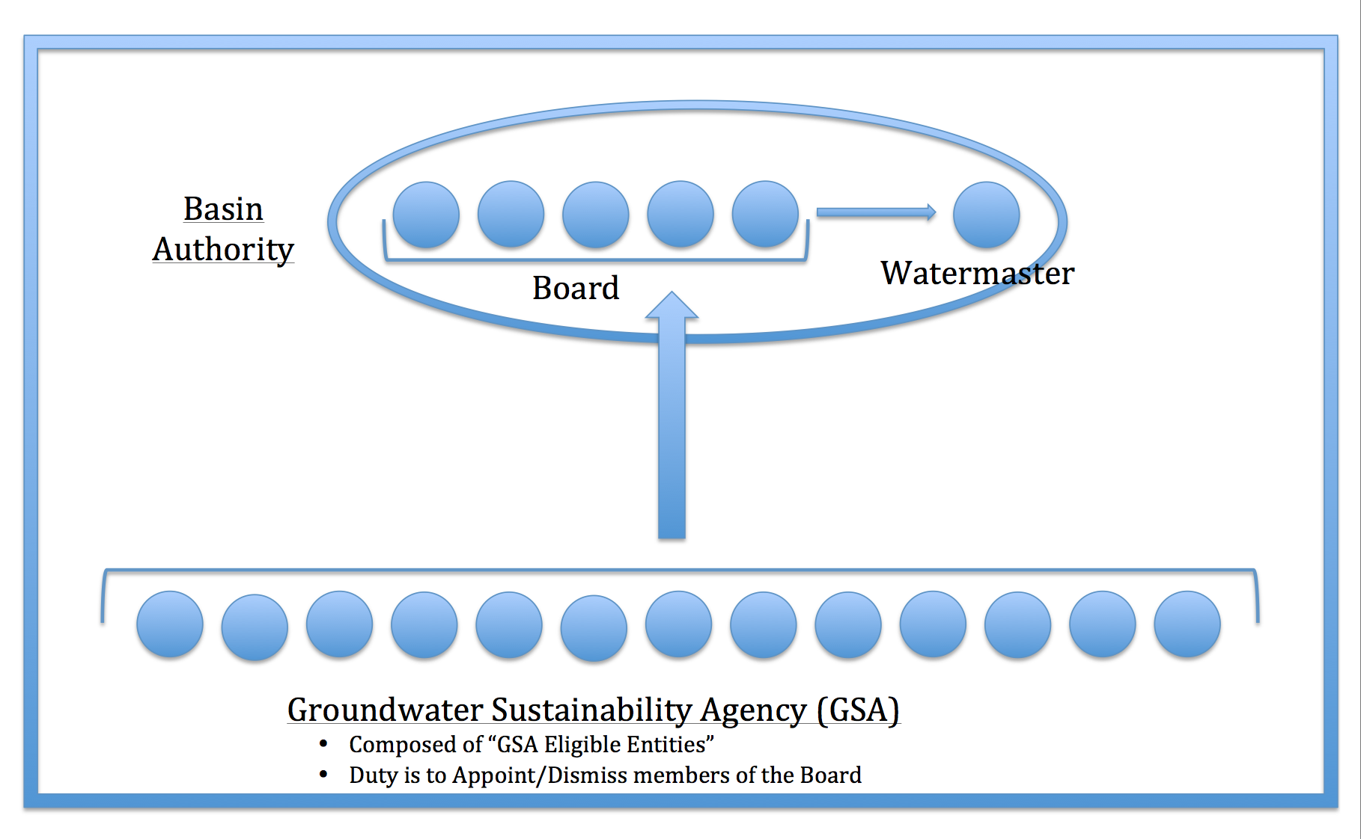
Governance

Slide 17
Domestic Water Use
Shares held by County or City with obligation to keep the “domestic water account” in positive balance
5 yr estimate of average use
Each household allowed to take up to locally agreed limit
When allocations per share @ zero,
households still allowed to take sufficient for essential purposes

Slide 18
Making it all work
Need a Chair who is trusted and is a skilled communicator
When in un- intentionally in deficit,
30 days to make good
After 30 days, Watermaster required to make good for you and charge double
Require DWR to be as disciplined as it expects users to be.

Slide 19
Issuing Shares
Requires careful engagement and consultation
Determining eligibility criteria
Design the share allocation database
Assemble and validate the database
Develop and finalize the allocation formula
Build share register and, where appropriate, record financial interests
Confirm accuracy of share register

Slide 20
Possible Share Allocation Formula
Best management practice for hottest of last 7 years
Initial allocation in proportion to current land use
Adjusted for age of current crop
1.1% of shares re-allocated in proportion to land use for ten years
Special 10 year reserve set aside to be allocated in proportion to land area
Maximum volume used in last 7 years allocated to packing sheds, businesses, etc.

Slide 21
Issues for Discussion
Shares as the long-term entitlement
Water allocations and Water accounting
Governance arrangements (GSA, Authority & Watermaster)
A gross or net accounting system
Metering v. remote ET assessment
Formula for issuing shares
Domestic water-use arrangements
Enforcement
Ensuring register and account integrity
Detail not covered in this presentation
  Zones, boundary modifications, etc.
  Cooperation with other GSAs and managing connections via Coordination Agreements
  GSP’s drought guarantee

Slide 22
ACKNOWLEDGEMENTS
Roadmap co-author and colleague Bryce G. McAteer
Rockefeller Foundation
Water Foundation
Duke University’s Nicholas Institute
Water Funders Initiative
  Rockefeller Foundation
  Pisces Foundation
  Bechtel Foundation
  Walton Foundation
Google “Young McAteer Groundwater” to access our Roadmap

Slide 23
Roadmap contents
Vision Statement
Plan Framework
  Purpose of Plan and Goals
  Avoiding Undesirable Results
  Sustainability Goal
Zones
ABC Groundwater Basin Authority
  Quorum
  No Conflict of Interest Allowed
  Equitable Decision-Making Processes
Periodic Plan Reviews
Plan Amendment Process
Water Sharing, Allocation, and Accounting System
Water Use Accounts
  Carryforward of Unused Allocations Allowed
  Transfer of Allocations among Zones and out of the Basin
  Groundwater Recharge and Augmentation
  Significant Interception of Groundwater
  Penalties for Unintentional Overuse
  Intentional Overuse
  Announcement and Issuance of Allocations
Share Register
  Recording Financial and Other Interests
  Share Transfer Process
  Restrictions on Share Transfers
Protection of Existing Water Rights
Initial Share Allocation
Issuing Groundwater Use Permits and Associating Them with Water Accounts
Basin Boundary and Zone Boundary Modification
  Modification of the Basin Area
  Zone Boundary Realignment
No Confidence in the Basin Authority or One or More of Its Members
  Appointment of a Basin Administrator
  Suspension of Plan during Nondrought States of Emergency
Fees and Charges
Legal Status and Commencement
Summary of Engagement Process Used during Development of this Plan
ABC Groundwater Sustainability Agency Resolutions
Approval and Acceptance of Plan for the Management and Administration of the ABC Groundwater Basin
Annexures
  1. ABC Basin Groundwater Annual Allocation Framework
  2. The ABC Groundwater Basin and Zones
  3. Accounting Arrangements for the Transfer of Water Allocations among Zones, Aquifer Recharge and Aquifer Augmentation
  4. Fees and Charges
  5. Glossary of Terms

