Slide 1


California Water Service
March 1, 2017
Quality. Service. Value.
2017 Kern County Water Summit
Water Association of Kern County
Notes:
Conservation is a way of life, DROUGHT is just a reminder

Slide 2

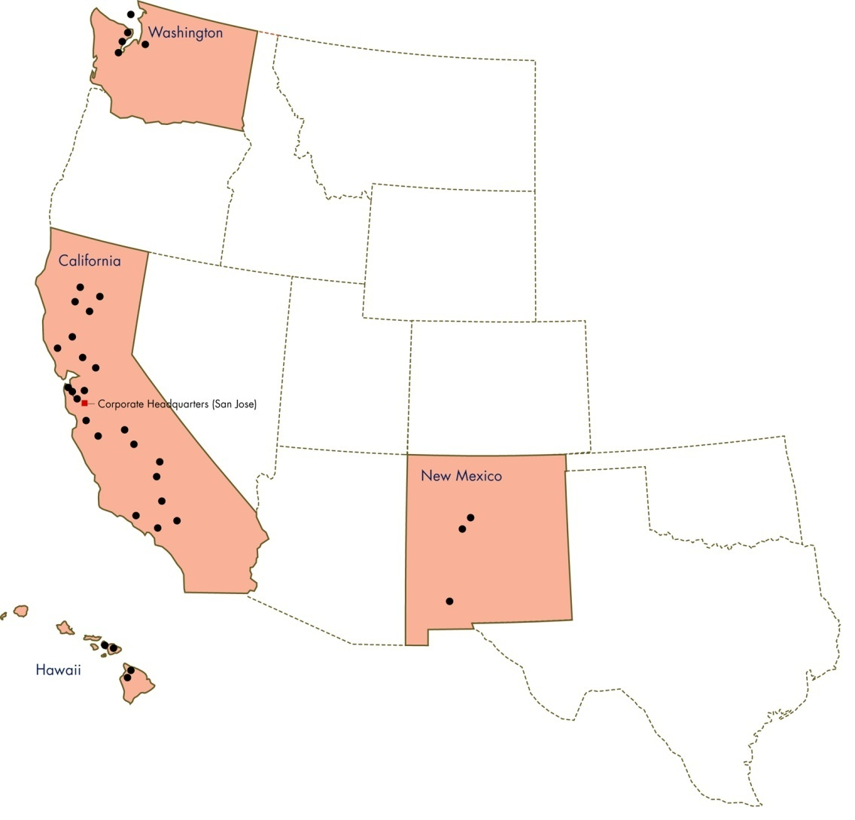



California Water Service Group
Largest in the West
3rd largest in the U.S.
Serves 2 million+ people via…
  6,000+ miles of main
  1,130 wells
  662 storage tanks
  155,000+ valves
  50,000+ hydrants
  2,010+ sampling stations
  6 surface water treatment plants
  7 wastewater treatment plants

Slide 3
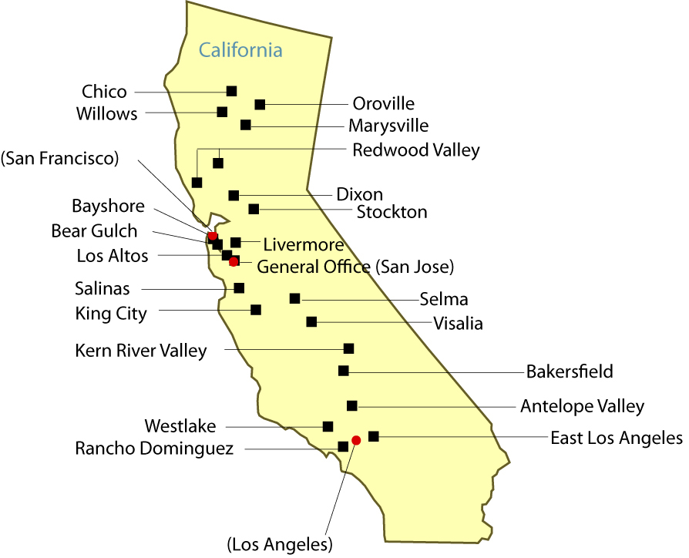
California Water Service

Slide 4
Bakersfield District
Providing service since 1926
68,000 service connections
System includes:
  900+ miles of main
  5700+ fire hydrants
  100+ wells
  40+ storage tanks
  3 water treatment plants

Slide 5
Agenda
Conservation Master Planning
Cal Water’s Water Shortage Contingency Plan
Conservation tools for Cal Water customers
Q&A

Slide 6
The Planning Process
Broad guidance document
Summarize mix of programs/water saving opportunities
Explains the evaluation process in detail
Provides update to previous plan to allow for adjustments
Path to meet demand reduction goals
Five year cycle – tandem with Urban Water Management Plan (UWMP)
Available for review on web-site
Notes:
Conservation Master Plans for each district

Slide 7
Self-Certification
The State Board allows water suppliers to set their own short-term reduction requirements
Based on supply and projected demand needs for the next three years assuming continuing drought conditions
Supply sources vs. long-term urban water management planning
Reduction requirements temporarily eased as a result

Slide 8
District Reduction Requirement
Previous mandatory reduction:
BK 29%
KRV 25%
Notes:
20.5% achieved June 2016

Slide 9
District Reduction Target
Reduction target:
BK 9%
KRV 10%
Notes:
voluntary

Slide 10
Water Shortage Contingency Plan
Components
Prohibited uses of water (permanent)
Outdoor irrigation restrictions
Other water restrictions
Enforcement mechanisms
Individualized water-use budgets
Conservation programs, tools, and rebates
Notes:
CWS governed by the CPUC

Slide 11
Prohibited Uses of Water
Applying water to outdoor landscapes that causes runoff onto adjacent property, non-irrigated areas, private and public walkways, roadways, parking lots, or structures
Use of a hose that dispenses water to wash a motor vehicle, except where the hose is fitted with a shut-off nozzle or device that causes it to cease dispensing water immediately when not in use
Applying water to driveways and sidewalks
Using water in a fountain or other decorative water feature, except where the water is part of a recirculating system

Slide 12
Prohibited Uses of Water
Applying water to outdoor landscapes during and within 48 hours after measurable rainfall (.10” or more)
Using potable water to irrigate outside of new construction without drip or microspray systems
Using potable water on street medians
Filling or refilling ornamental lakes or ponds except to sustain existing aquatic life

Slide 13
Other Restrictions
Customers must fix leaks within their control within five business days of notification (may vary according to local ordinance)
Restaurants and other eating and drinking establishments may only serve drinking water upon request
Hotel/motel operators must provide option to not have towels or linens laundered daily during a guest’s stay, and must provide clear notice of this option in easy-to-understand language

Slide 14
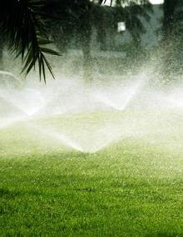
Outdoor Irrigation Restrictions
      Even: Sunday, Wednesday, Friday
      Odd street - no street addresses/: Tuesday, Thursday, Saturday
      No watering 9 a.m.- 5 p.m.
      Exemptions: drip systems, micro spray, hand-watering

Slide 15
Water Waste Enforcement Measures
Approved enforcement measures:
  Written notice
  Option to assess $25 or $50 penalty
  Authorization to install flow restrictor
  Authorization to discontinue water service

Slide 16
Water Budgets
Temporarily suspended effective July 29, 2016
Reduction targets to show on bill
All previously banked water will remain in customers’ accounts through the current drought period (January 2017)
Drought conditions will be reassessed and a decision will be made at that time
Bank information will not show on future bills, but is still available online
Appeals were offered to assist customers with unique challenges, no longer accepted after July 28, 2016

Slide 17
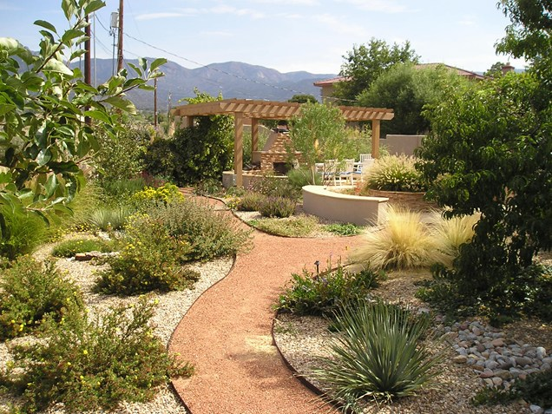
Residential Conservation Programs
High-efficiency (HE) toilet rebates
HE clothes washer rebates
Smart Irrigation Controller rebates
Free sprinkler nozzles
HE toilet delivery (limited)
Conservation kits

Slide 18
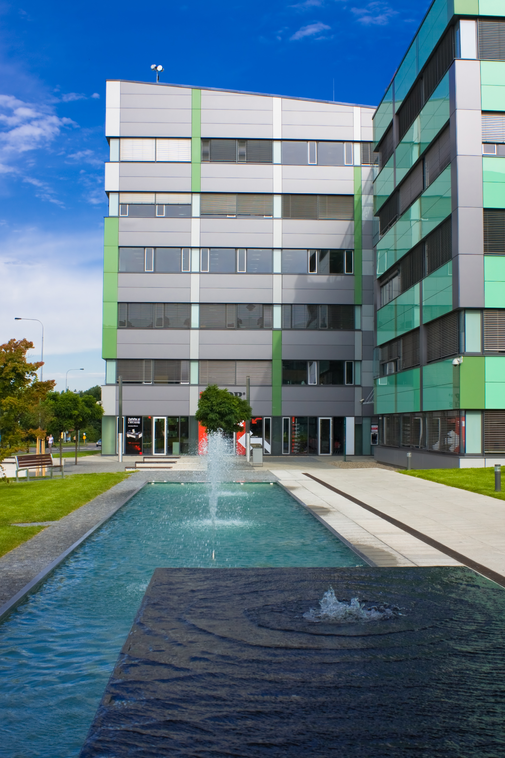
Commercial Conservation Programs
HE toilet rebates
HE urinal rebates
HE clothes washer rebates
Smart Irrigation Controller rebates
Water-use efficiency evaluations
Free sprinkler nozzles
Rotating nozzle rebates
Spray body with integrated pressure regulation and check valve rebates

Slide 19
Notes:
2016 - 21 million gallons saved with expected lifetime of 210 million gallons

Slide 20
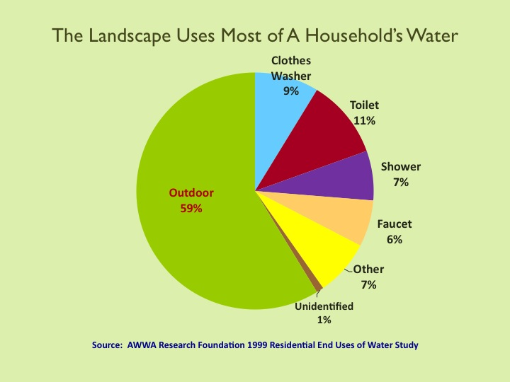

Slide 21
Other Cal Water Resources for Customers
Drought resources page on calwater.com
Fact/tip sheets
Informational mailings
Social media
  Facebook: facebook.com/calwater
  Twitter: @calwaterservice
  YouTube: calwater1

Slide 22
Cal Water’s Local Customer Center
(661) 837-7200
infoBK@calwater.com

Slide 23

Quality. Service. Value.

