Slide 1


Kern County Water Summit
Richard Chapman
March 1, 2017
Presented by the Water Association of Kern County

Slide 2
“History may not always repeat, but it often rhymes.”
Mark Twain
Presented by the Water Association of Kern County

Slide 3
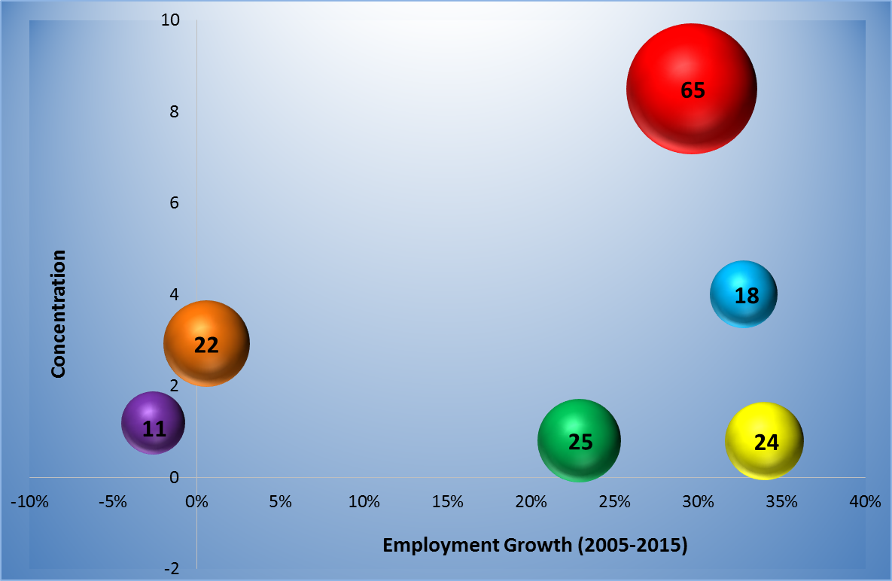
Kern County’s Economic Portfolio
Value-Added Agriculture
Energy & Natural Resources
Aerospace
Tourism
Healthcare
Logistics
Presented by the Water Association of Kern County

Slide 4
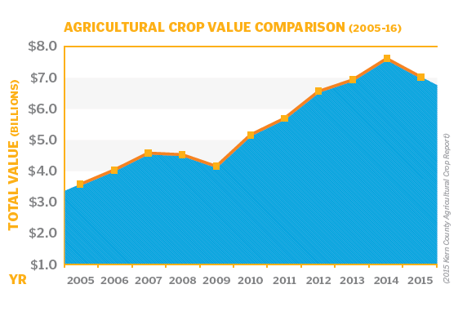
Presented by the Water Association of Kern County

Slide 5
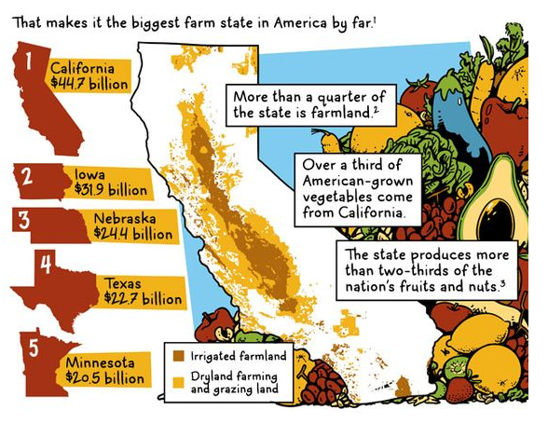
Presented by the Water Association of Kern County

Slide 6
Breakdown of Type II Employment Multiplier
Agriculture Sector
Direct Effects
1.00
Agriculture Sector
Indirect Effects
0.43
Induced Effects
0.82
Total
2.25
Presented by the Water Association of Kern County

Slide 7


The Value of a Job
The regional economic impact of 100 jobs includes spending:
$7,400,000
in residential real estate
$1,390,000
in car payments and insurance
$962,000
in recreation, entertainment and restaurants
$825,000
in clothing/apparel, furniture and appliances
$2,376,000
in business services and other retain
… and millions more in commercial real estate, housing,
bank deposits, real estate taxes and others
IN ONE YEAR!
Presented by the Water Association of Kern County

Slide 8
Future Employment Opportunities
USDA study estimates that demand in agriculture and life science-related fields will be strongest for:
Water Resource Scientists & Engineers
Farm Animal Veterinarians
Plant Scientists
Precision Ag & Pest Control Specialists
Presented by the Water Association of Kern County

Slide 9
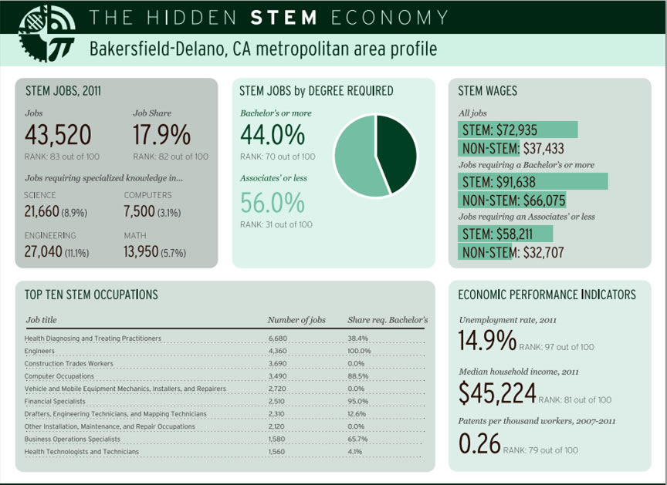
Presented by the Water Association of Kern County

Slide 10
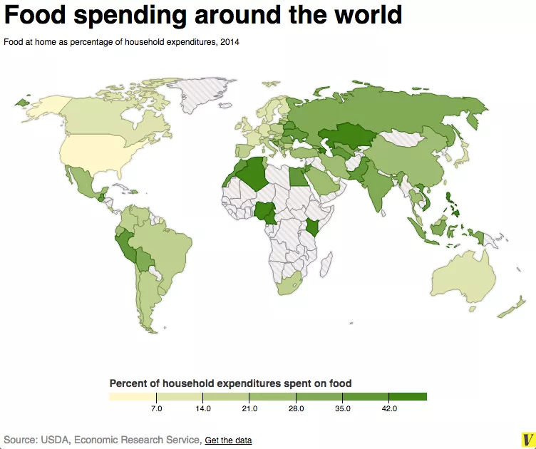
Presented by the Water Association of Kern County

Slide 11
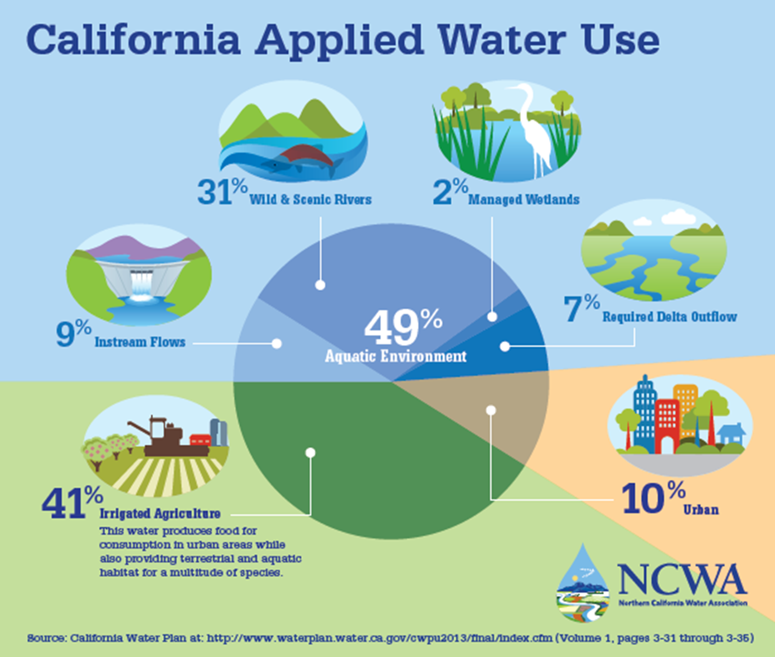
Presented by the Water Association of Kern County

Slide 12
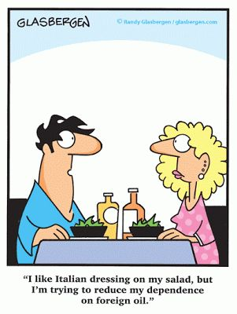
Presented by the Water Association of Kern County

