Slide 1


Presented by the Water Association of Kern County

Slide 2

Presented by the Water Association of Kern County

Slide 3
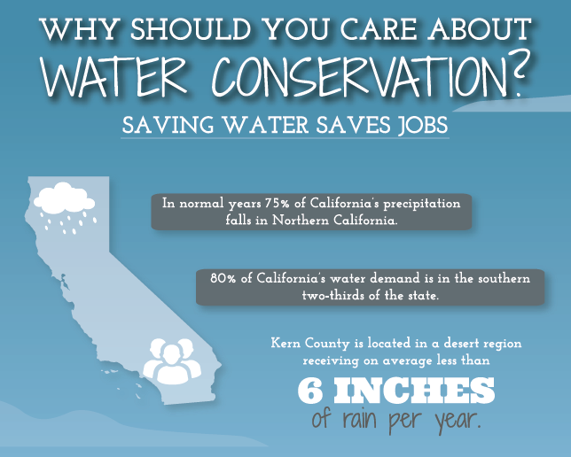
Presented by the Water Association of Kern County

Slide 4
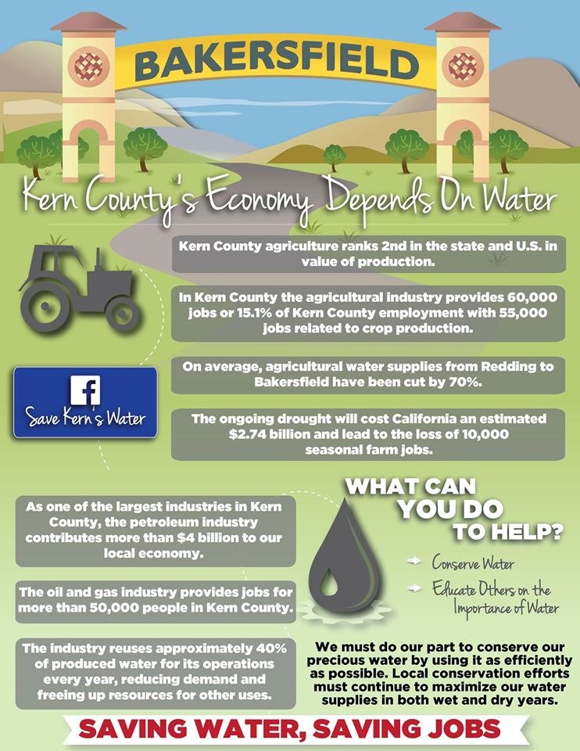
Presented by the Water Association of Kern County

Slide 5
Presented by the Water Association of Kern County

