Slide 1

Drought and a Changing Climate
Notes:
Everybody else on the agenda has some positive spin about working with our available water supply.
Not me; I get to deliver the gloom and doom talk about drought and a changing climate.
My job is to remove any remaining joy from your hearts.
If you are subject to bouts of depression, this is your opportunity to leave the room; come back in 25 minutes.
This is not a talk about some change predicted to occur in the future.
This is about how the last 3 decades differ from the 9 decades that came before them.
The good times ended in the mid-1980s. We just didn’t recognize that change when it began.

Slide 2
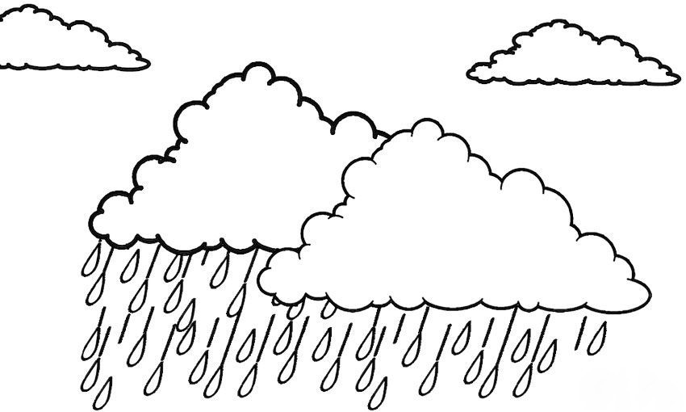
Three ways to think about drought:
1. A period of less than average precipitation
Notes:
There are at least three very good ways to view drought.
First, drought can be viewed as a period of time when precipitation is significantly less than average.
Runoff in our basin was only 35% of average during the 2012-15 drought.

Slide 3
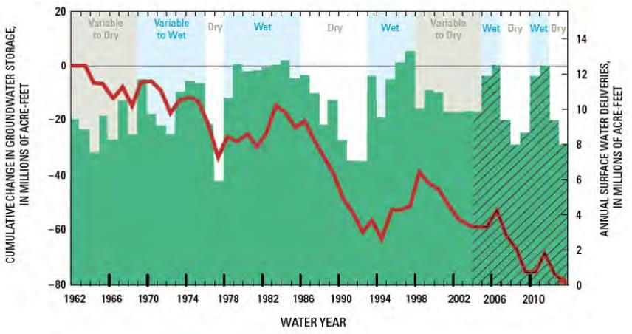
2. Water supply is inadequate to meet the demand of humans — the amount we chose to apply
Notes:
Second, drought can be viewed as a period of time when our dedicated and developed water supplies are inadequate to meet the water demand of humans, the amount of water we chose to apply.
If we’ve got enough water supply to meet our needs, our water demand, then we aren’t in drought.
Dedicated and developed water supplies are the sustainable component of applied water.
When our sustainable water supplies are inadequate to meet our demand, we routinely turn to our groundwater reserves.
We have been doing this since the 1880s (and the discovery of the Artesian Belt) when we first learned how to tap our groundwater reserves.
This repeated turning to groundwater to make up for our unmet needs has resulted in a significant draining of our groundwater aquifer.
Basin-wide, our groundwater aquifer has been going down an average of 2–4 feet per year in recent years.
When groundwater first began to be used for irrigation, it was commonly believed that the supply was inexhaustible.
But as the draft on the groundwater increased, that soon changed.
The artesian belt covered over one million acres.
The artesian wells stopped flowing in the first few years of the 1900s.
A lowering of the water table was noted in many areas by the mid-1920s, 90 years ago.
Groundwater began dropping in earnest in the 1930s with the introduction of rural electricity and affordable pumps.
Over the past 150 years (since the 1860s), the Central Valley has lost about 38 cubic miles of groundwater.
Most of that volume came out of the Tulare Lake Basin.
That is a huge volume of water, equivalent to 130 million acre-feet — more than the volume of Lake Tahoe.
That could cover the entire state of California to a depth of 15 inches.
More than half of that (about 73 million acre-feet) has been lost during the last 52 years (1962-2014).
In recent years, our basin has been overdrawing the groundwater aquifer by about 1.2 million acre-feet per year.
For perspective, that is equal to the average flows of the Kaweah, Tule, and Kern Rivers, combined.
That is a very big problem.
That is not sustainable in the long run.

Slide 4
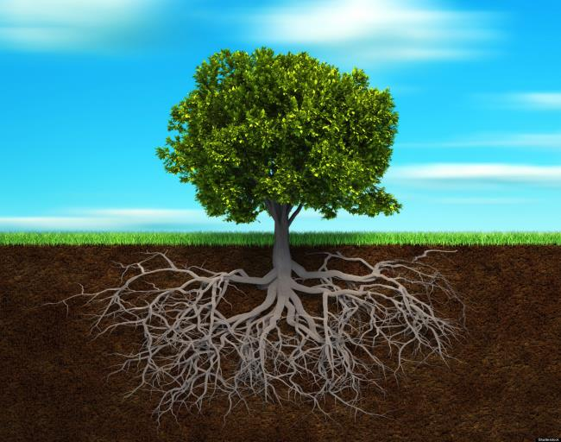
3. Water supply is inadequate to meet demand of plants — to avoid water stress
Notes:
A third way of looking at drought is a period of time when our water supplies are inadequate to meet the water demand of plants.
Water demand, from a plant’s point of view, is the supply it needs to avoid stress.
Plants lose water vapor through their leaves and needles; they are natural vaporizers.
The term for this is transpiration or, more generally, evapotranspiration (ET).
Water vapor is invisible, but it constitutes an enormous amount of water.
The Tulare Lake Basin loses 23 million acre-feet of water through evapotranspiration in an average year.
All the water we use each year is converted to ET and sent over the Sierra; that’s why we are not immersed under a giant lake.
Think of evapotranspiration like a straw that runs from the canopy to the roots.
The suction in that straw is called potential evapotranspiration (PET).
Potential in this sense is how much water would be sucked back up that straw to the canopy if supply were readily available down in the root zone.
The hotter the temperature, the greater the suction in that straw.
On a hot day, PET is like a giant sucking sound.
The higher the temperature, the more water plants need to avoid water stress. Just like humans.
The water supply that comes up that straw in response to PET, gets vaporized through the leaves and needles.
If plenty of water comes up that straw, the plant is happy.
But in drought conditions, plants may not be able to get all the water that they need.
If there isn’t enough water supply available in the root zone to meet demand (PET), the plant is under water stress.
The difference between demand (PET), and supply (actual ET), is how much water stress the plant is under.
That is how much additional water supply would be needed to make up for the water deficiency.
That difference between PET and actual ET is the size of the drought from the viewpoint of plants.

Slide 5

Plants view drought like a mathematician
Notes:
From the viewpoint of plants, there are two sides of the drought equation, which is called the Palmer Drought Severity Index.
If PDSI is 0, plants are happy; they have all the water they can use.
It PDSI is positive; plants have a greater supply of water than they can use.
If PDSI is negative, plants experience a water deficiency and are in drought; they are in water stress.
The bigger the negative number, the more severe the drought is from the viewpoint of plants.

Slide 6
Topics to be addressed
Water demand. Increase in temperature, potential evapotranspiration, and frequency of severe droughts since the mid-1980s.
Water supply. Apparent decrease in frequency of rain-producing weather types and precipitation since the mid-1980s.
Water supply. Decrease in average runoff since the mid-1980s.
Notes:
I’ll be moving these topics pretty fast to cover everything in the available time.
There will be time at the end of my presentation for questions.
If I slip by a topic too quickly before I explain it adequately, stop me right then
That’s the time to address those questions.
These are complex issues; my goal is to explain them clearly, not just run through them.

Slide 7
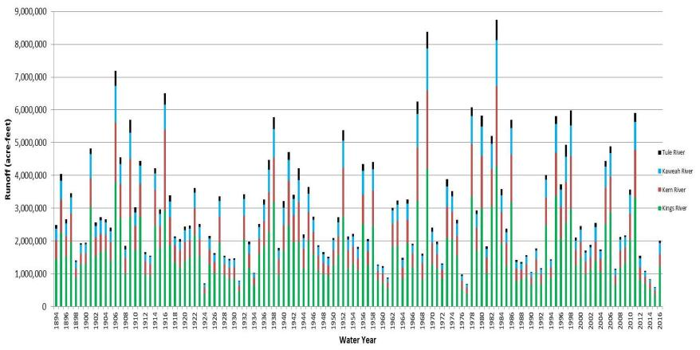
Variation in runoff over past 123 years: 1894–2016
Conditions changed 30 years ago
Notes:
Runoff is a reflection of precipitation
Only about 24% of the 13.6 million acre-feet that falls as average total precipitation becomes runoff.
This chart shows runoff of our 4 big rivers, stacked one on top of the other.
The long-term average flow is 2.9 million acre-feet per year.
Precipitation and runoff in our area are extremely variable; we seldom have “normal.”
Point out the 17-year-long megadrought of 1918–34.
Point out the 2000–04, 2007–09, and 2012–15+ droughts.
These last 3 droughts can be thought of as a 16-year dry spell, interrupted by two short bursts of intense rainfall.
Those wet periods occurred because our precipitation has high variability.
Just like in the 1920s, we keep wondering if the drought has really ended.
If we look at this from California’s perspective, we have experienced 3 droughts of relatively average duration: the 2000–04, 2007–09, and the 2012–15+ droughts.
However, if we were to step back and look at the bigger picture, we are really on the edge of a record-setting megadrought.
More area in the Western U.S. has persistently been in drought during the 16-year period from 2000–15 than in any other 16-year period since recordkeeping began in 1895.
It is probably the worst 16-year period in more than 850 years, since about the 1150s.
1987 marked a big change in our precipitation.
Precipitation during the previous nine-year period (1978-1986) had been 39% above the long-term average.
In 1987, we entered a three-decade-long period of relatively dry years.
It began with the six-year drought of 1987–92.
We are only aware of 10 droughts in the last 11 centuries that have lasted 6 or more years.
Ranchers during this period made insurance claims from SCC because precipitation was less than 50% of what they thought was average. But what really was average precipitation?
1983 was 297% of the long-term average. The national park chose that year to determine safe yield for Giant Forest’s surface water system.
We built the new water plant and began operating it for this supposed safe yield. What did we get? We got OOPS — an Outcome Outside Planned Scenario.
It was a good lesson about the importance of identifying what average really is.
I’ll be talking about 3 big changes that have occurred since the mid-1980s.
But that doesn’t mean that a climate change necessarily occurred at that point.
It could be that the last 3 decades are different than previous decades.
It could be that a long-term trend first became noticeable in the mid-1980s and is getting more severe.
It could be both.

Slide 8
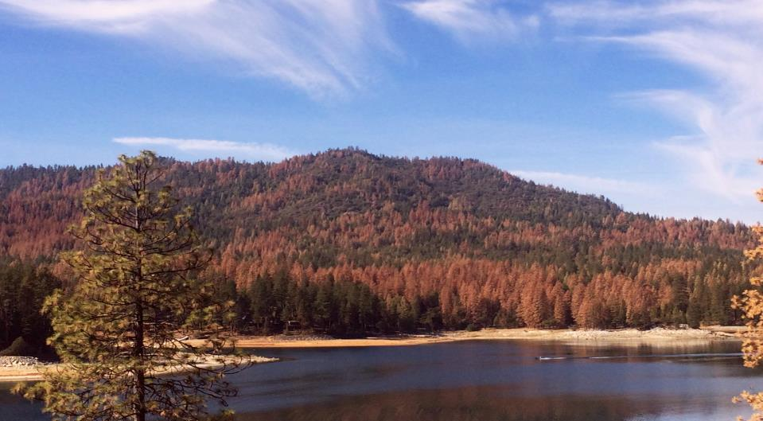
Conifer mortality
Notes:
This picture of pine mortality due to western pine beetle attack was taken in the Sierra National Forest.
Sustained high PDSI levels during the 2007–09 and 2012–15+ droughts severely stressed conifers throughout the Southern Sierra.
Drought-related moisture stress predisposes white firs and pines to successful attack by bark beetles.
Conifer mortality was particularly apparent in the lower montane zone (3000–6000 foot elevation), involving virtually all conifer species except giant sequoia.
The US Forest Service estimated that over 100 million trees died in California between 2010-2016.
62 million of those died in 2016 despite average rain the previous winter.
Among other things, this has raised fuel loads and the risk of large wildfires.
The current episode of beetle-caused mortality is much higher than what occurred in the 1918-34 and 1976–77 droughts.
From an ecological perspective, this mortality event is roughly equivalent to a hot, patchy fire.
Bark beetles, under epidemic population levels, are not very selective thinning agents.
They are a crude tool, but the result is more or less what land managers want to accomplish, especially in the face of global climate change.
The mortality significantly reduces stand density in a mosaic patchwork.

Slide 9
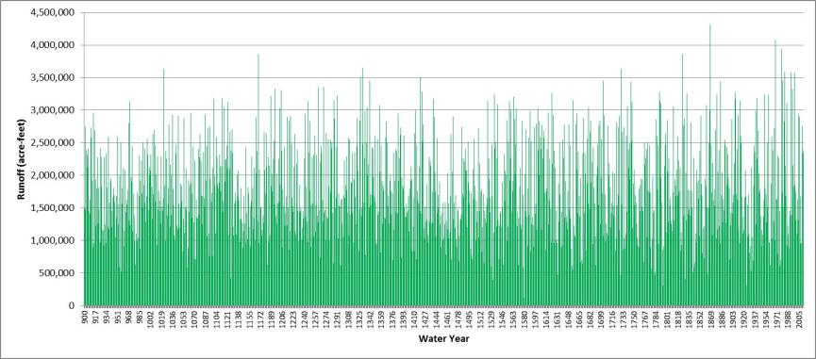
Variation in runoff over 1113 years: 900–2012
Upper San Joaquin River — Millerton Lake
Notes:
So what is putting all the water stress on plants; what is driving up PDSI?
Let’s start with the history of precipitation.
This is based on tree-ring reconstruction.
This is the REALLY big picture. The graph is way too busy to read from a distance.
But it shows you what kind of data is available.
The biggest drought year during this period was 1580.
The tree ring for that year is barely detectable.
That year is the low flow-of-record on every river in the Southern Sierra.
When we set a record low flow in 2015; that was #2 to the year 1580.
When you look at the top dozen drought years, only three of our droughts since 1894 make that list: 2015, 1977, and 1924. It is a reminder of how severe a drought can be in a given year.
Studies show that although our precipitation is very variable, there is no long-term tend, and no repeating pattern.
There were two megadroughts in the Great Basin and Merced River Basin before the Little Ice Age:
A 243-year megadrought that lasted from AD 832–1074.
A 178-year megadrought that lasted from AD 1122–1299.
There is no evidence that those droughts were in the San Joaquin River Basin.
The trend in precipitation has been relatively steady since 1300, and probably since 900.
There may have been a decrease in precipitation in the last three decades.

Slide 10
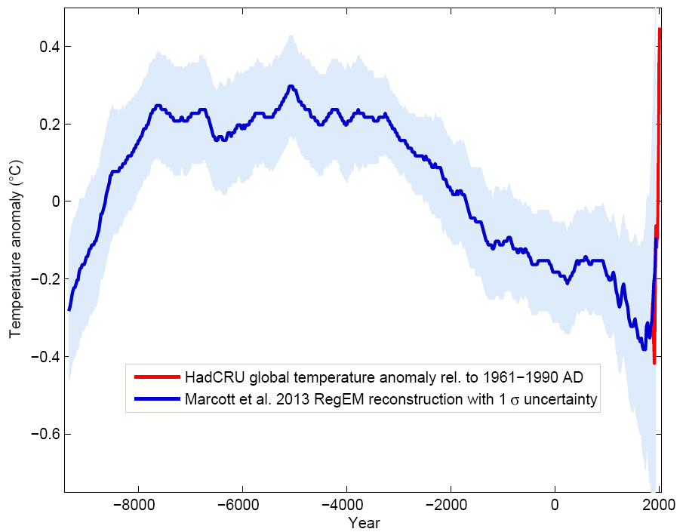
Change in global temperature for 11,000 years
Notes:
The other half of the PDSI equation is demand, driven by temperature.
This graph covers the entire Holocene period, just over 11,000 years.
A group of researchers from Harvard and Oregon State created this graph by combining 73 different reconstructions of temperatures from around the world.
From 11,000–7,000 years ago, the vegetation of the Tulare Lake Basin resembled that of the Great Basin, pinyon–juniper–oak woodland in the foothills, with greasewood on the salt flats near the lake. The upper watersheds consisted of open pine forests and dry meadows with very few sequoias.
A very dry period set in at the end of this warming period; it covered all North America. For example, from 7900 to 7500 years ago, the lake levels in the Great Lakes dropped dramatically, up to 66 feet below their outlets, so that they became disconnected from each other. Each lake became a closed basin, like the Tulare Lake Basin. Their overflow rivers, including the Niagara River, ran dry during this period.
From 7,000–4,500 years ago, the Tulare Lake basin was drier, and there was widespread increase in fire frequency. Great Basin-like vegetation (both woodland and greasewood) was generally replaced by drought-tolerant grassland and flowering plants.
A cooling (and moister) period began about 4,500 years ago. This is when the sequoia groves, the mixed conifer forest, and the wet Sierra meadows began developing. Fire was relatively infrequent in the upper watersheds prior to 4,500 years ago, apparently due to low fuel levels.
The Medieval Warm Period or Medieval Climatic Anomaly lasted from about 950–1250 A.D. The western Sierra was droughty and often fiery during the Medieval Warm Period; it had the most frequent fires of any period during the last 3,000 years. During that period, extensive fires burned through parts of Giant Forest at intervals of about 3–10 years.
Then the cooling trend resumed.
The Little Ice Age lasted from approximately 1275–1850.
The 5000-year cooling trend ended abruptly with the rapid warming of the 20th Century.
American settlement in the San Joaquin Valley began in 1850, right at the end of Little Ice Age.
The red line shows where temperature is today.
It has been 3 million years since temperatures were substantially warmer than this for a sustained time.

Slide 11
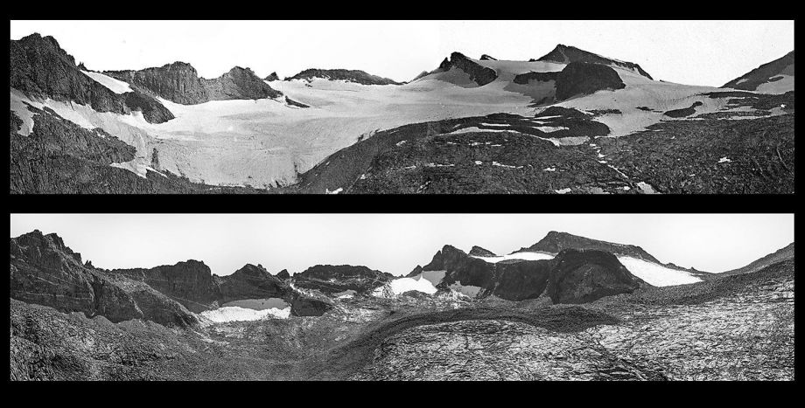
Melting of Sierra glaciers
Lyell Glacier 1883 - 2015
Notes:
Visalia was founded in 1852, right at the end of the Little Ice Age.
The glaciers in the Sierra have advanced and retreated with each of the various ice ages.
The Sierran glaciers reached their maximum extent during the Little Ice Age about 1850.
Lyell Glacier was discovered by John Muir in 1871, and was the largest glacier in Yosemite National Park.

Slide 12
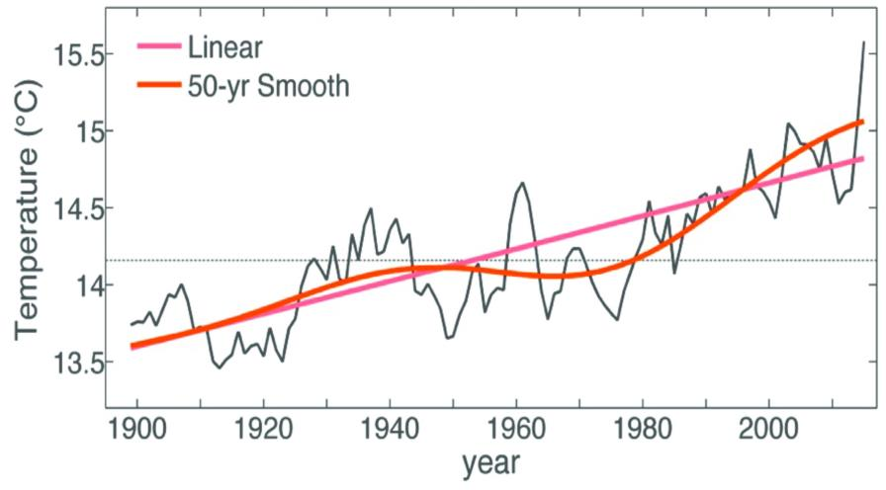
Changes in California average temperature for 120 years: 1895–2015
Notes:
This graph is from a 2015 study led by Park Williams of Columbia University.
It shows the statewide changes in precipitation for 120 years.
Temperature has been climbing since the end of the Little Ice Age in 1850.
It has not been climbing at a steady rate.
The average temperatures started climbing at an increased rate around 1970.
This is driven primarily by a rise in nighttime temperatures.
Many people have observed the decrease in valley fog, apparently due to warmer nighttime temperatures.
2016 was the 20th year in a row with U.S. temperatures above the 20th-century average.
Each of the last 3 decades has been much warmer than the decade before.
Temperatures along the West Coast have warmed much more than those in adjacent regions.
Rising temperatures have also increased potential evapotranspiration and decreased PDSI.

Slide 13
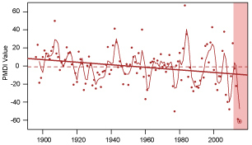
Changes in California drought severity for 120 years: 1896–2015
Notes:
This graph is from a 2016 Stanford study led by Daniel Swain.
It shows the statewide average for years measured August–July.
The red shaded regions depict the 2013-2015 drought
This study also showed that the long-term temperature trend associated with global warming has increased both the likelihood and the severity of drought in California—even when there is no significant change in precipitation.

Slide 14
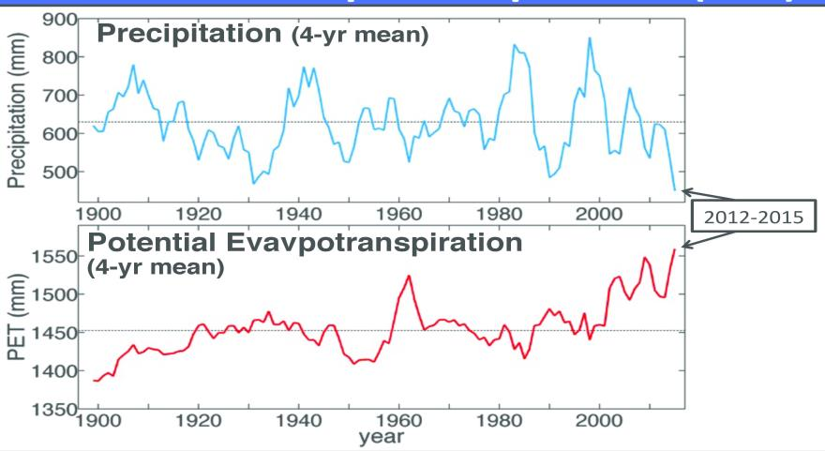
Changes in California precipitation and PET for 115 years: 1901–2015
Notes:
This graph is from a 2015 study led by Park Williams of Columbia University.
It shows the statewide changes in precipitation and potential evapotranspiration for 115 years.
Precipitation has shown little trend during this period while potential evapotranspiration has been increasing steadily, especially since the mid-1980s.

Slide 15
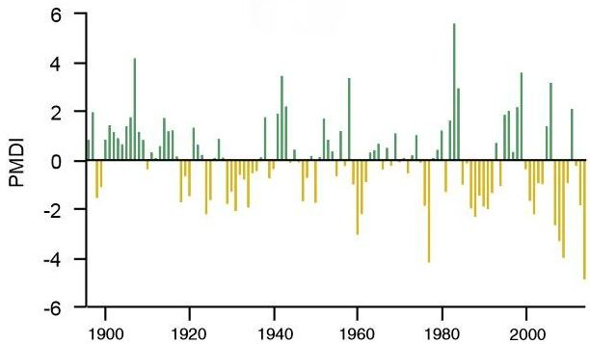
California drought severity for past 119 years: 1896–2014
Notes:
This is a statewide graph; done in 2015 by a team of Stanford researchers led by Noah Diffenbaugh.
Positive PDSI is good. But plants can’t make use of any available moisture above the 0 line.
Negative PDSI represents soil moisture deficiency or plant stress. That is drought.
Point out the two times when short bursts of intense rainfall have briefly broken through our current 16-year dry spell; they were able to compensate for the increasing PET.
Most severe droughts have occurred when conditions were both warmer and drier than average.
Dry years have been twice as likely to produce a severe drought if they occur in a warm year.
Severe droughts have occurred twice as often in the last two decades as in the previous century.
During the first century (1896–1994), only 27% of dry years resulted in severe droughts.
During the last two decades (1995–2014), 55% of dry years resulted in severe droughts.
This doubling in the risk of severe droughts has occurred despite statewide precipitation staying the same.
The other half of the PDSI equation is demand, driven by temperature.
The number of warm years has been twice as high in the last two decades as in the previous century.
During the first century (1896–1994), 45% of years were warm years.
During the last two decades (1995–2014), 80% of years were warm years.
The odds of a dry year occurring in a year that is warm have doubled in the last two decades.
That means the probability of a dry year producing a severe drought has doubled in the last two decades.
The future with continued rising temperatures? Virtually every dry year will be warm.
The frequency of severe droughts will increase.

Slide 16
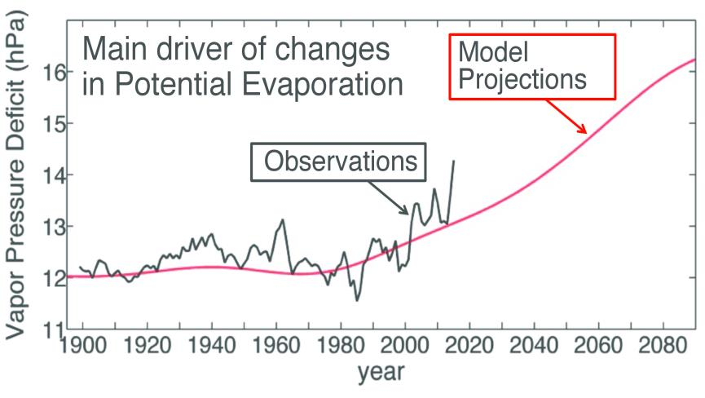
Changes in California PET
1901–2080
Notes:
This graph is from a 2015 study led by Park Williams of Columbia University.
It shows the statewide changes in potential evapotranspiration since 1901.
Potential evapotranspiration started climbing at an increased rate in the mid-1980s.
The 2015 Williams study essentially replicated the 2015 Stanford study.
They found that precipitation is the primary driver of droughts in California, but temperature has become a large and growing component.
The 2012–2014 drought would have been a fairly bad drought no matter what. But it was made worse by the increase in temperature and potential evapotranspiration. They calculated that about 15% to 20% of the 2012–2014 drought was due to the effects of increased temperature and potential evapotranspiration.
The odds of California suffering droughts at the far end of the scale, like the 2012–2014 drought, have roughly doubled over the past century.
Temperatures in California are forecast to continue increasing over at least the next few decades. Potential evapotranspiration is also forecast to continue increasing.
Our climate is changing, but it is still highly variable.
A 2016 study led by Daniel Swain at Stanford showed that we still periodically get short periods of intense rainfall; the frequency of those really wet periods has not been decreasing in recent decades.
Currently, these are periods when short bursts of intense rainfall overpower the effects of potential evaporation.
The 16-year drought that we are in has been interrupted by 2 of these bursts so far.
Several studies have shown that these periods have been getting shorter as temperature and potential evapotranspiration increase.
The Williams study found that by the 2060s, 50 years from now, more or less permanent drought conditions will set in. By then, potential evaporation will overpower virtually all the short bursts of intense rainfall.
Supply (precipitation) will no longer be able to compensate for the increased demand (PET). PDSI will always be negative.

Slide 17
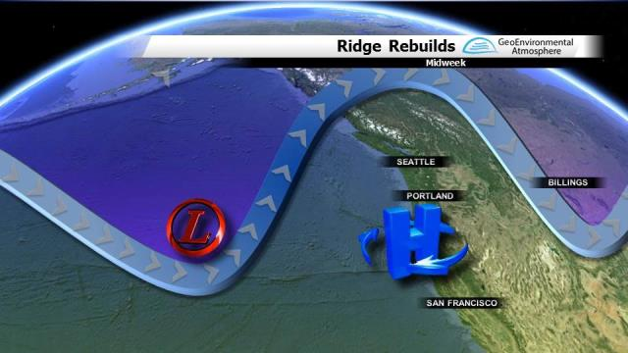
High pressure ridge
The cause of our biggest droughts
Notes:
Sometimes an unusually persistent high pressure ridge will develop in the winter off the West Coast, deflecting the Pacific storm track north of its typical cool-season position along the West Coast.
This is a very strong ridge of high pressure along the entire West Coast, from southern California all the way to the Alaskan arctic.
When this ridge is present, eastward-moving Pacific storms that appear destined for California often veer north before they penetrate very far into the state.
Because the storm track stops short, northern watersheds get more precipitation than southern watersheds.
This ridging pattern has preceded some of the worst West Coast droughts.
The 1934 drought was caused by a high pressure ridge over the West Coast.
Such a ridge preceded the first year of the 1976–77 drought.
It was the cause of the dry winters of 2013–14 and 2014–15.
The three patterns that tend to bring the most wet weather to the Southwest all involve low pressure systems centered in the North Pacific just off the coast of Washington, typically during the winter.
California relies on the rain and snow that falls when the jet stream dips south—and it does this for relatively short intervals—sending storm systems barreling toward us.
The most important of these storms are associated with atmospheric rivers.
Atmospheric rivers are the source of nearly half of California’s precipitation, and they cause the large majority of our major serious floods.
This dependence of California’s entire water supply upon the occurrence of just a few atmospheric river events each winter means that a surplus or deficit of just one or two such storms can quickly increase the risk of flood or drought in any given year.
As a result, diversion of the Pacific storm track by unusually persistent winter ridges is the most common cause of California droughts.
Research has shown that the high pressure ridge has become more pronounced and persistent during the last three decades.
As a result, drought years (warm years with few low-pressure weather systems) have occurred more often during the last three decades.
A 2016 study from Stanford, Northwestern, and Columbia confirmed with high confidence that increasingly frequent atmospheric patterns conducive to extreme drought in California are increasing.
However, there has been no decrease in atmospheric patterns conducive to very wet years. Those are the years that interrupt droughts.
This observed increase in dry/wet extremes (and fewer normal years) is consistent with climate model projections for California in the 21st century.

Slide 18
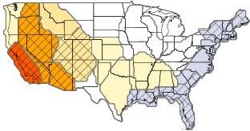
Change in frequency of rain-producing weather types
(1980-2010)
Notes:
The Pacific Southwest subregion experienced a greater decrease in rain-producing weather types than any other subregion in the country.
The observed drying trend becomes less severe as you move inland.
Increasing sea level pressure trends in the North Pacific are the main driver for this observed decreasing trend in rain-producing weather types in the Pacific Southwest subregion.

Slide 19
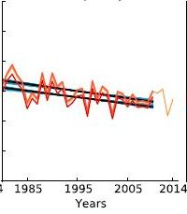
Change in frequency of rain-producing weather types
Pacific Southwest Subregion (1980-2010)
Notes:
During the 30-year period 1980-2010, the frequency of rain-producing weather types in the Pacific Southwest subregion decreased at -7% per decade, using 1980 as a baseline.
The Pacific Southwest subregion lost approximately 25% of its precipitation during the 30-year period 1980-2010 due to the decrease of rain-producing weather types.
This means that our subregion received 25% less precipitation on average in 2010 than we were receiving 30 years earlier in 1980.
That trend appears to be continuing.
This suggests that the precipitation regime for our region is decreasing; the safe yield for each decade is lower than for the previous decade.

Slide 20
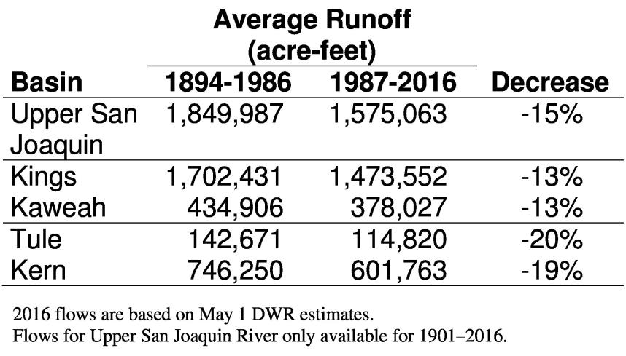
Decrease in runoff — last three decades
Notes:
The researchers involved in those two studies are well respected, and their research was peer reviewed.
But if their research findings are “real,” we should see it reflected in our stream gages.
We have 123 years of stream gage data for the four rivers in the Tulare Lake Basin.
The average runoff for the last 3 decades has decreased compared to the average for the previous 9 decades for every river basin that we’ve checked throughout the Central Valley.
The decrease has been greatest in the southern basins (Tule and Kern).
There has been a decrease of about 13-15% in the Kaweah, Kings and Mono Basins.
The four biggest river basins in the Sacramento Valley have experienced an average decrease of about 11%.
That is the kind of results we would expect if the winter high pressure ridge has become more pronounced and persistent during the last 3 decades, reducing the frequency of rain-producing weather types in the southern part of the San Joaquin Valley.
Some portion of this decrease in runoff was probably due to increased temperatures and evapotranspiration.
In any case, this suggests that the precipitation and runoff regime for our basin has changed; years prior to the mid-1980s can’t be used when calculating what our current safe yield is.
One possibility is that the decrease in observed runoff could have been caused by rain-producing weather types and precipitation. If it weren’t for the NCAR study, we wouldn’t know that our precipitation was decreasing.
Another possibility is that the decrease in observed runoff could have been caused by the increase in potential evapotranspiration. Potential evapotranspiration has been increasing steadily, especially since the mid-1980s. But nobody has shown that this can cause decreased runoff in California.
There is a third possibility; we could be experiencing a statistical oddity.
So I did the calculations.
If, say, the next four years (2017-2020) were a repeat of the very wet 4-year spell that we experienced in 1995-1998, this would wipe out about three-quarters of the negative trend that began in the mid-1980s.
(It would only be half in the Kern River Basin.)
Many residents in our area are hopeful that something like this will occur; the sooner the better.
Me, too. But I don’t think we should plan on it.
Removing the preceding nine-year wet period (1978-1986) from the analysis would reduce the amount of the observed change by about a third.

Slide 21
Take-away messages
Current drought from the perspective of plants
Plants have required more water to avoid stress since the mid-1980s. Increase in PET driving increase in significant droughts. Trend seems bad.
Apparent decrease in frequency of rain-producing weather types and precipitation since the mid-1980s. Trend seems bad.
Runoff has been reduced since the mid-1980s. Three plausible explanations.
Current drought began in 2000. Two brief interruptions caused by short bursts of intense rainfall.
Notes:
Number 1. We understand what is going on with #1; the cause and effect.
Number 2 and 3. These are just observations of what is occurring.
These changes were not predicted by any of the climate models.
Neither of these big observed changes (the winter high pressure ridge becoming more pronounced and persistent, the decrease in the frequency of rain-producing weather types) are predicted by the climate models.
They just seem to be happening. Scientists are scrambling to figure out the causes.
There is more room for uncertainty whenever the cause of an observed effect is not understood.
Number 3. The possible causes of reduced runoff (reduced storm frequency and increased PET) are not mutually exclusive.
Time check: 25 minutes

