Slide 1
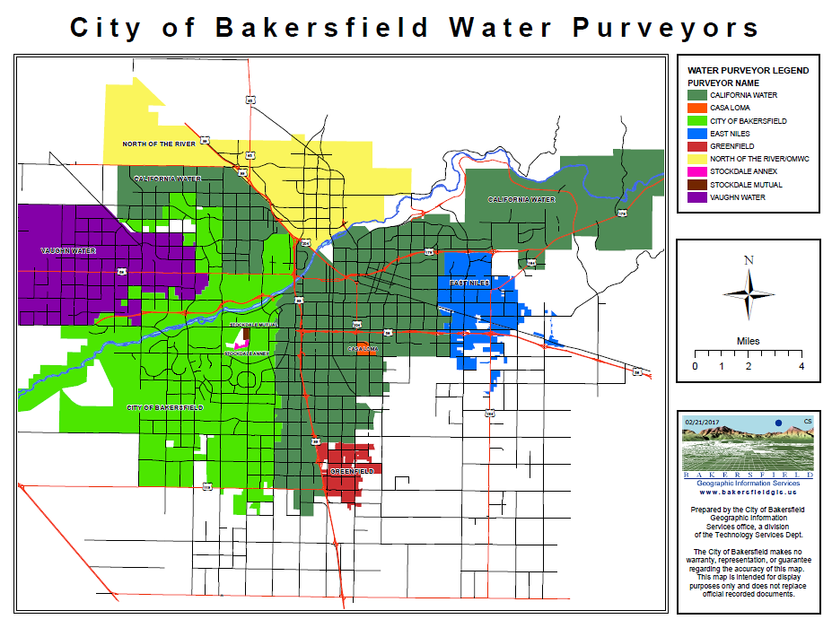

Presented by the Water Association of Kern County

Slide 2
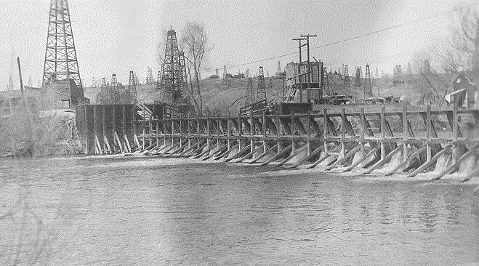
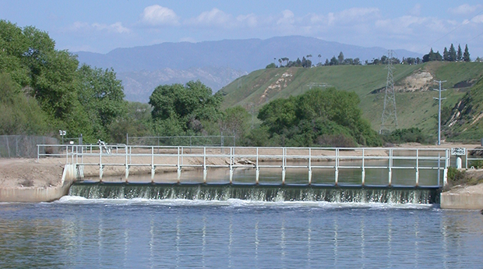
40 Years of City Domestic Water Service Area Growth
1977
2017
Presented by the Water Association of Kern County

Slide 3
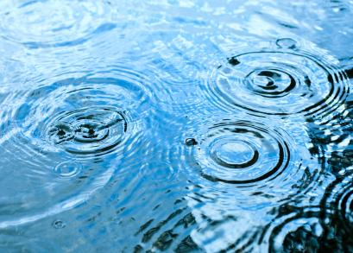
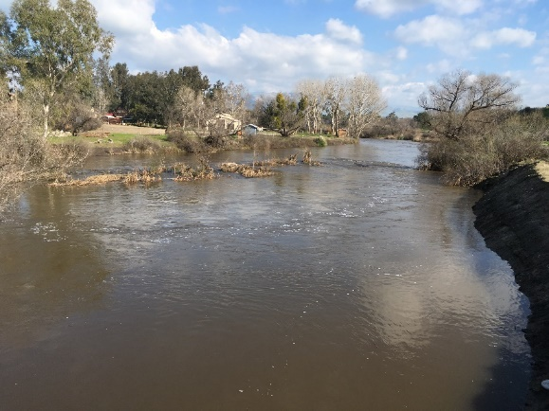
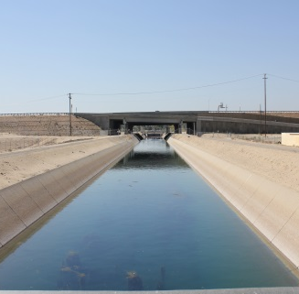
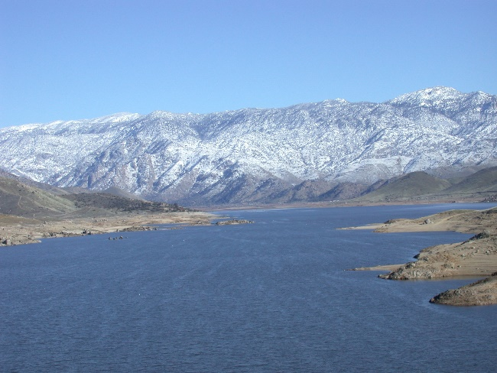
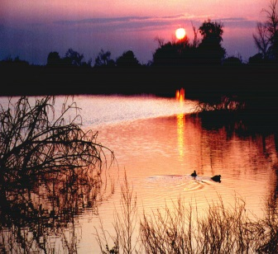
City of Bakersfield Sources of Water
State Water
Project
Precipitation
Other Supplies:
Tertiary Treated Water From WWTP 3
Seepage From Kern River and Canals
Percolation from Stormwater Basins
Water Conservation Efforts
Kern River
Groundwater from
Water Banking
Lake Isabella Storage
Presented by the Water Association of Kern County

