Slide 1
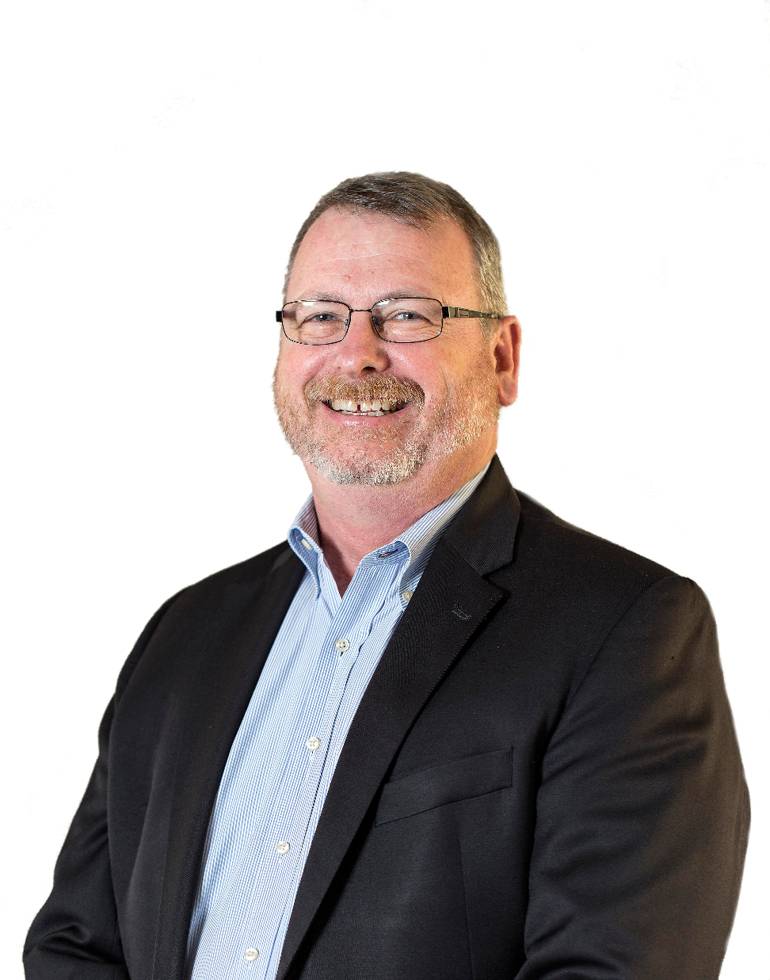
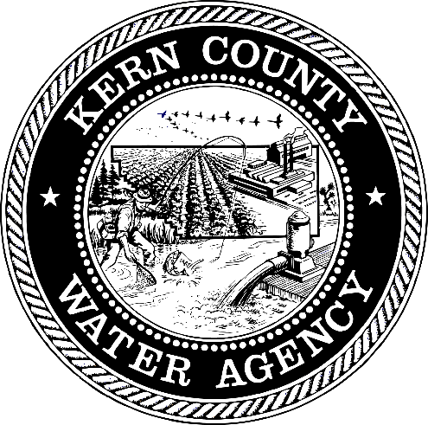

Kern County Water Agency
General Manager
Curtis Creel
Presented by the Water Association of Kern County

Slide 2
Water 101 — Where does Kern County/California get its water supply and how much is really available for development, farming, industry and homes?
Presented by the Water Association of Kern County

Slide 3
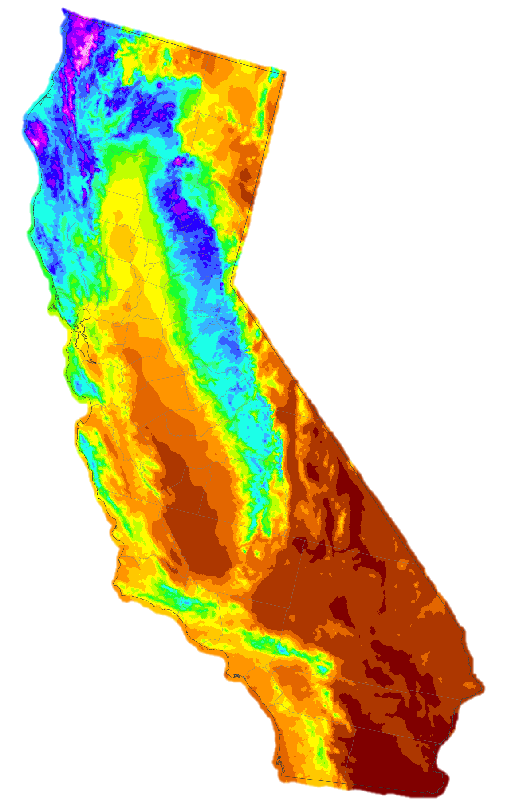
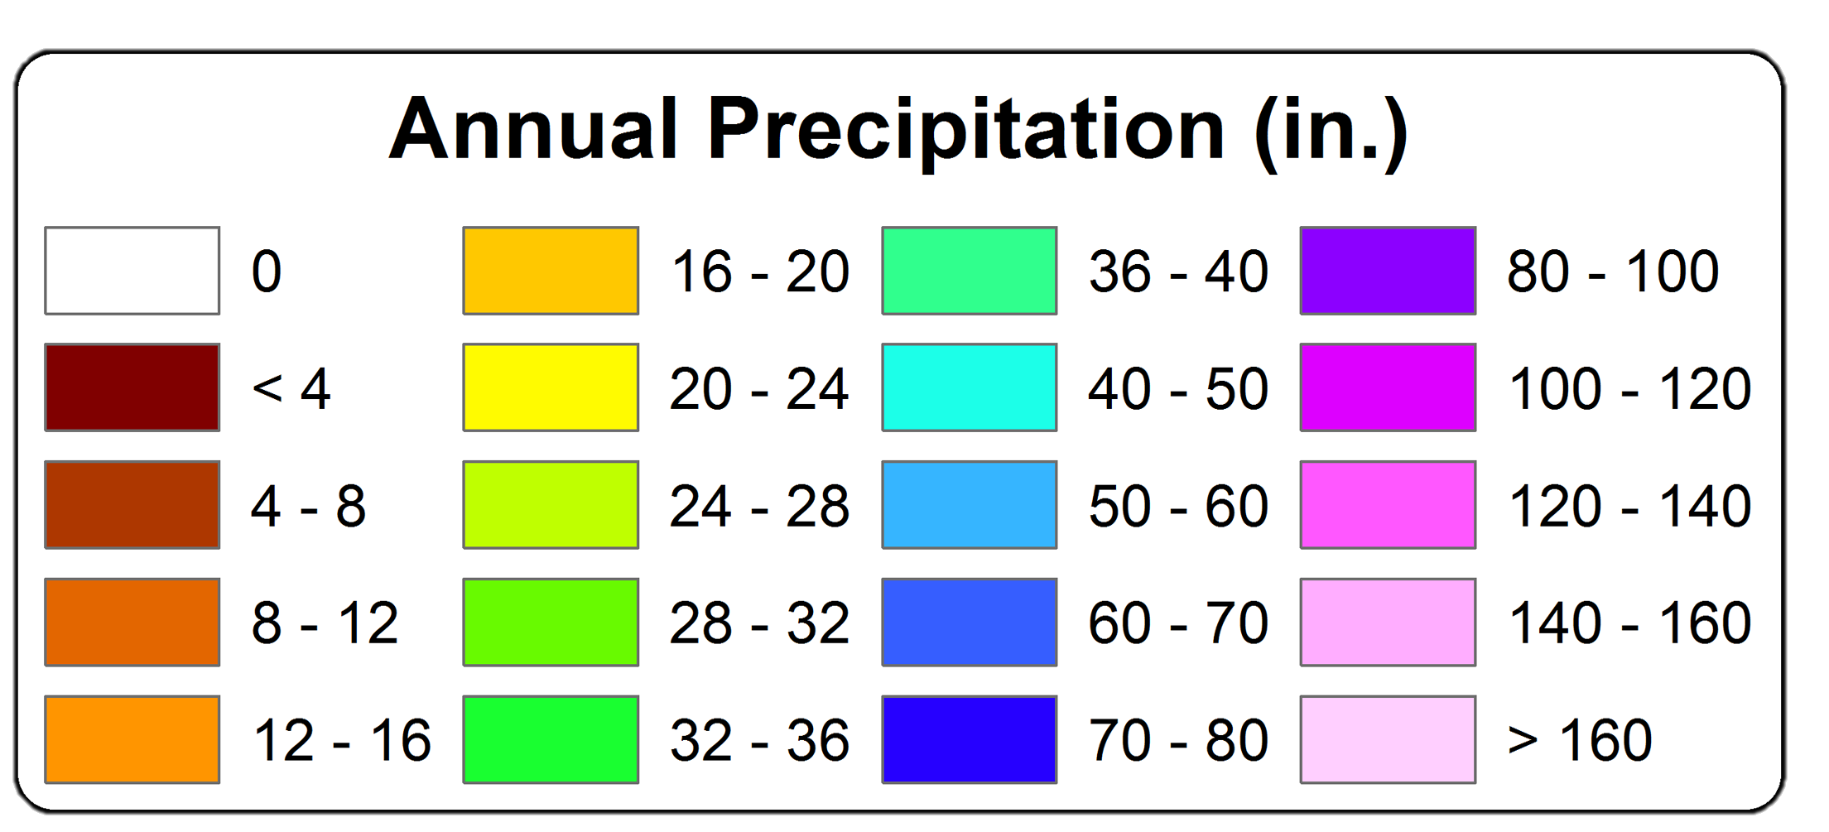
California’s Hydrology
Rain does not fall where people live and work
1981-2010 Prism Climate Group, OSU

Slide 4
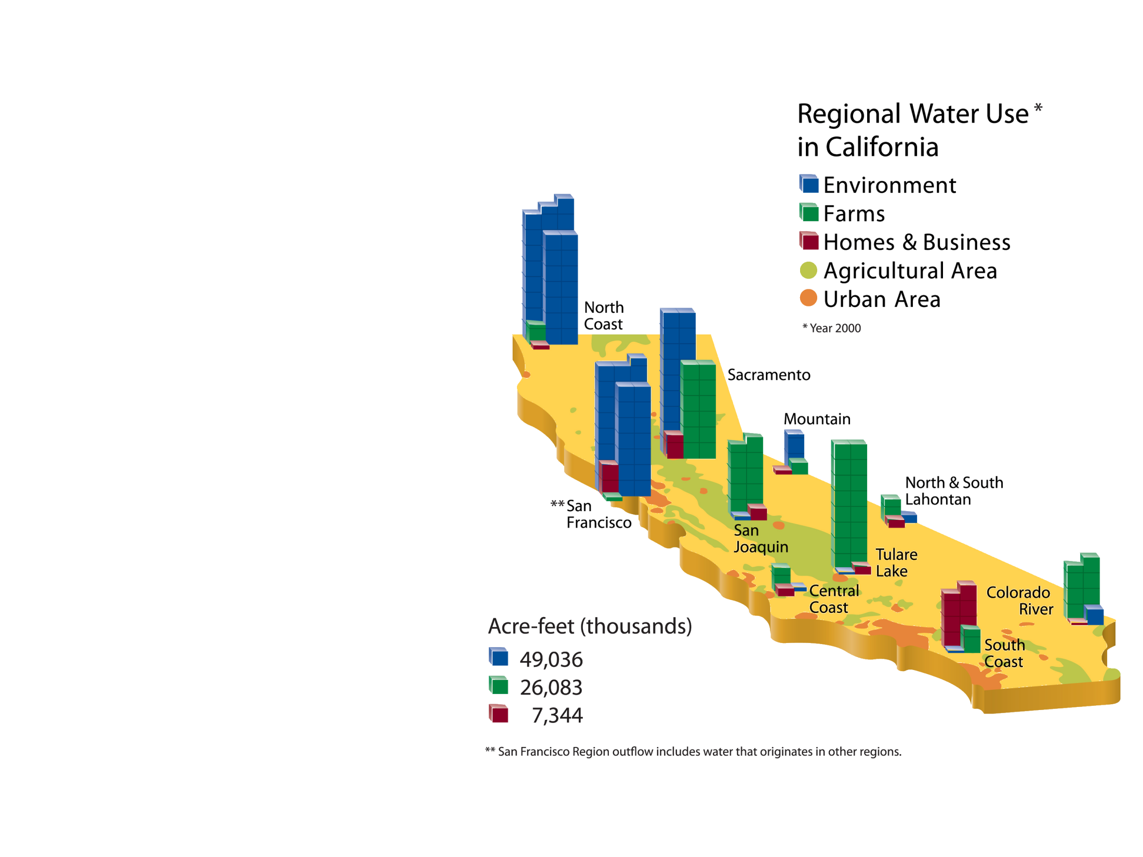
Who Uses Water In California?
Notes:
Is updated data available? If not, simplify to single slide with breakdown for state? – In theory, data should be in California Water Plan.

Slide 5
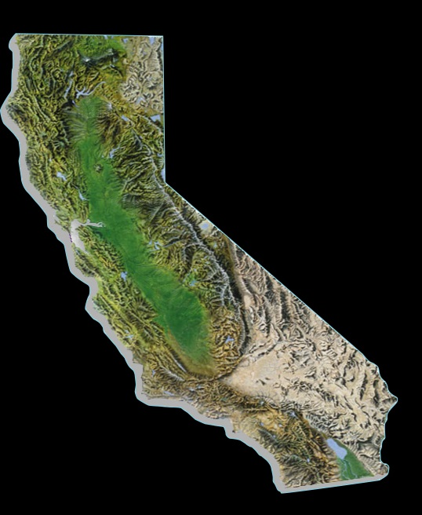
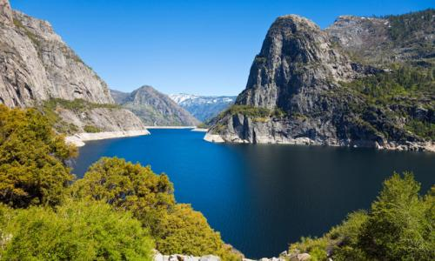
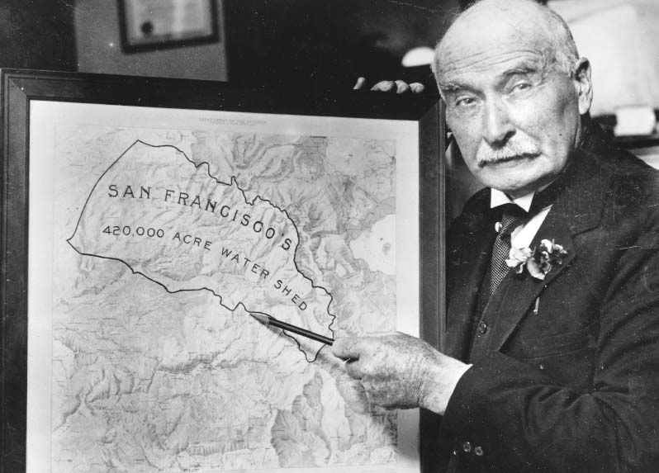
California’s Water Systems
Hetch Hetchy
System
Hetch Hetchy System
San Francisco Public Utilities Commission
1913
(Raker Act)
Notes:
The Central Valley Project (CVP) was originally conceived as a State project to protect the Central Valley from crippling water shortages and devastating floods. The basic concept and facilities of today's massive project were included in the State Water Project formulated in the 1930's. In the depression era, however, the State was unable to finance the project. Most of the water development envisioned by the State was accomplished by the Federal CVP, beginning with its initial authorization in 1935.
Work began in 1937 with the Contra Costa Canal which began delivering water in 1940. The next facility built was Shasta Dam, the keystone of the project. Work on the dam began in 1938, and water storage started even before its completion in 1945. Congress subsequently passed 13 separate measures to authorize the development of other major project facilities over the next 3 decades. The final dam, New Melones, was completed in 1979.
EBMUD is formed in 1923. In 1929, water itself reached the East Bay Area when East Bay Municipal Utility District voters completed Pardee Dam and the 82-mile long Mokelumne Aqueduct.
SWP - 1960 California voters approved the $1.75 billion Burns-Porter Act bond issue to begin building the State Water Project (SWP). The Project was designed and constructed by the Department of Water Resources. By 1973, the initial facilites were completed and water delivery to southern California began.
1971 On October 8, Governor Ronald Reagan starts the first pump at A.D. Edmonston Pumping Plant, as part of a ceremony celebrating the first water deliveries to Southern California.
LADWP: In 1907, the voters of Los Angeles again gave their overwhelming endorsement to this project, approving a $23 million bond issue for aqueduct construction. The only task that remained was to build it.

Slide 6
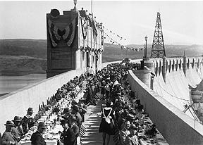


California’s Water Systems
Pardee Reservoir
Mokelumne
River Aqueduct
Hetch Hetchy
System
Mokelumne River
Aqueduct
East Bay Municipal
Utility District
1929
Notes:
The Central Valley Project (CVP) was originally conceived as a State project to protect the Central Valley from crippling water shortages and devastating floods. The basic concept and facilities of today's massive project were included in the State Water Project formulated in the 1930's. In the depression era, however, the State was unable to finance the project. Most of the water development envisioned by the State was accomplished by the Federal CVP, beginning with its initial authorization in 1935.
Work began in 1937 with the Contra Costa Canal which began delivering water in 1940. The next facility built was Shasta Dam, the keystone of the project. Work on the dam began in 1938, and water storage started even before its completion in 1945. Congress subsequently passed 13 separate measures to authorize the development of other major project facilities over the next 3 decades. The final dam, New Melones, was completed in 1979.
EBMUD is formed in 1923. In 1929, water itself reached the East Bay Area when East Bay Municipal Utility District voters completed Pardee Dam and the 82-mile long Mokelumne Aqueduct.
SWP - 1960 California voters approved the $1.75 billion Burns-Porter Act bond issue to begin building the State Water Project (SWP). The Project was designed and constructed by the Department of Water Resources. By 1973, the initial facilites were completed and water delivery to southern California began.
1971 On October 8, Governor Ronald Reagan starts the first pump at A.D. Edmonston Pumping Plant, as part of a ceremony celebrating the first water deliveries to Southern California.
LADWP: In 1907, the voters of Los Angeles again gave their overwhelming endorsement to this project, approving a $23 million bond issue for aqueduct construction. The only task that remained was to build it.

Slide 7
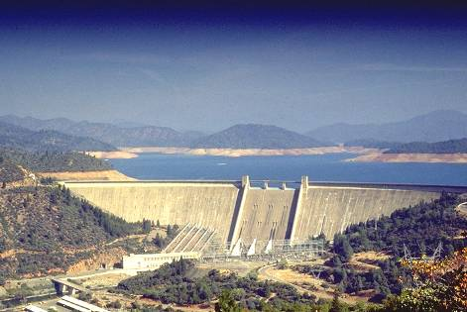
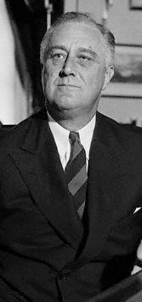



California’s Water Systems
Shasta Dam
CVP
Mokelumne
River Aqueduct
Franklin D.
Roosevelt
Hetch Hetchy
System
Central Valley Project
U.S. Bureau of Reclamation
1940
First water delivered via the Contra Costa Canal
Los Angeles
Aqueduct
Colorado River Aqueduct
Notes:
The Central Valley Project (CVP) was originally conceived as a State project to protect the Central Valley from crippling water shortages and devastating floods. The basic concept and facilities of today's massive project were included in the State Water Project formulated in the 1930's. In the depression era, however, the State was unable to finance the project. Most of the water development envisioned by the State was accomplished by the Federal CVP, beginning with its initial authorization in 1935.
Work began in 1937 with the Contra Costa Canal which began delivering water in 1940. The next facility built was Shasta Dam, the keystone of the project. Work on the dam began in 1938, and water storage started even before its completion in 1945. Congress subsequently passed 13 separate measures to authorize the development of other major project facilities over the next 3 decades. The final dam, New Melones, was completed in 1979.
EBMUD is formed in 1923. In 1929, water itself reached the East Bay Area when East Bay Municipal Utility District voters completed Pardee Dam and the 82-mile long Mokelumne Aqueduct.
SWP - 1960 California voters approved the $1.75 billion Burns-Porter Act bond issue to begin building the State Water Project (SWP). The Project was designed and constructed by the Department of Water Resources. By 1973, the initial facilites were completed and water delivery to southern California began.
1971 On October 8, Governor Ronald Reagan starts the first pump at A.D. Edmonston Pumping Plant, as part of a ceremony celebrating the first water deliveries to Southern California.
LADWP: In 1907, the voters of Los Angeles again gave their overwhelming endorsement to this project, approving a $23 million bond issue for aqueduct construction. The only task that remained was to build it.

Slide 8
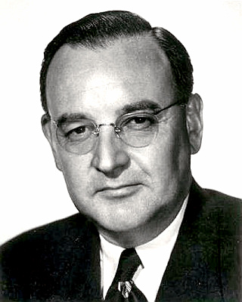
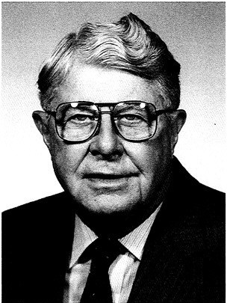
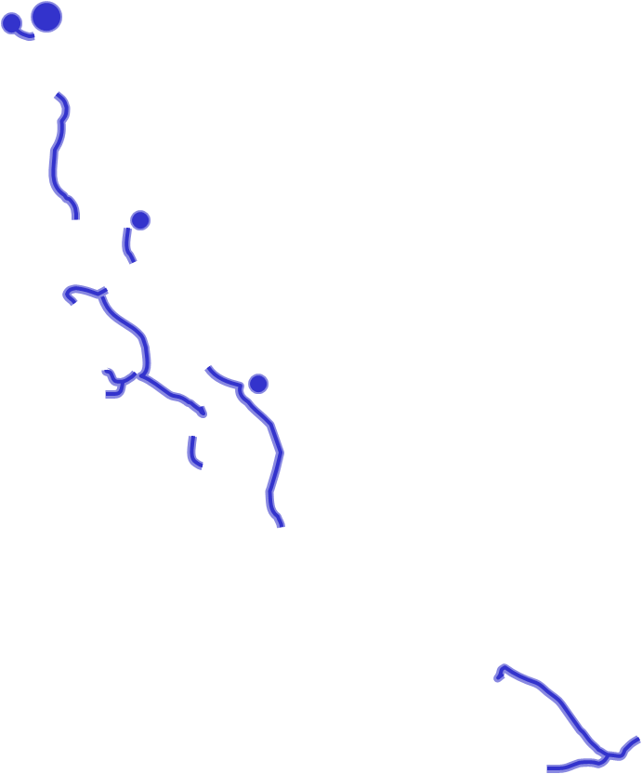
California’s Water Systems
Mokelumne
River Aqueduct
Hetch Hetchy
System
Governor Pat Brown
Harvey O. Banks
State Water Project
California Department
of Water Resources
1960 – Burns Porter Act
1973 – 1st water to So Cal
Los Angeles
Aqueduct
Colorado River Aqueduct
SWP
Notes:
The Central Valley Project (CVP) was originally conceived as a State project to protect the Central Valley from crippling water shortages and devastating floods. The basic concept and facilities of today's massive project were included in the State Water Project formulated in the 1930's. In the depression era, however, the State was unable to finance the project. Most of the water development envisioned by the State was accomplished by the Federal CVP, beginning with its initial authorization in 1935.
Work began in 1937 with the Contra Costa Canal which began delivering water in 1940. The next facility built was Shasta Dam, the keystone of the project. Work on the dam began in 1938, and water storage started even before its completion in 1945. Congress subsequently passed 13 separate measures to authorize the development of other major project facilities over the next 3 decades. The final dam, New Melones, was completed in 1979.
EBMUD is formed in 1923. In 1929, water itself reached the East Bay Area when East Bay Municipal Utility District voters completed Pardee Dam and the 82-mile long Mokelumne Aqueduct.
SWP - 1960 California voters approved the $1.75 billion Burns-Porter Act bond issue to begin building the State Water Project (SWP). The Project was designed and constructed by the Department of Water Resources. By 1973, the initial facilites were completed and water delivery to southern California began.
1971 On October 8, Governor Ronald Reagan starts the first pump at A.D. Edmonston Pumping Plant, as part of a ceremony celebrating the first water deliveries to Southern California.
LADWP: In 1907, the voters of Los Angeles again gave their overwhelming endorsement to this project, approving a $23 million bond issue for aqueduct construction. The only task that remained was to build it.

Slide 9
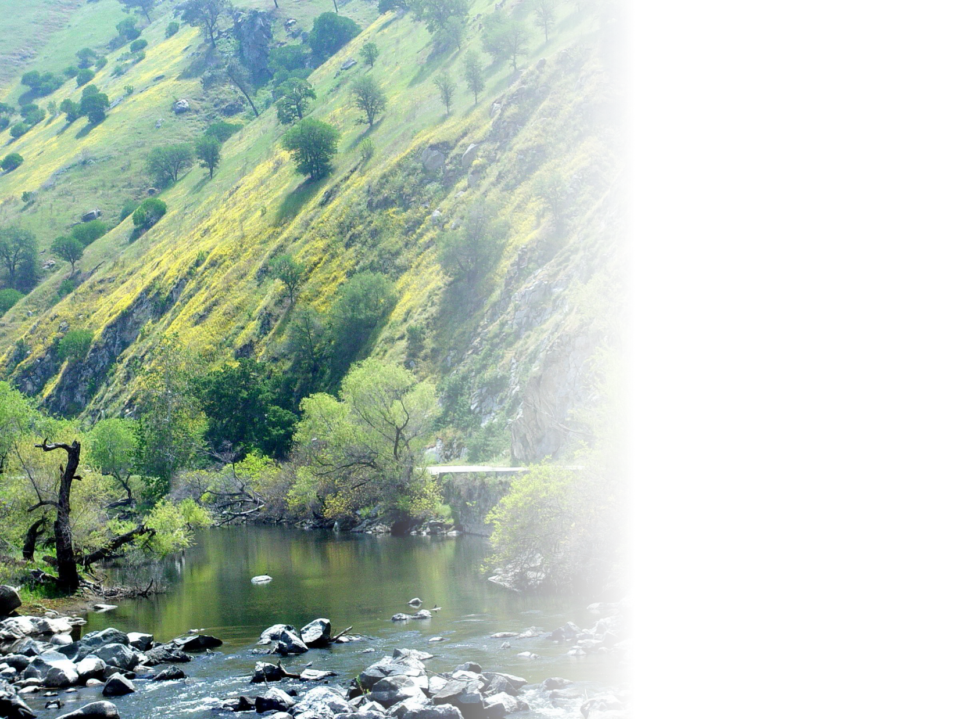
Kern County Sources of Surface Water
10-Year Supply Average (2002-11) in Acre-feet
SWP 890,990 af
CVP 433,800 af
Kern River 710,630 af
Misc. Local 205,930 af
Presented by the Water Association of Kern County

Slide 10
Kern County Sources of Water
10-Year Supply Average (2002-11) in Acre-feet
?
SWP 890,990 af
CVP 433,800 af
Kern River 710,630 af
Misc. Local 205,930 af
Presented by the Water Association of Kern County

Slide 11
Kern County Sources of Water
10-Year Supply Average (2002-11) in Acre-feet
SWP 890,990 af
CVP 433,800 af
Kern River 710,630 af
Misc. Local 205,930 af
Groundwater 1,434,650 af
Presented by the Water Association of Kern County

Slide 12
Kern River Districts | 745,000 af per year
California Aqueduct
Delano-Earlimart ID
Devils Den WD
Lost Hills WD
Southern San Joaquin MUD
Isabella
Reservoir
Kern-Tulare WD
Berrenda Mesa WD
Semitropic WSD
5
5
43
46
5
5
46
Kern River
33
Cawelo
WD
North Kern WSD
Belridge WSD
Shafter-Wasco ID
5
Friant-Kern Canal
178
5
5
5
Olcese WD
Buena Vista WSD
5
43
Bakersfield
Rosedale-Rio Bravo WSD
5
Cross Valley Canal
KCWA Improvement District No. 4
58
5
58
Arvin-Edison WSD
5
5
33
119
Kern Delta WD
West Kern WD
Henry Miller
WD
5
5
99
5
5
Tehachapi-Cummings CWD
Wheeler Ridge-Maricopa WSD
5
184
5
166
5
5
Tejon-Castac WD
Lebec CWD
4
0
4
8
Presented by the Water Association of Kern County
Notes:
Water type/facility colors should be consistent throughout presentation graphics.
Background maps should have same look/format throughout presentation.

Slide 13
Central Valley Project Districts | 392,100 af per year
California Aqueduct
Delano-Earlimart ID
Devils Den WD
Lost Hills WD
Southern San
Joaquin MUD
Isabella
Reservoir
Kern-Tulare WD
Berrenda Mesa WD
California Aqueduct
Semitropic WSD
5
5
43
North Kern WSD
46
5
5
46
33
Cawelo WD
Kern River
Shafter-Wasco ID
Belridge WSD
5
178
Buena Vista WSD
Friant-Kern Canal
5
5
5
Rosedale-Rio Bravo WSD
5
43
Bakersfield
Olcese WD
Cross Valley Canal
5
Cross Valley Canal
KCWA Improvement District No. 4
58
5
58
Arvin-Edison
WSD
5
5
33
119
Kern Delta WD
West Kern WD
Henry Miller WD
5
5
99
5
5
Tehachapi-Cummings CWD
Wheeler Ridge-Maricopa WSD
5
184
5
166
5
5
Tejon-Castac WD
Lebec CWD
4
0
4
8
Presented by the Water Association of Kern County
Notes:
Water type/facility colors should be consistent throughout presentation graphics.
Background maps should have same look/format throughout presentation.
Final slide shows two colors for CVP water types, this only shows one?

Slide 14
State Water Project Member Units | 799,400 af per year
Delano-Earlimart ID
Devils Den WD
Lost Hills
WD
Southern San Joaquin MUD
Isabella
Reservoir
Kern-Tulare WD
Berrenda Mesa WD
Semitropic WSD
5
5
43
North Kern WSD
46
5
5
46
33
Cawelo WD
Kern River
Belridge
WSD
Shafter-Wasco ID
5
Friant-Kern Canal
178
5
5
5
Buena Vista WSD
5
43
Bakersfield
Olcese WD
Rosedale-Rio Bravo WSD
5
Cross Valley Canal
KCWA ID4
58
California Aqueduct
Cross Valley Canal
5
58
Arvin-Edison WSD
5
5
33
119
Kern Delta WD
West Kern WD
Henry Miller WD
5
5
99
Tehachapi-Cummings CWD
5
5
Wheeler Ridge-Maricopa WSD
5
184
5
166
5
5
Tejon-Castac WD
Lebec CWD
4
0
4
8
Presented by the Water Association of Kern County
Notes:
Water type/facility colors should be consistent throughout presentation graphics.
Background maps should have same look/format throughout presentation.

Slide 15
Local Water Management Beyond Surface Supplies
2011
2015
Presented by the Water Association of Kern County

Slide 16

Water Supplies and Demands, SJV Portion of Kern
Acre-feet
Groundwater
Recharge
Groundwater
Recovery
Notes:
Lloyd to update information.

Slide 17
Kern County Groundwater Programs
California Aqueduct
Delano-Earlimart ID
Rag Gulch WD
City of Bakersfield 2,800 Acres
Devils Den WD
Lost Hills WD
Berrenda Mesa Banking
Southern San Joaquin MUD
Kern-Tulare WD
Isabella Reservoir
Pioneer Banking
Berrenda Mesa WD
Semitropic WSD
Semitropic WSD
Kern Water Bank
Semitropic WSD
North Kern WSD
North Kern WSD
5
5
43
46
46
5
Cawelo WD
Semitropic/MWD/et al Banking
33
Cawelo WD
5
˜
Shafter-Wasco ID
Arvin-Edison/MWD Banking
Belridge WSD
Buena Vista WSD
ID4/KTRG Banking
Buena Vista WSD
5
5
5
Buena Vista Banking
43
KCWA Improvement District No. 4
Rosedale-Rio
Bravo WSD
Bakersfield
Rosedale-Rio Bravo WSD
KCWA Improvement District No. 4
Rosedale-Rio Bravo Banking
5
58
5
58
Elk Hills
Kern Delta/MWD Banking
Arvin-Edison WSD
Arvin-Edison WSD
Kern County has made major investments since the 1987-92 drought.
5
5
Cawelo/Dudley Ridge Banking
33
119
Kern Delta WD
Kern Delta WD
West Kern WD
Henry Miller WD
5
North Kern Banking (proposed)
5
99
5
5
Wheeler Ridge-Maricopa (proposed)
Wheeler Ridge-Maricopa WSD
Wheeler Ridge-Maricopa WSD
184
5
166
Useable groundwater basins
5
5
Notes:
(low) update graphics if possible.

Slide 18
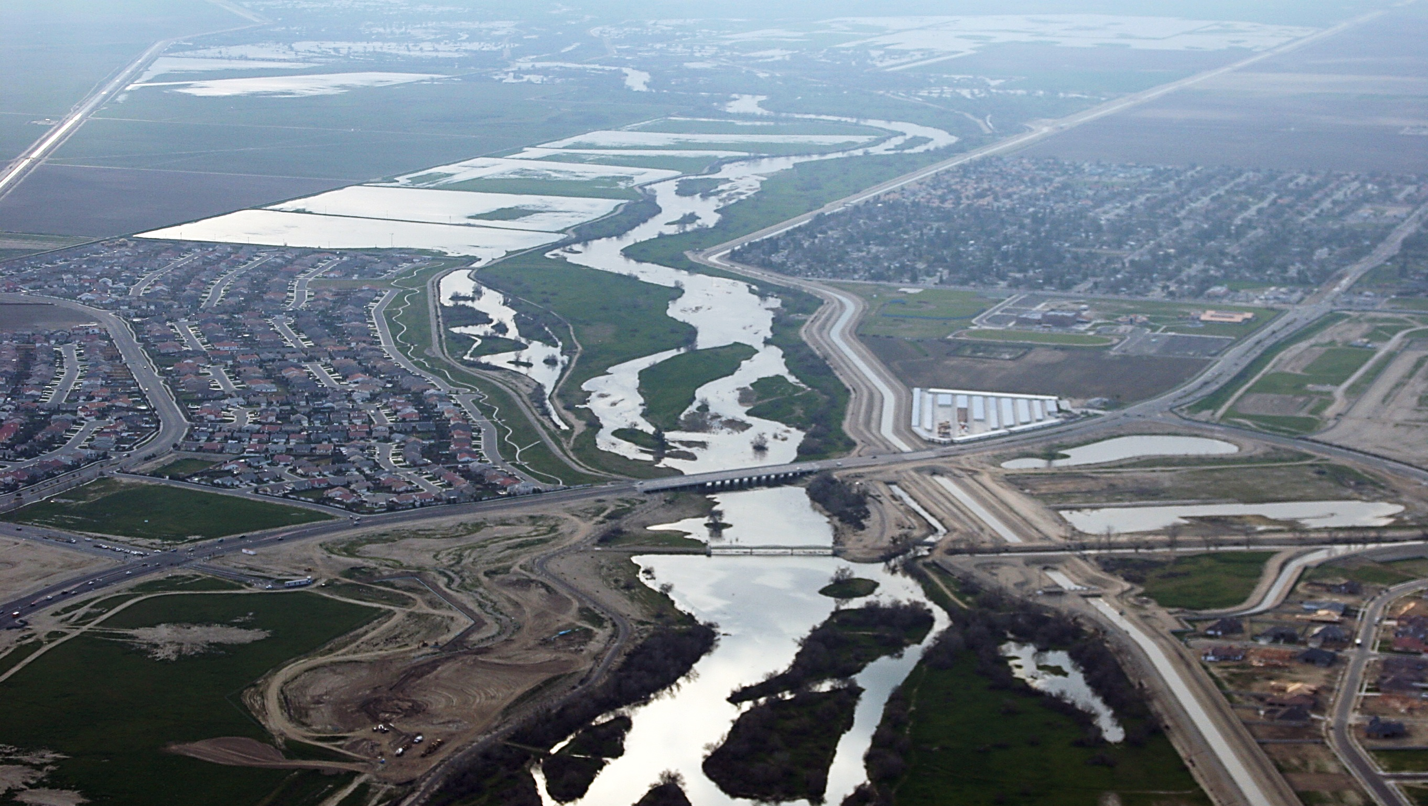
Four Keys to Success with Groundwater Banking
Facility Infrastructure
Soils, Geology, Good Water Quality
Local Management
and Support
Multiple Water Supplies

Slide 19
Kern County Sources of Surface Water
10-Year Supply Average (2002-11) in Acre-feet
SWP 890,990 af
CVP 433,800 af
Kern River 710,630 af
Misc. Local 205,930 af
Presented by the Water Association of Kern County

Slide 20
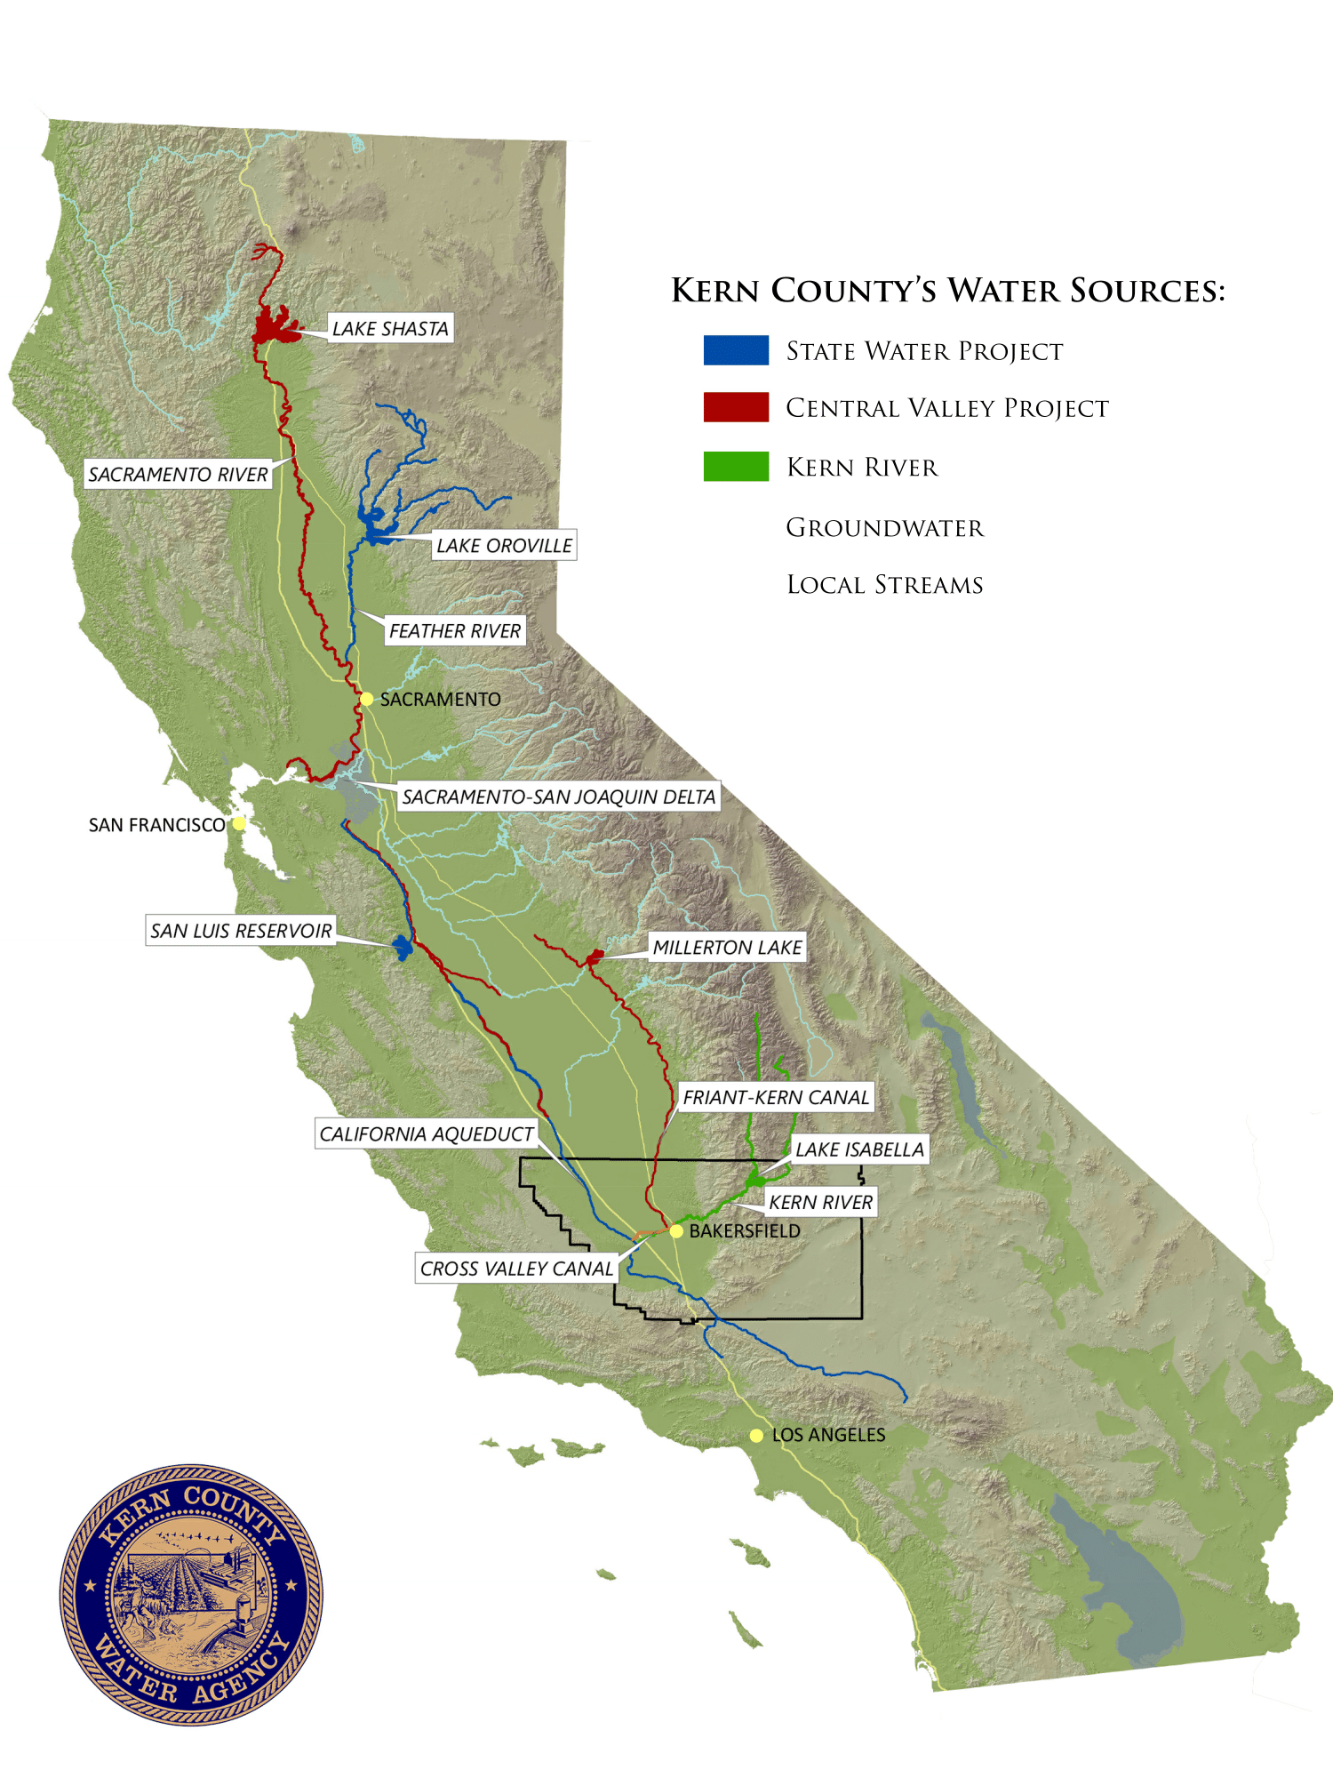
We Are All
Connected
With the
Delta
Presented by the Water Association of Kern County

Slide 21
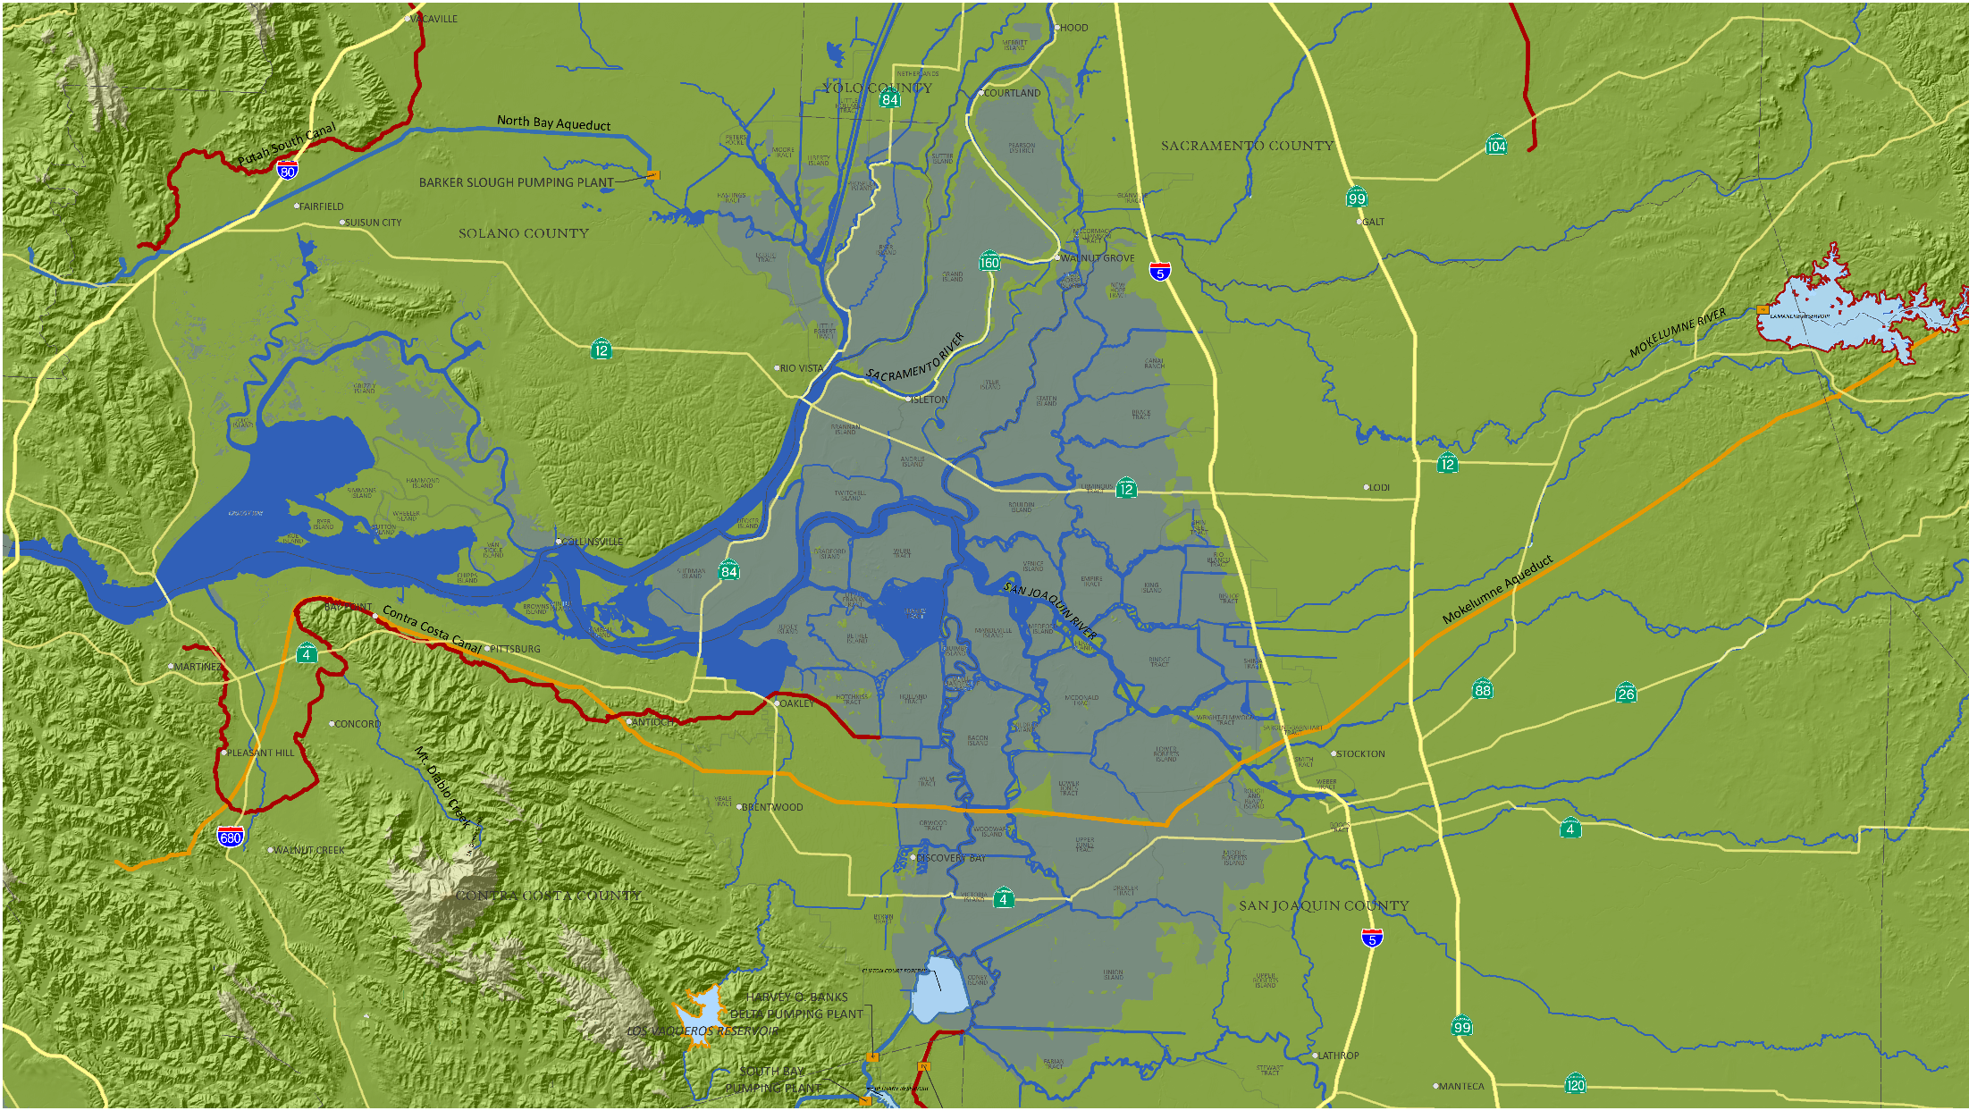

Sacramento-San Joaquin Delta
Presented by the Water Association of Kern County

